Slide 1
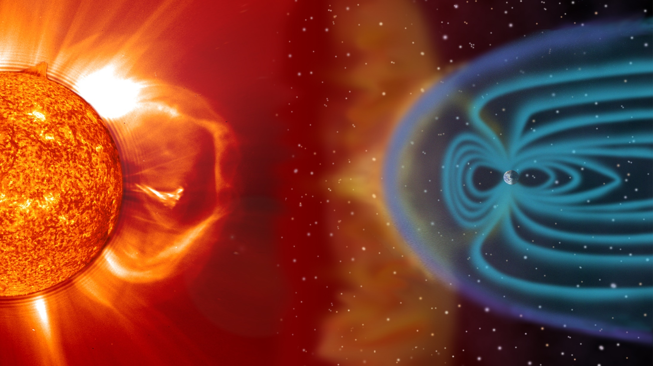
Slide Title
SWFO-L1 SWiPS
Instrument and Data Description
Heather Elliott, Brad Trantham,
Rebecca Perryman, Nicole Standiford, and Rob Ebert
April 28, 2025

Slide 2
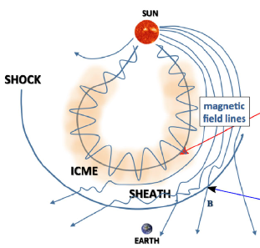
SWiPS Operational Goal
Purpose: Measure solar wind ions from Earth’s L1 point to provide early warning of events which can affect the geospace environment.
The measurements are used to characterize Space Weather causing events such as:
  Coronal mass ejections (CMEs).
  Interplanetary (IP) shocks.
  Corotating interaction regions (CIRs).
  High-speed flows associated with coronal holes.
Solar wind ion velocity, density, temperature, & dynamic pressure are provided every minute.
CMEs and IP Shocks
Kilpua et al. 2017
shock
Deforest, de Koning, & Elliott, 2017

Slide 3
SWiPS Performance Requirements
Measurement | SWFO-L1 Performance Requirement
Cadence | 1 minute
H+ Velocity Range | 200-2500 km s⁻¹
H+ Velocity Accuracy | +/- 10%
H+ Density Range | 0.1 -150 cm⁻³
H+ Density Accuracy | +/- 10%
H+ Temperature Range | 40,000 -2,000,000 K (3.45 to 172.3 eV)
H+ Temperature Accuracy | +/- 10%
SW H+ & He++ Dynamic Pressure | 1 – 100 nPa

Slide 4
SWiPS Data Products
Level | Description | Target Use
0b | CCSDS packets unpacked into complete energy angle sweeps | Real-time latency NOAA internal Common starting point for SWPC and NCEI pipelines
1a | Full resolution science data count rates at full energy, azimuth, and elevation | Real-time latency, NOAA internal Retrospective, external; NCEI processing
1b | Phase space distribution as a function of energy, elevation, and azimuth | Real-time latency, SWPC internal Retrospective, external, base product for science users wanting to apply their own calibration
2 | Full temporal resolution moments of protons (p) and alphas (a); n_{p}, T_{p}, V_{p}, n_{a}, V_{a}, and Total Dynamic pressure (n_{p}m_{p}V_{p}²+n_{a}m_{a}V_{a}²) | Real-time SWPC data

Slide 5
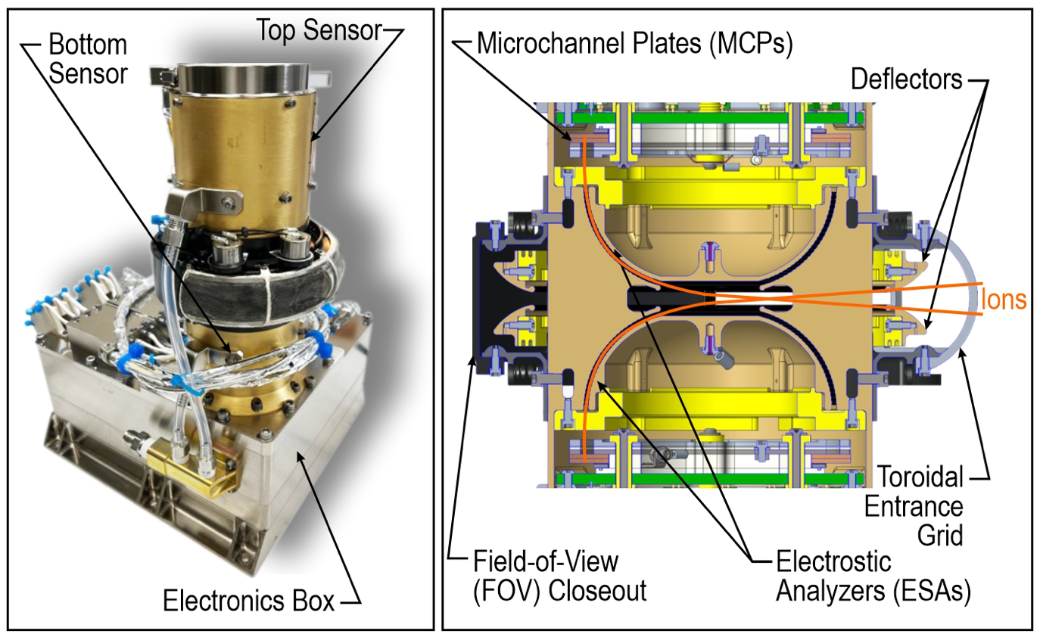
SWiPS Instrument Design
Both sensors (Top and Bottom) can measure ions
Selective redundancy: ESAs, detectors, and front-end electronics
Broad energy/charge range
Cross-cal between both sensors is possible.
Notes:
Rob Presents?

Slide 6
SWiPS Instrument Performance
Key Instrument Parameters | Value
Energy range | 0.17 - 33 keV/q (ions) (128 discrete steps)
Energy resolution, ∆E/E (FWHM) | 0.07 eV/eV
Field-of-view | 90∘ (azimuth) 45∘ (elevation)
Azimuth Angular Resolution | 5° (< ±25°) 10° (> ±25°)
Elevation Angular Resolution | 2 – 3° (FWHM)
Analyzer Constant (k) | 10.6 eV/V
Geometric Factor (per anode) | ~1x10⁻⁵ cm² sr eV/eV

