Slide 1
SWFO Data:
Operational Users
User Readiness for Space Weather Data from
NOAA Program of Record 2025 Mission
2025 January 14
Steven Hill
Notes:
Good morning. Today I’m going to talk about operational data products from the SWFO program, which includes both GOES-19 and SWFO-L1. But first I’d like to thank my co-authors, along with others who helped with this presentation.

Slide 2


Outline
Team
Lead
  Jeff Johnson
Developers
  Nathan Miles
  Martin Aubrey
  Michael Burek
  Mark Nakasone
Scientists
  George Millward
  Lois Landwer
Other Contributors
  Mark Miesch
  Tibor Durgonics
  Ratina Dodani
  Vic Pizzo
Background
GOES-19
SWFO-L1
Conclusion
Notes:
Good morning. Today I’m going to talk about operational data products from the SWFO program, which includes both GOES-19 and SWFO-L1. But first I’d like to thank my co-authors, along with others who helped with this presentation.

Slide 3
SWPC Mission and SWFO
Models, Applications, and Displays associated with coronagraph images and real-time solar wind data
Models
WSA-Enlil
OVATION (Aurora)
Geospace
WAM-IPE
REFM
CTIPe
Geoelectric
Magnetopause crossing
Forecaster tools
CME Analysis Tool (CAT)
CME Naming Tool (CMENT)
Near-real-time movie loops (24-hr, 7-day, 27-day)
National Critical Notifications
Power Grid (NERC Hotline)
FEMA
Forecasts, Reports, Watches, and Warnings
Geomagnetic Storm Watches
Aviation Advisories
Forecast Discussion
Weekly Highlights and 27-day Forecast
Solar and Geophysical Event Reports
Dashboards
Aviation, Electric Power, Emergency Management, Satellites, GPS, Radio Communications, Space Weather Enthusiasts
SWPC Data Service
Web Displays
Coronagraph images and movies
Real-Time Solar Wind

Slide 4
Product Philosophy
NOAA Mission
Observation
Non-NOAA Mission
DSCOVR
ACE
SWFO-L1
GOES-19
(CCOR-1)
GOES 16-18
Mag field, plasma
Low
energy particles
High
energy particles
Corona-
graph
images
Xray/EUV Images
Xray/EUV
Flux
Protons
Electrons
Mag
Customer-focused
Data source agnostic
Consistent formats
Consistent content
Supports continuity of users
IMAP
I-ALiRT
SOHO
(LASCO)
PUNCH
(NFI)

Slide 5
Continuity and Change
Measurement | Today | SWFO-L1 & GOES-19
Coronal Images | SOHO LASCO C2 & C3 Pass through from NASA/GSFC, 12 min cadence | GOES-19 CCOR-1, SWFO-L1 CCOR-2 2048x1920 pix; 15 min cadence; jpeg files; 1, 7, 27 day animations, FITS
Thermal Plasma Velocity, Density, & Temperature | ACE SWEPAM, DSCOVR FC 1 min cadence, ASCII, JSON | SWFO-L1 SWiPS 1 min cadence, JSON, Dynamic displays
Suprathermal Ion Differential Flux | ACE EPAM 5 min cadence, ASCII, JSON | SWFO-L1 STIS 1 min cadence, JSON, Dynamic displays
Vector Magnetic Field | ACE DSCOVR MAG 1 min cadence, ASCII, JSON | SWFO-L1 MAG; 1 sec cadence, 1 min cadence, JSON, Dynamic displays

Slide 6
Level 3 Data Products
CCOR
  Images at 15 minute cadence
  Incorporated into animations
MAG
  1 sec cadence
  1 min cadence synced with UTC
SWiPS
  1 min cadence synced with UTC
STIS
  1 min cadence synced with UTC
  ACE/EPAM (8/4 ion/electron channels) for data continuity
Level 3 data products are derived environmental variables that have been resampled. They are the primary products used by forecasters and customers
From full resolution right now extending to back to the start of the ACE mission
2hr/6h/1d/3d/7d/30d/54d/1y/5y/30y

Slide 7
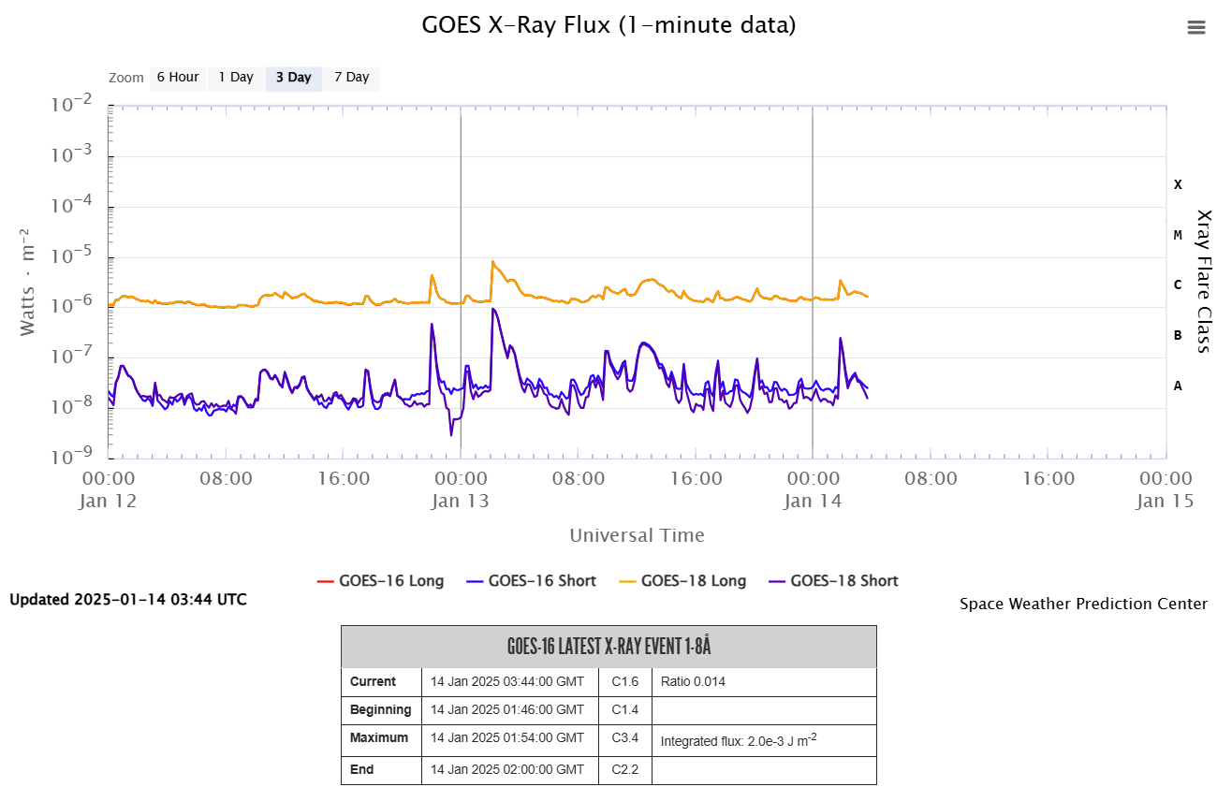
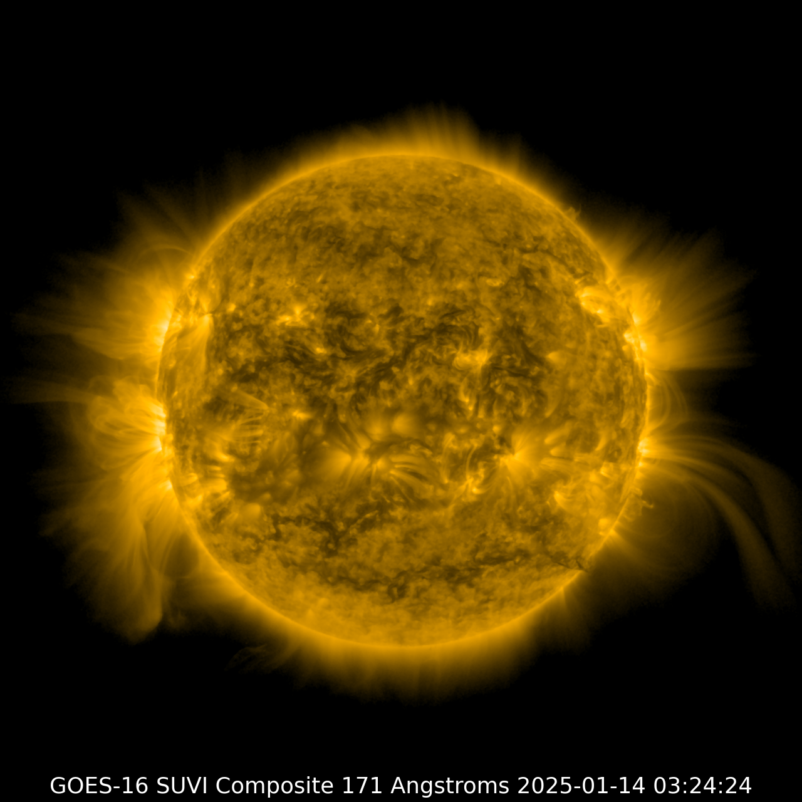
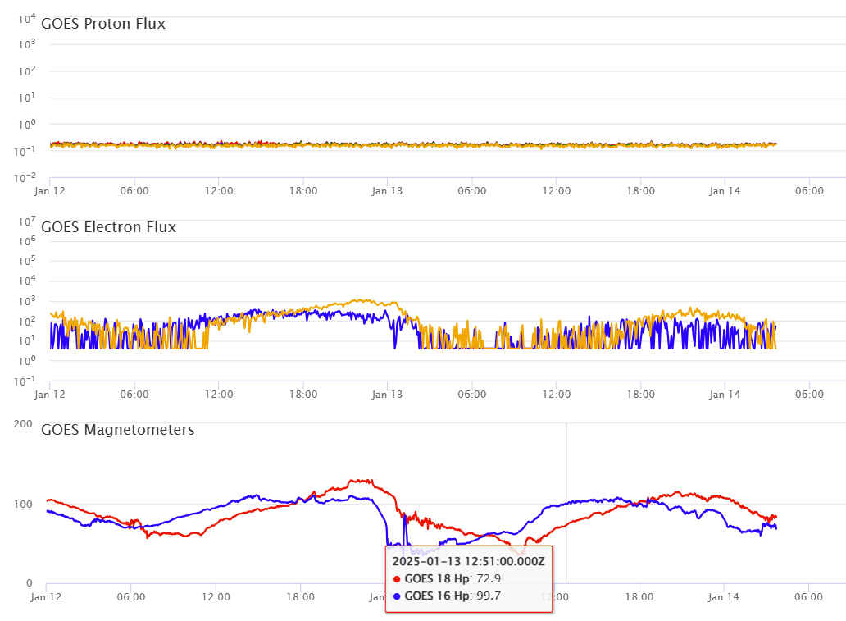
GOES-19: CCOR and More
X-ray flux
Replaces GOES-16 in April
CCOR - New SWFO instrument
Continuity Instruments
  EUV and X-ray Irradiance Sensor (EXIS)
  Magnetometer (MAG)
  Space Environment In-Situ Suite (SEISS) - Energetic
  Heavy Ion Sensor (EHIS), Magnetospheric Particle
  Sensors - High and Low (MPS-HI and MPS-LO),
  Solar and Galactic Proton Sensor (SGPS).
  SUVI: Solar Ultraviolet Imager
SUVI
Proton, Electron Flux & Magnetic Field

Slide 8
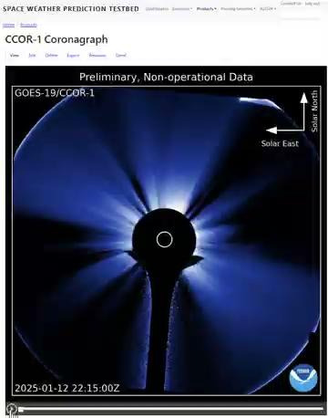


CCOR Level 3 Products
High-quality images for use with movies, applications, forecasts, alerts for situational awareness.
Downsample 50% for use by SWPC forecasters and stakeholders.
  1024 x 960 for optimal viewing on computer screens.
  Movies 1 day, 7 day, 27 day (no decimation, 96 frames/day).
  Soon to go live to the public.
  Real-time JPEG, JPEG2000, and MPEG files provided for download.

Slide 9
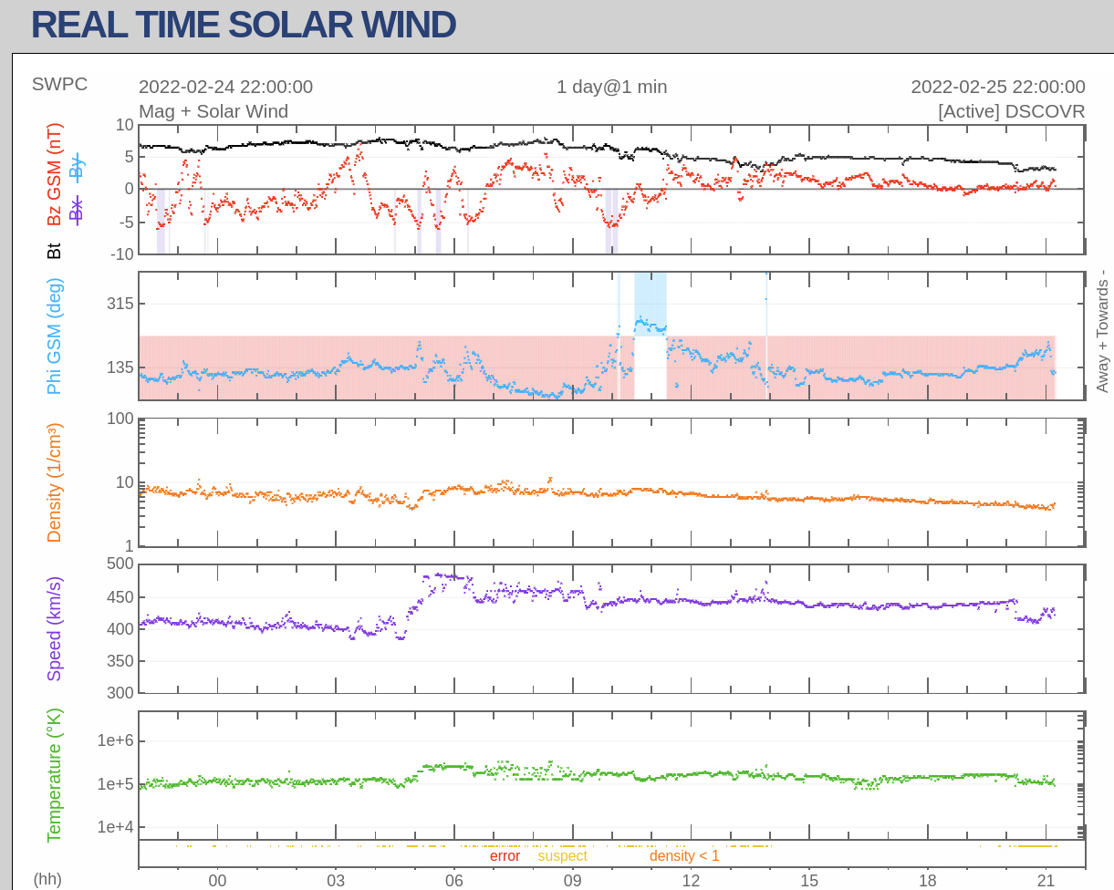
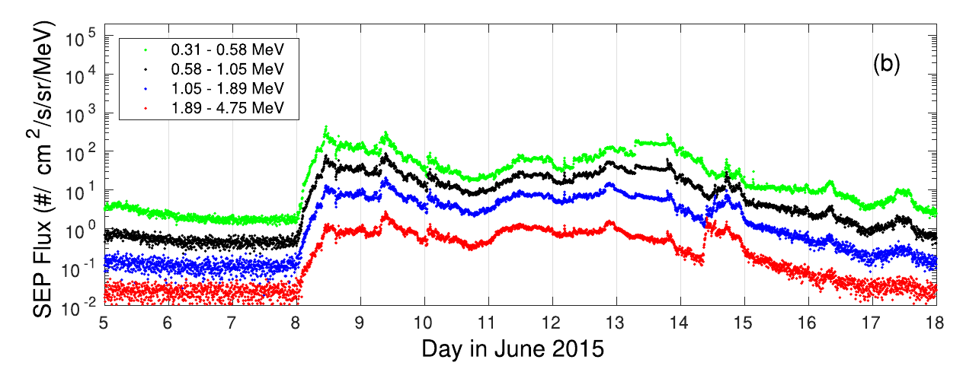
SWFO-L1 Launch NET September 2025
“SWiPS” and MAG (DSCOVR)
Joins ACE and DSCOVR as a new forward monitoring post at L1
SWiPS - Thermal Plasma
  Ion velocity, density, and temperature
MAG - Vector Magnetic Field
STIS
  Suprathermal Ion Differential Flux
  8/4 ion/electron channels
  Data continuity with ACE/EPAM
CCOR-2
“STIS” Suprathermal protons (ACE/EPAM)
Thampi et al (2019)

Slide 10
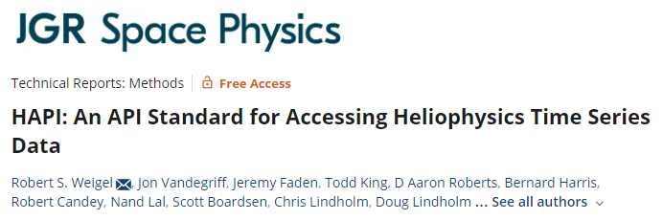
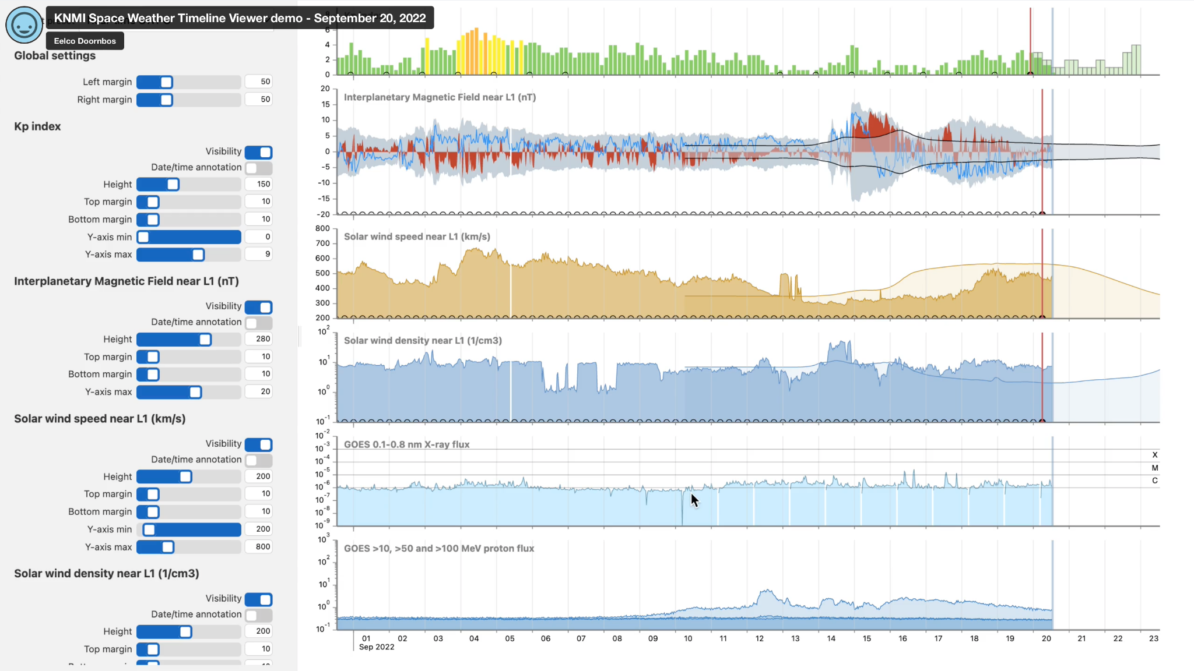


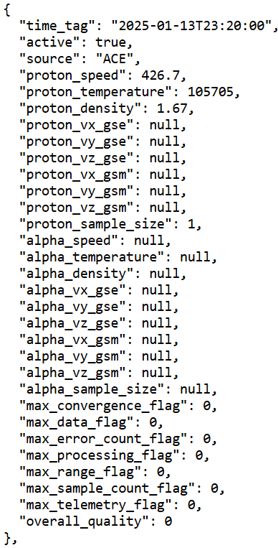
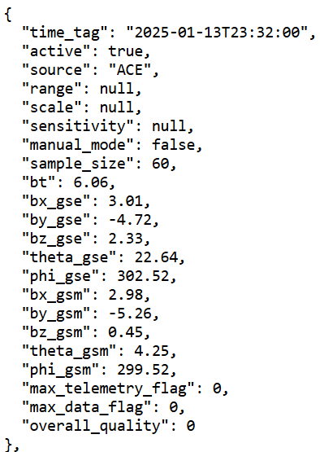

Applications
New Display and data services based on HAPI and KNMI timeline viewer

Slide 11
Access
SWPC data products served to the public via SWPC’s website:
  https://spaceweather.gov/products
Visualization tools are provided; data files can be downloaded:
  https://spaceweather.gov/products/real-time-solar-wind
Web service provided for use by automated systems:
  https://spaceweather.gov/content/data-access
  https://services.swpc.noaa.gov (base services URL)
  https://services.swpc.noaa.gov/json/
  etc.

