Slide 1
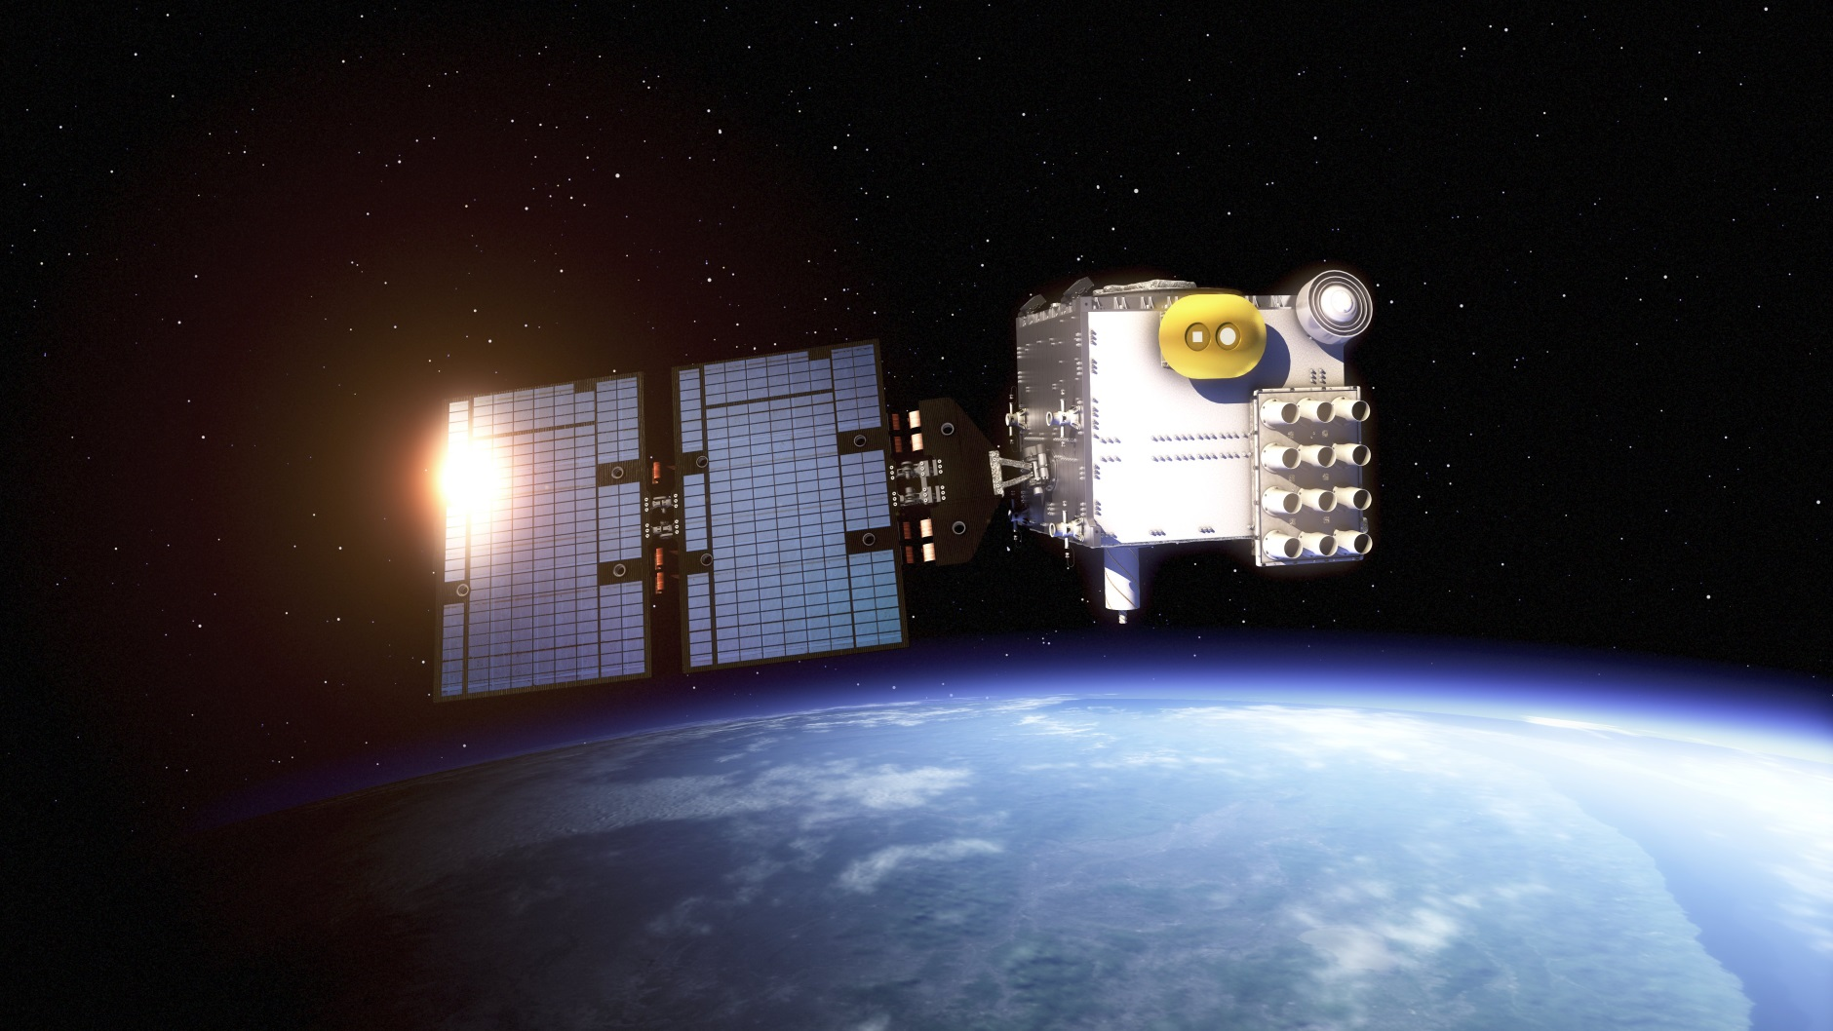
COSMIC-2 Space Weather Products Status
J. Braun and J. Weiss (UCAR/COSMIC) and the COSMIC-2 Team
Space Weather Meeting at AMS
January 14, 2025

Slide 2
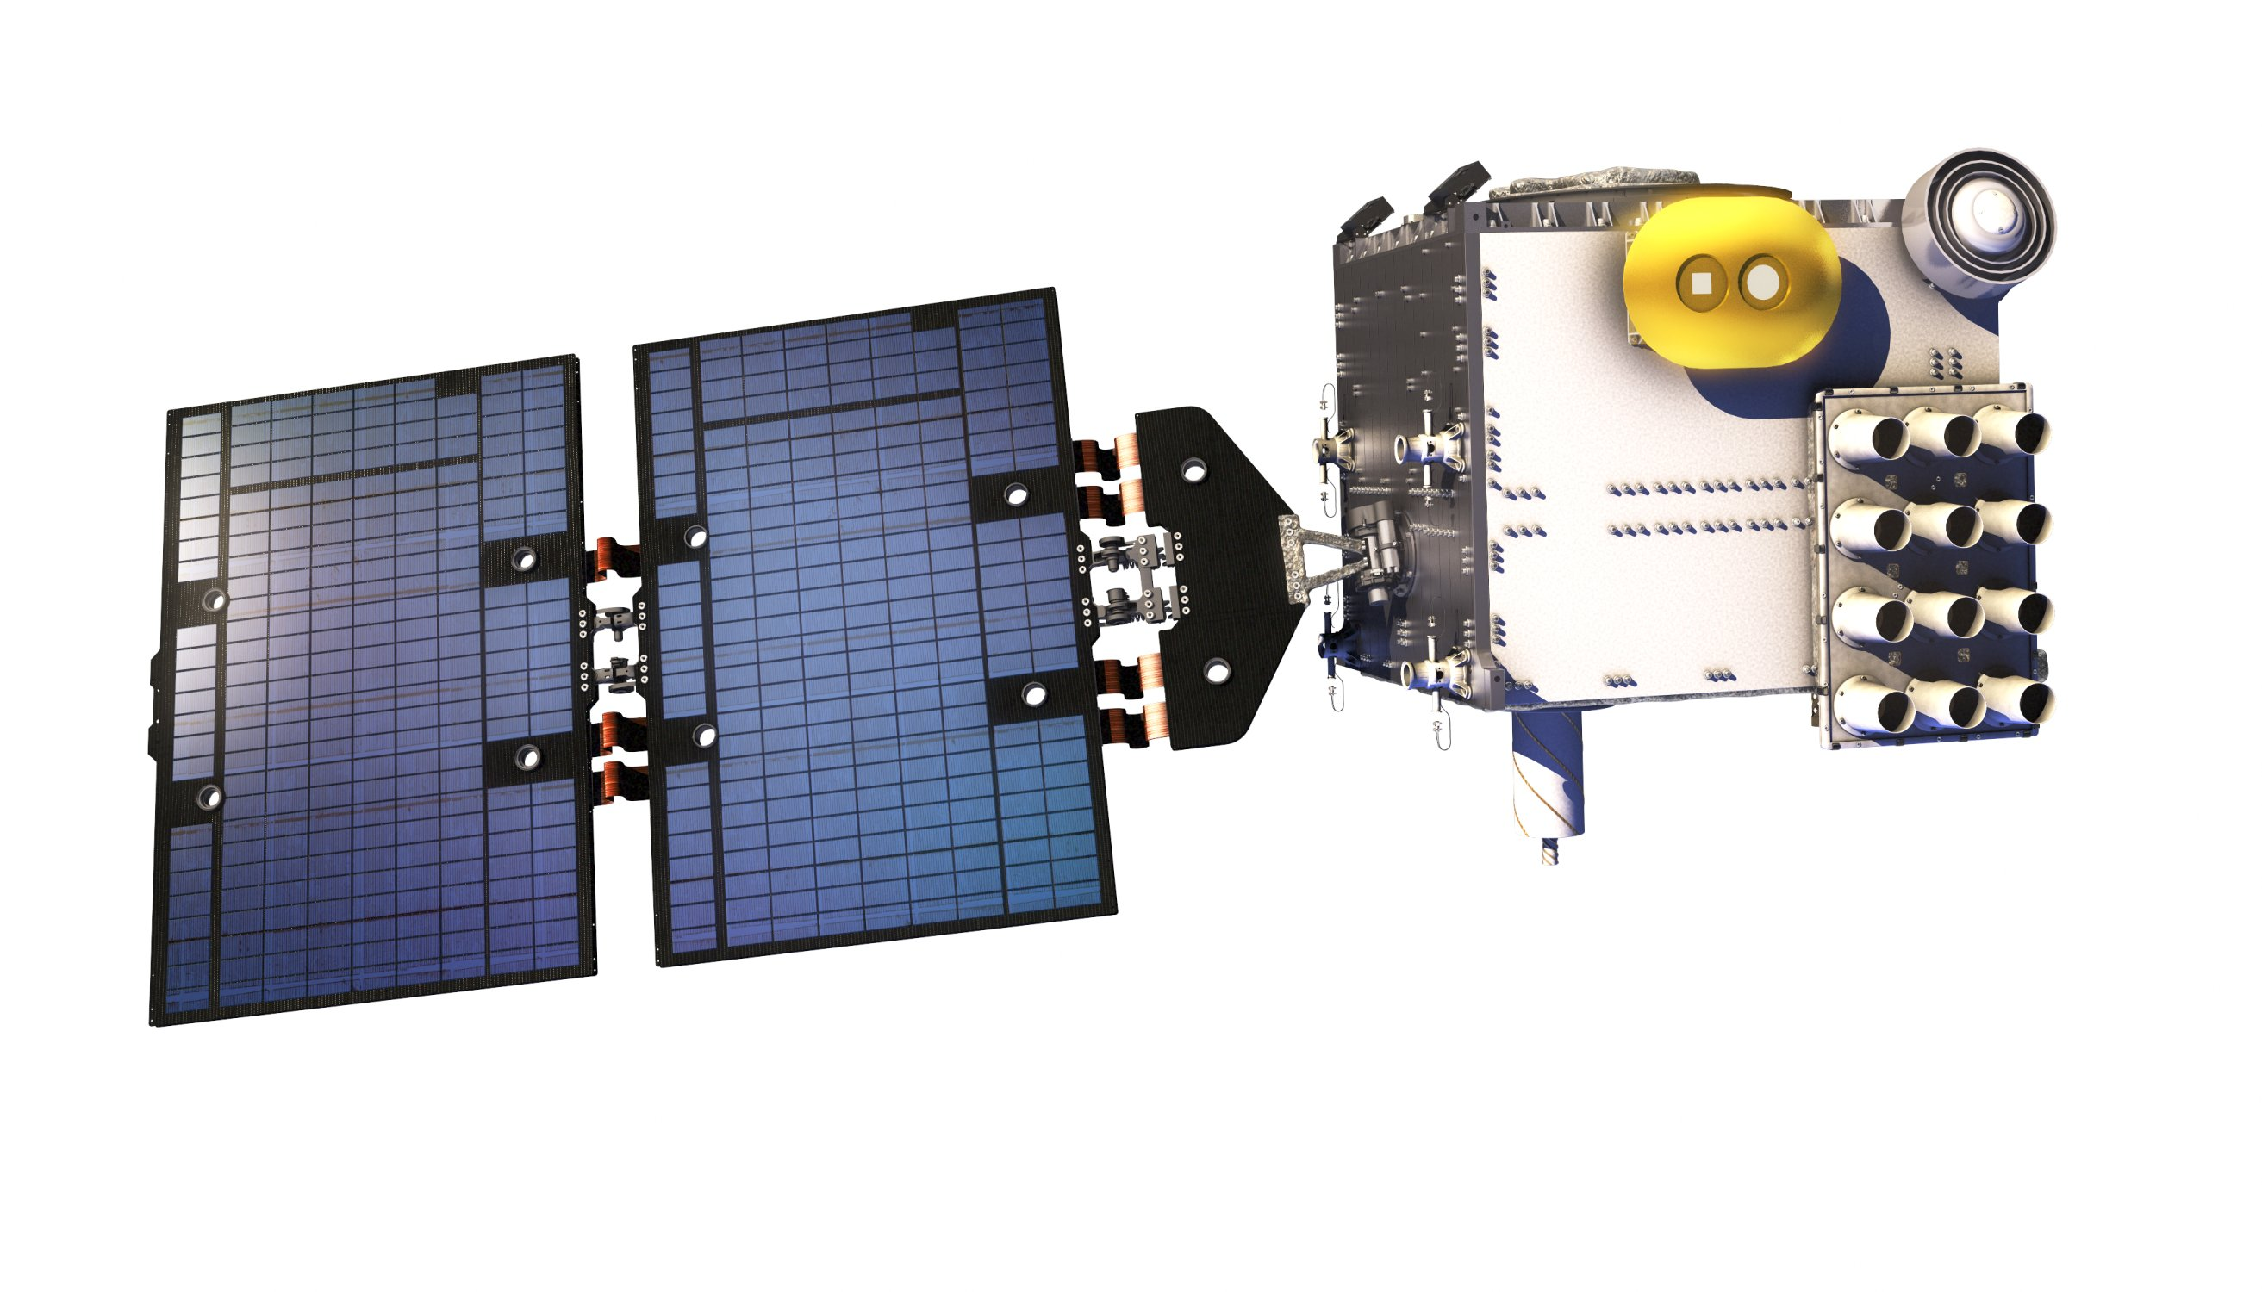
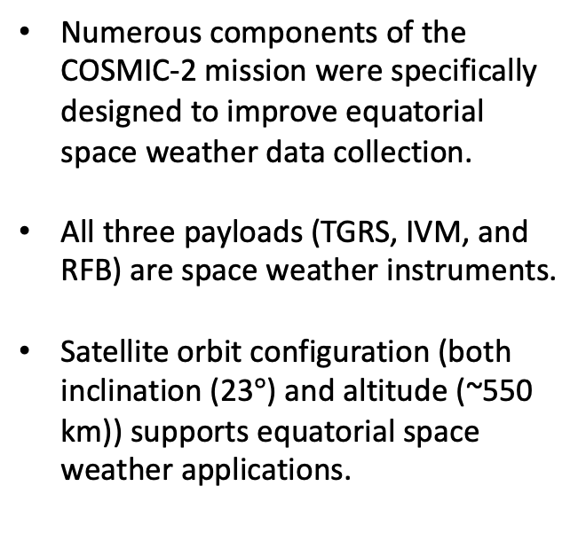
COSMIC-2: A Mission Designed for Space Weather
IVM
TGRS POD Antenna
Numerous components of the COSMIC-2 mission were specifically designed to improve equatorial space weather data collection.
      All three payloads (TGRS, IVM, and RFB) are space weather instruments.
      Satellite orbit configuration (both inclination (23$°$) and altitude (~550 km)) supports equatorial space weather applications.
TGRS RO Antenna
RF Beacon Antenna
  The COSMIC-2 mission is unique in its ability to monitor and deliver multiple space weather data products across all local times for both operational and research applications.

Slide 3
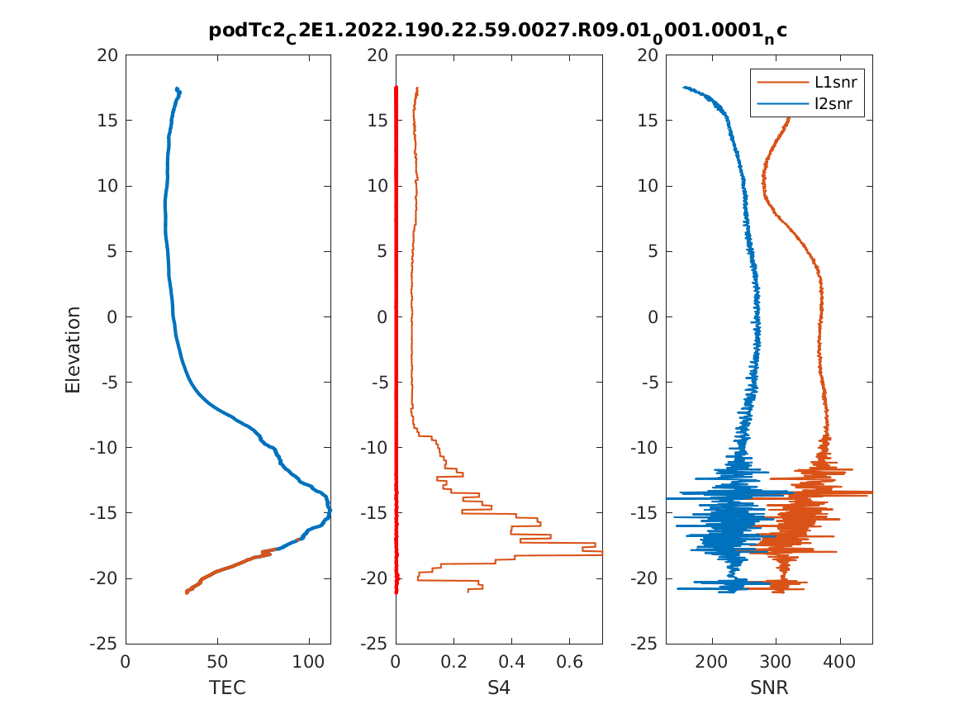
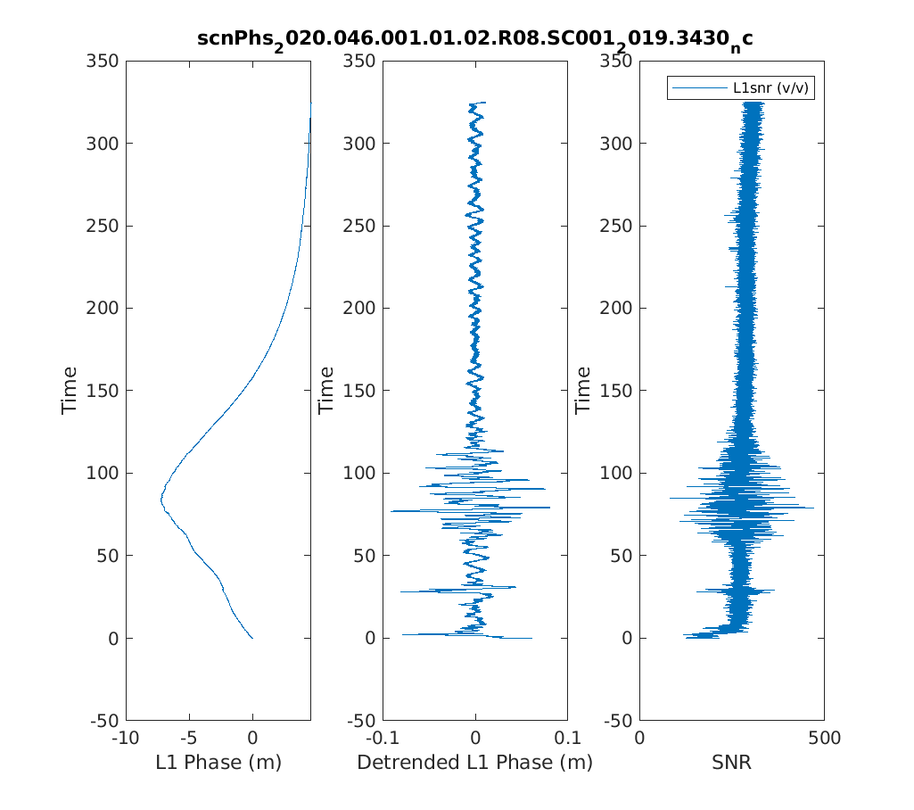
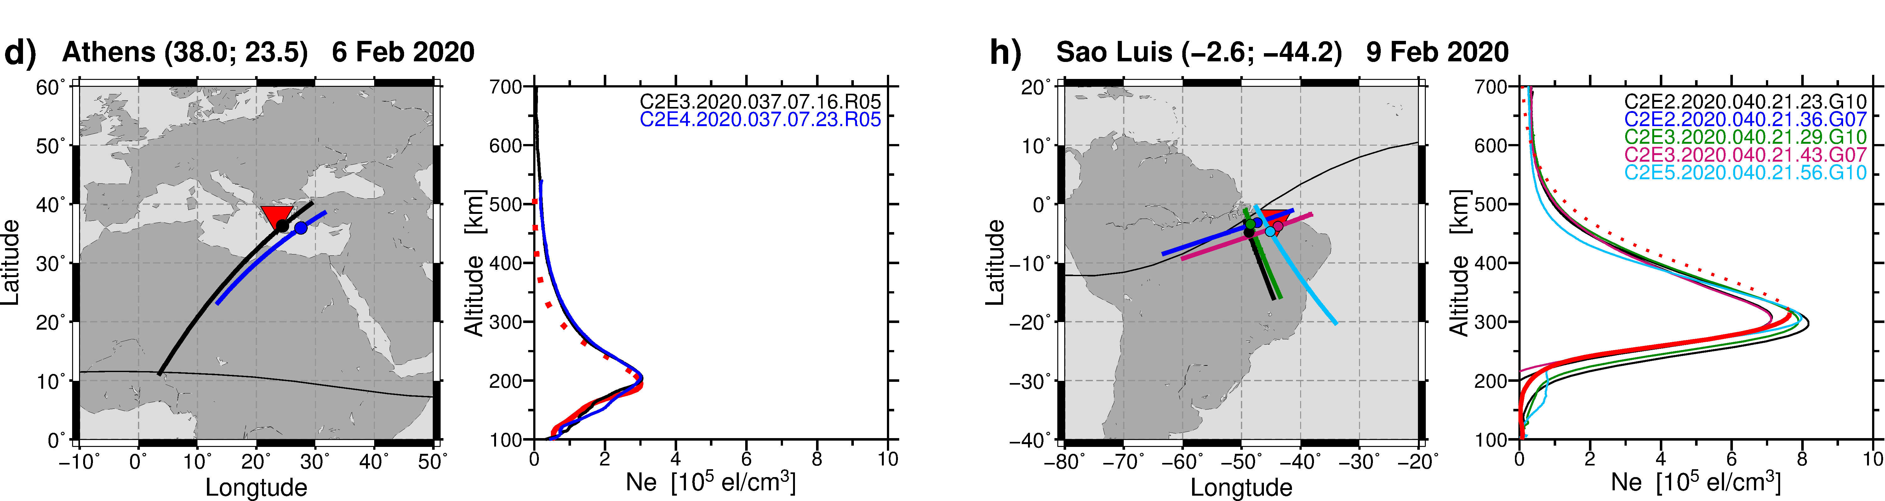
COSMIC-2 Space Weather Data Products
Total Electron Content (TEC) and S4
Scintillation High-Rate Data
Product | Payload | Status
Abs total electron content | TGRS | Operational
Electron density profiles | TGRS | Operational
Line of sight scintillation amplitude and phase indices | TGRS | Operational
Scintillation all-clear | TGRS | Operational
Scintillation geolocation | TGRS | Operational
Scintillation bubble map | TGRS | Operational since Feb. 2024
Limb-to-disk | TGRS | Future
In situ plasma density, composition, temperature | IVM | Operational
Electron Density Profiles

Slide 4
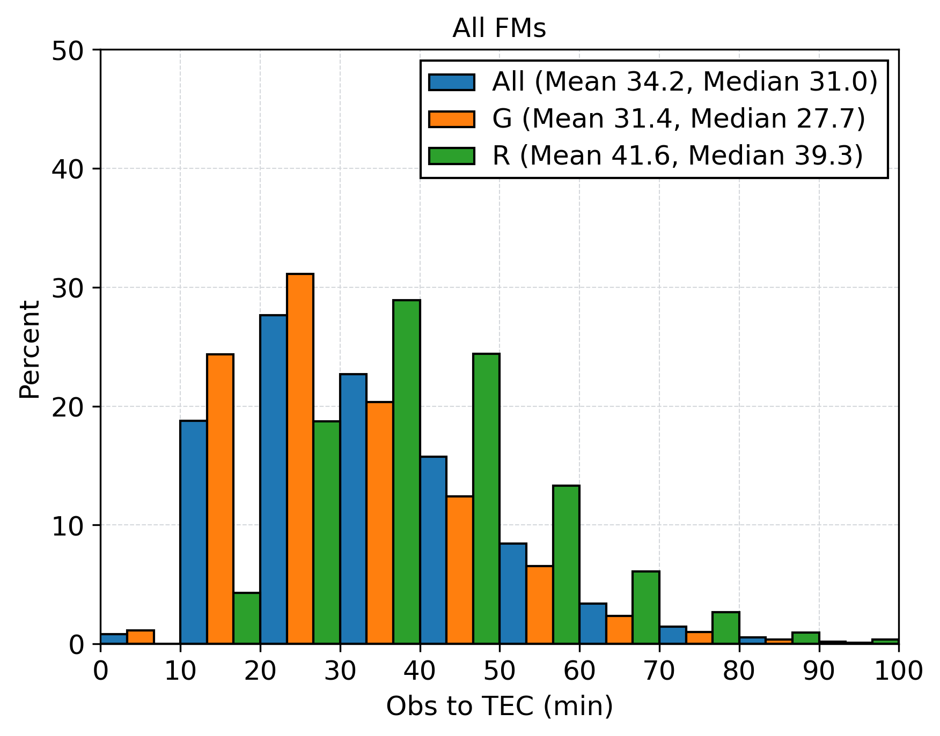
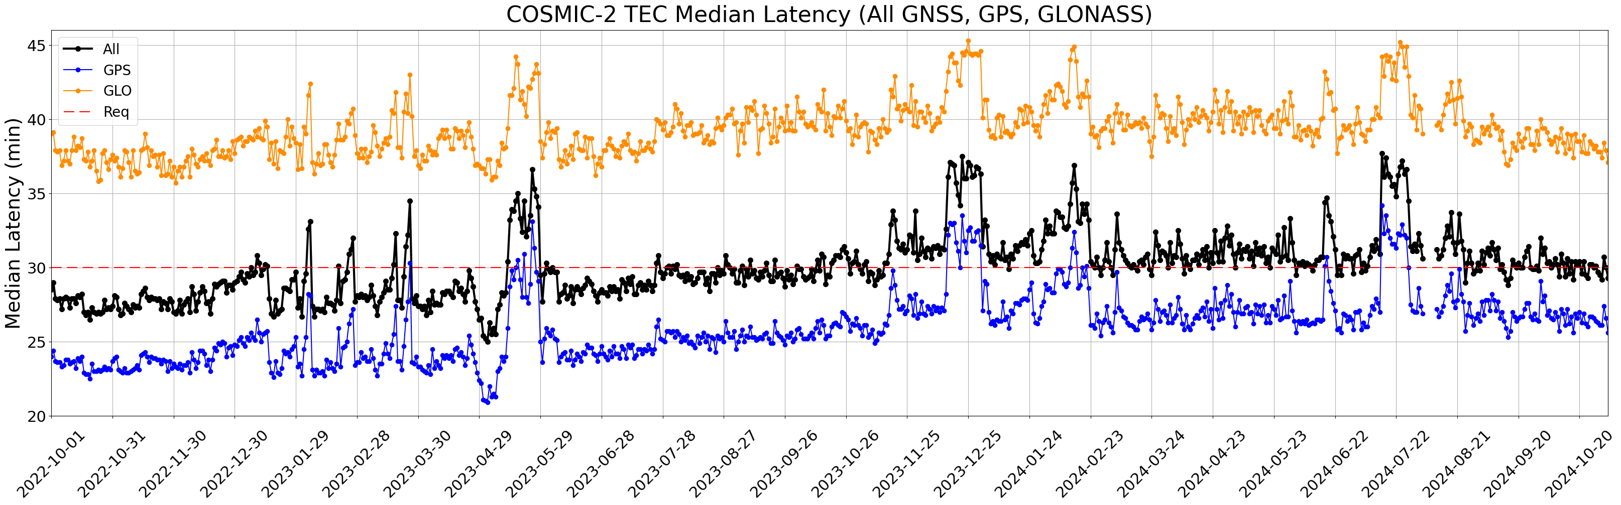
TEC Latency
COSMIC-2 mission requirement for TEC latency is 30 minutes (median)
Recent latency ~34 minutes
To meet 30 minute latency would require increase ground station contacts

Slide 5
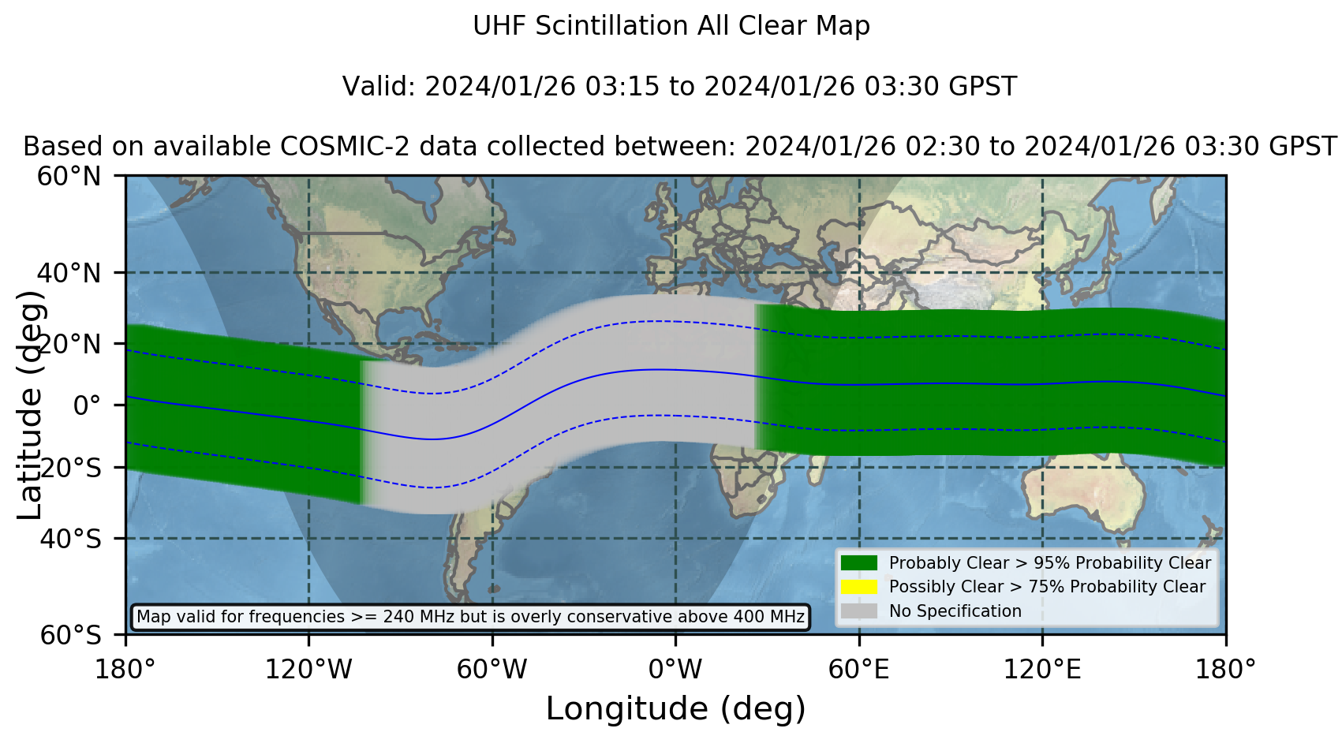
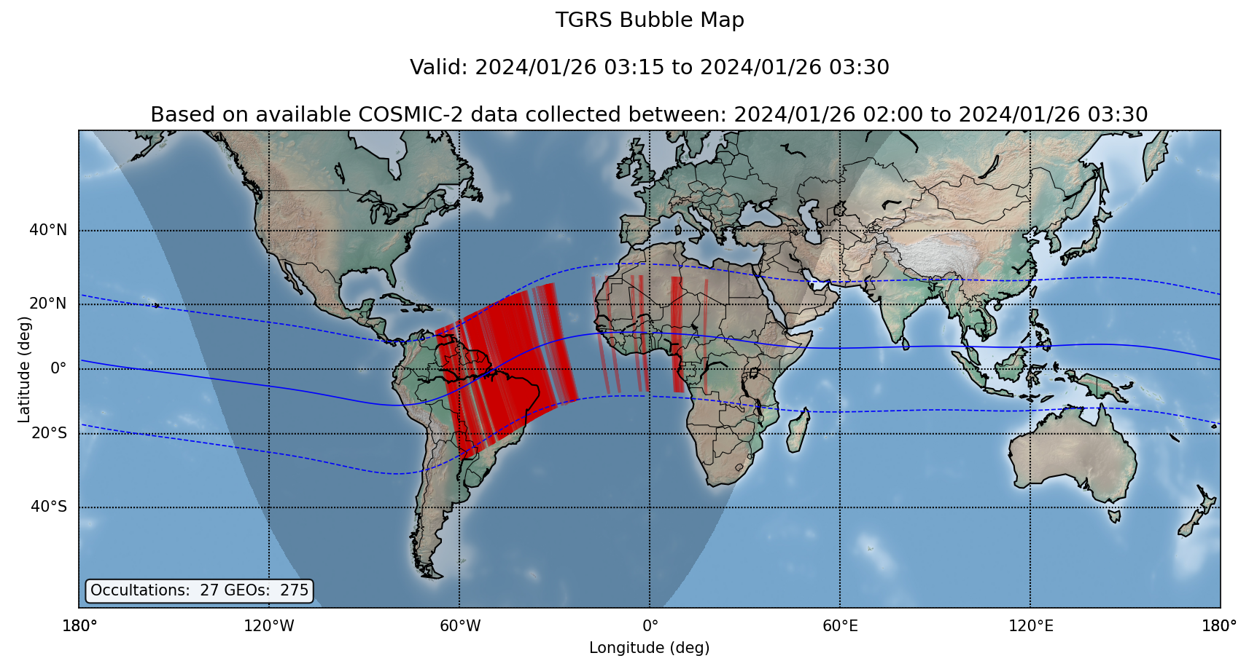
Ionosphere Scintillation Bubble Map and All-Clear
UCAR CDAAC operationally implemented two algorithms developed by Boston College
Bubble map generated from UCAR/CDAAC scintillation geolocations over a time window
Scintillation all-clear algorithm utilizes estimates when scintillation is not likely along a signal path
Both run at 15 min cadence with output to web dashboards available to NOAA SWPC and USAF557WW
Examples below show bubble and all-clear maps for similar data window
  Consistent bubble identification and corresponding all-clear indication
Likely no other system produces such information globally and with low latency

Slide 6
Space Weather User Status
NOAA Space Weather Prediction Center (SWPC)
  Operational use of absolute TEC since Mar 2022
USAF 557th Weather Wing
  Operational use of neutral atmosphere products began July 2022
  Operational use of ionosphere products since Jan 2021
Taiwan Central Weather Administration (CWA)
  Ionospheric profiles assimilated into CWA Global Ionospheric Specification and Ionospheric Space Weather Forecast System since Feb 2020
  Research community
  TEC, scintillation amplitude (S4), electron density profiles, and IVM in-situ density and composition products published daily to data.cosmic.ucar.edu

Slide 7
Questions?

