Slide 1
Supporting Geostationary Observations from TEMPO and GeoXO: High-Resolution Surface Measurements from NOAA's ARC Mobile Lab
Xinrong Ren¹, Phil Stratton^{1,2}, Jiayang Sun^{1,2}, Paul Kelley^{1,2}, Winston Luke¹, Russ Dickerson², Zigang Wei³, Shobha Kondragunta³, and Joel Dreessen⁴
¹NOAA/OAR/Air Resources Lab
²University of Maryland
³NOAA/NESDIS/Center for Satellite Applications and Research
⁴Maryland Department of Environment

Slide 2
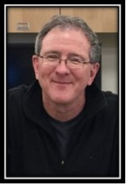
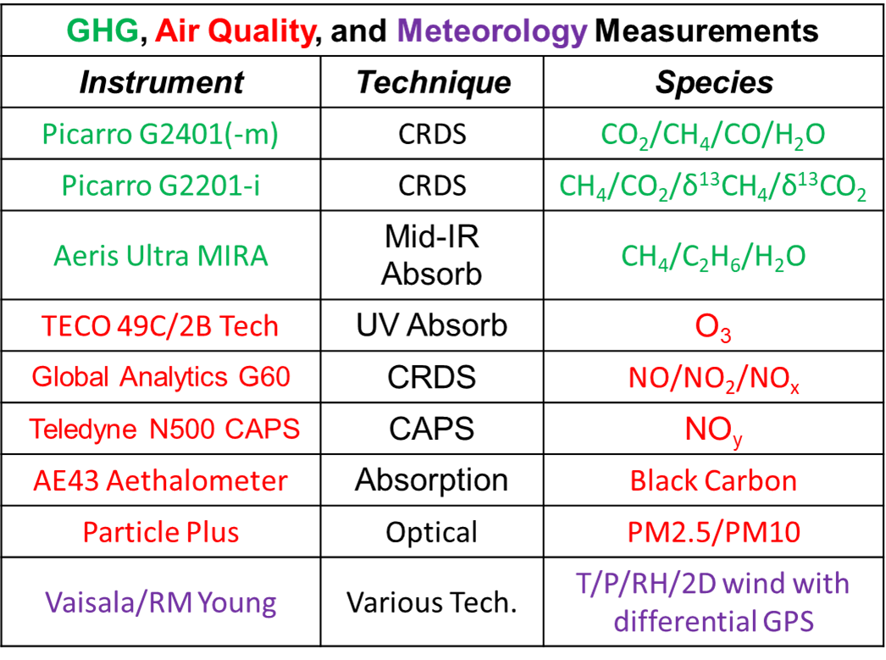
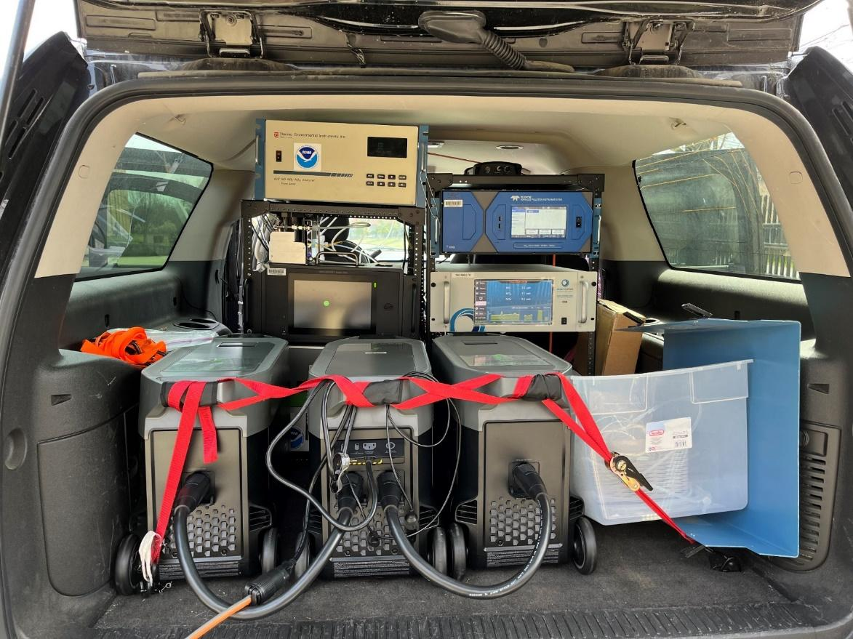
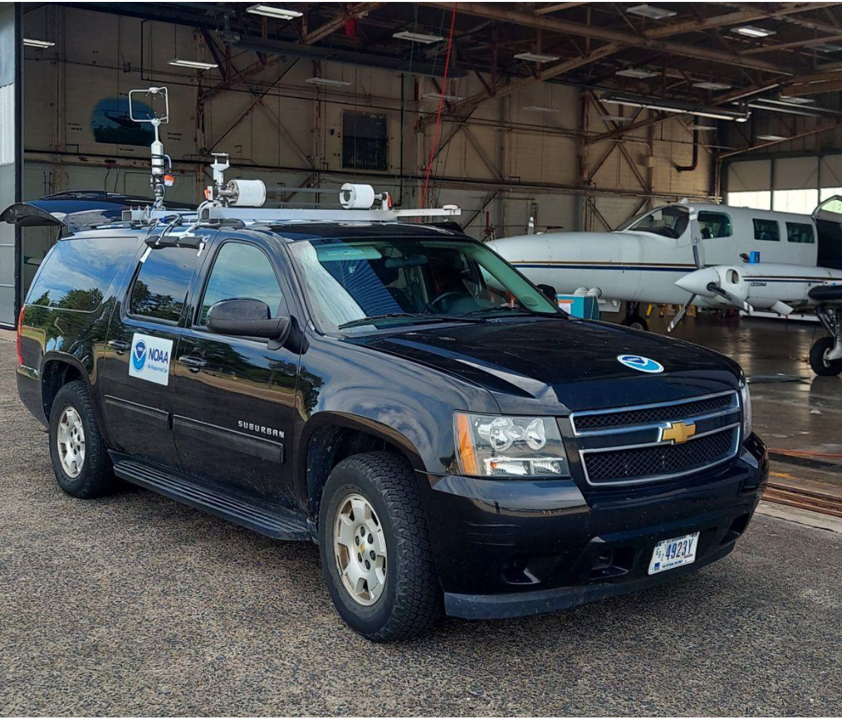
NOAA’s ARC Mobile Lab Team and Instrument Suite
Winston Luke - NOAA ARL
Phil Stratton - NOAA ARL
Xinrong Ren - NOAA ARL
Hannah Daley - U. of MD
Paul Kelley - NOAA ARL
Jiayang Sun - U. of MD
An Instrumented Chevy Suburban
3 EcoFlow battery generators with a capacity of 10.8 KWh
8-10 hours of measurement
Two inlets, one for gases, the other for aerosols

Slide 3
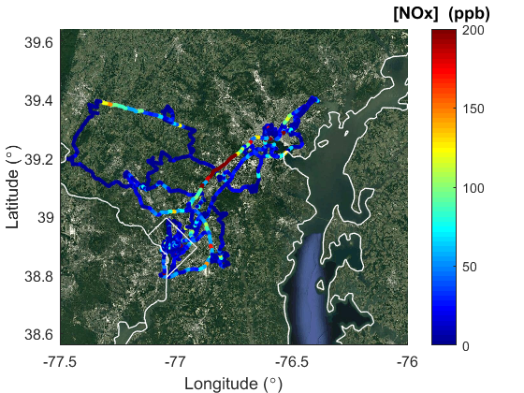
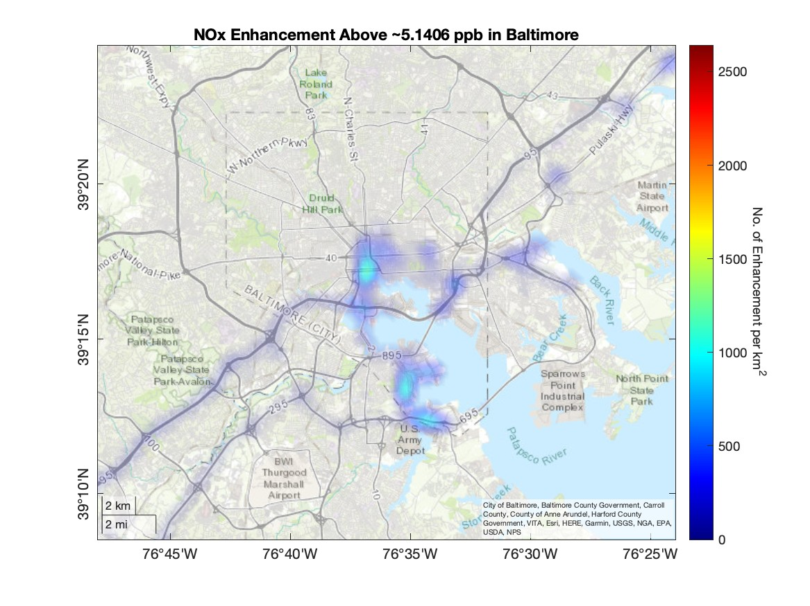
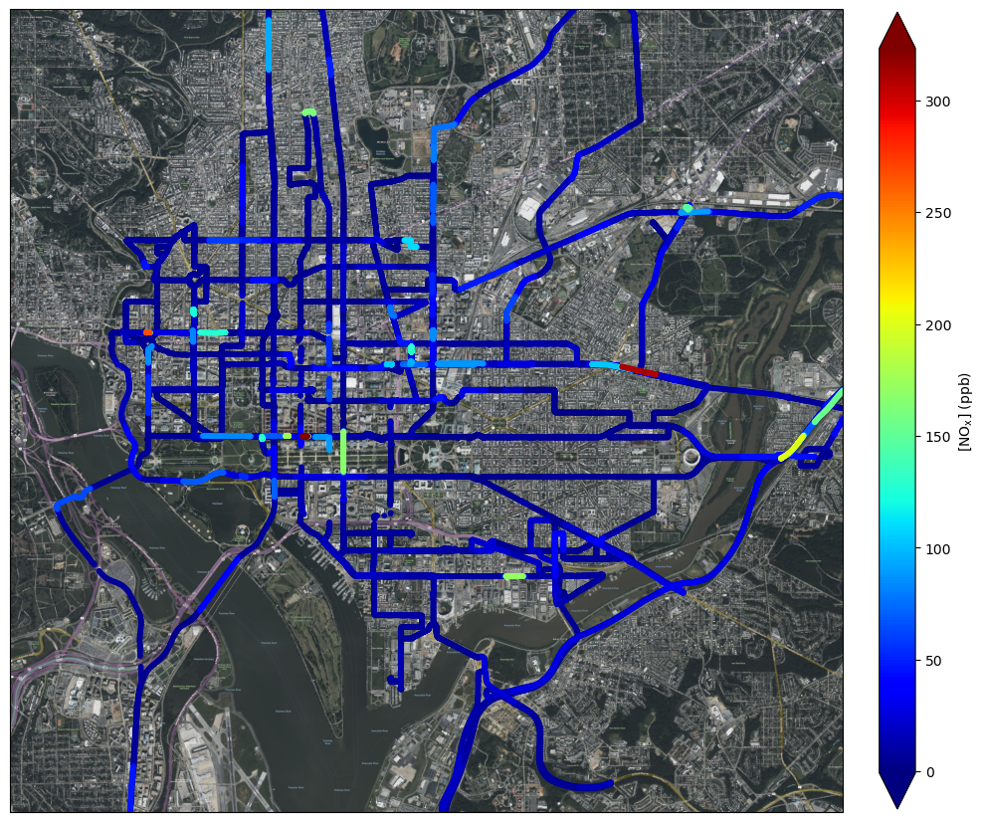
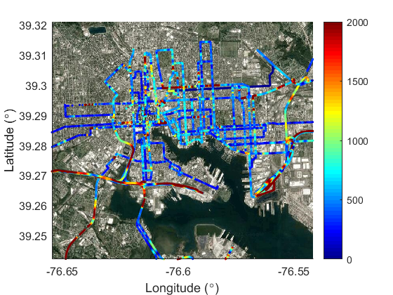
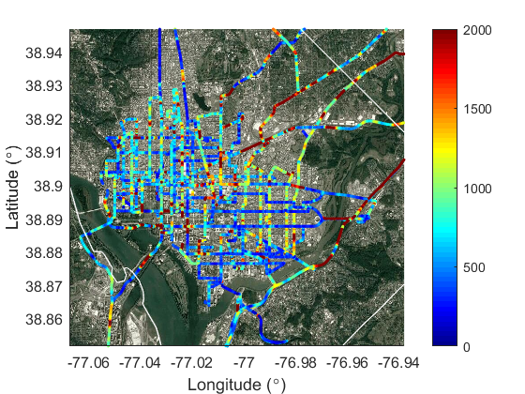
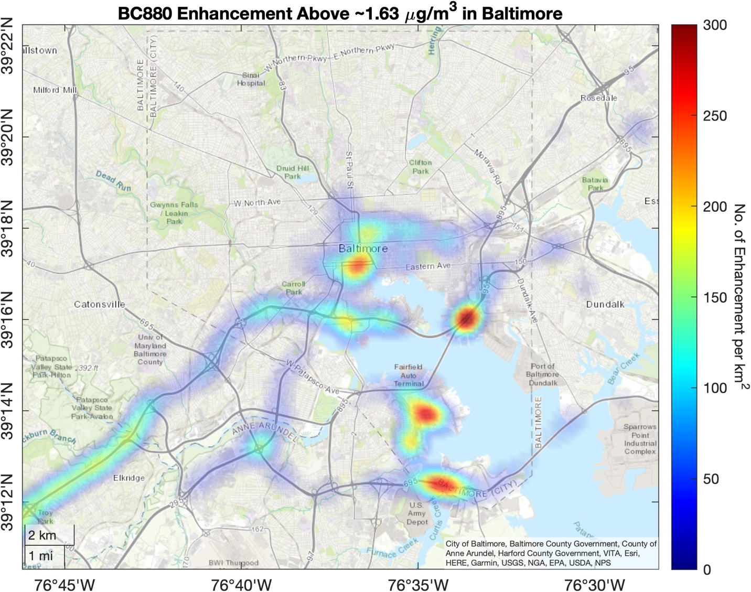
NOAA’s ARC Mobile Measurements in Baltimore and Washington, DC
DC-Baltimore
Baltimore
Washington, DC
Hot colors indicate where NOAA’s ARC frequently observed high concentrations.
Black Carbon (ng m⁻³)
Baltimore
Black Carbon (ng m⁻³)
Baltimore
Washington, DC

Slide 4
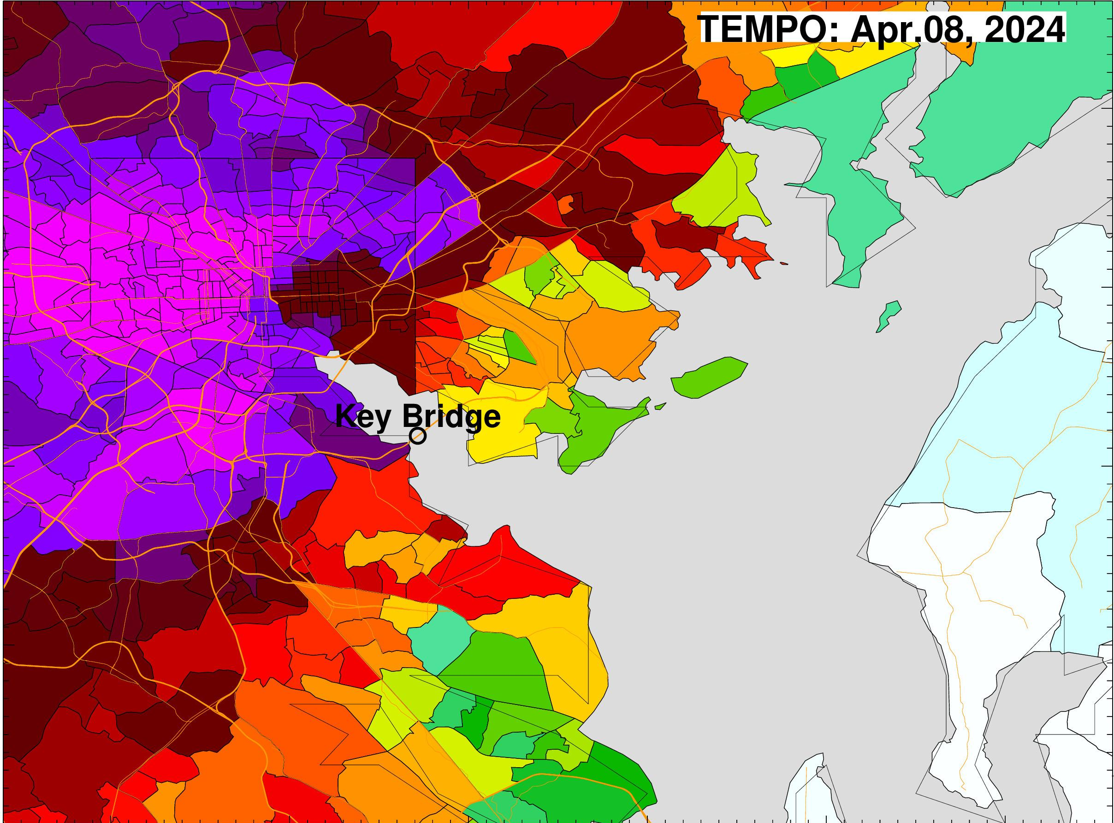
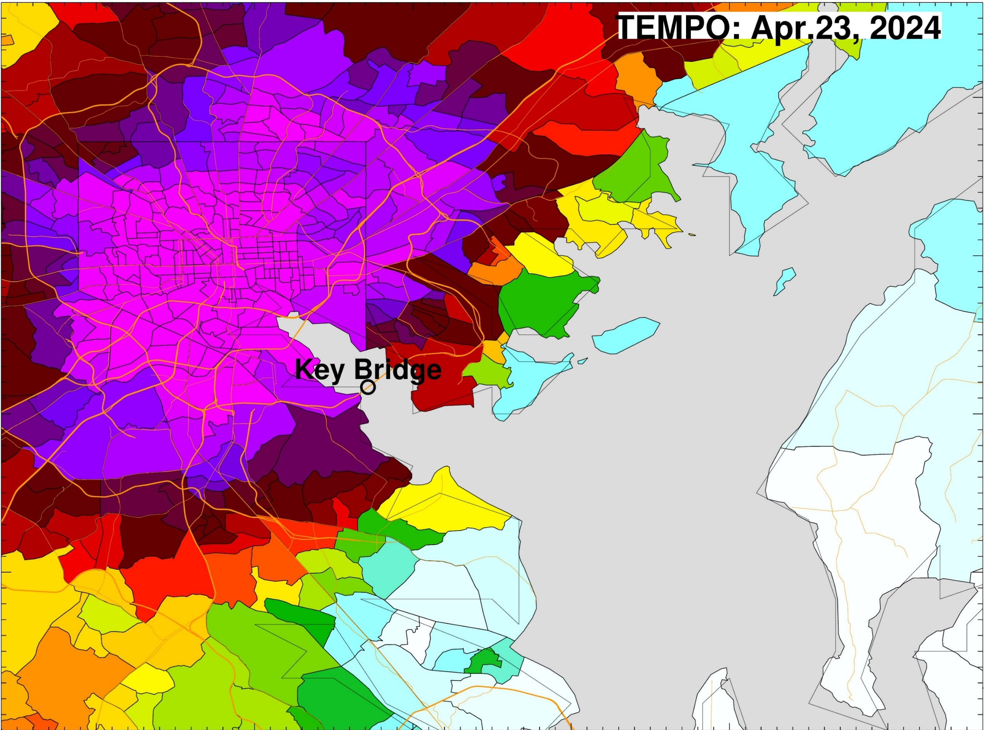
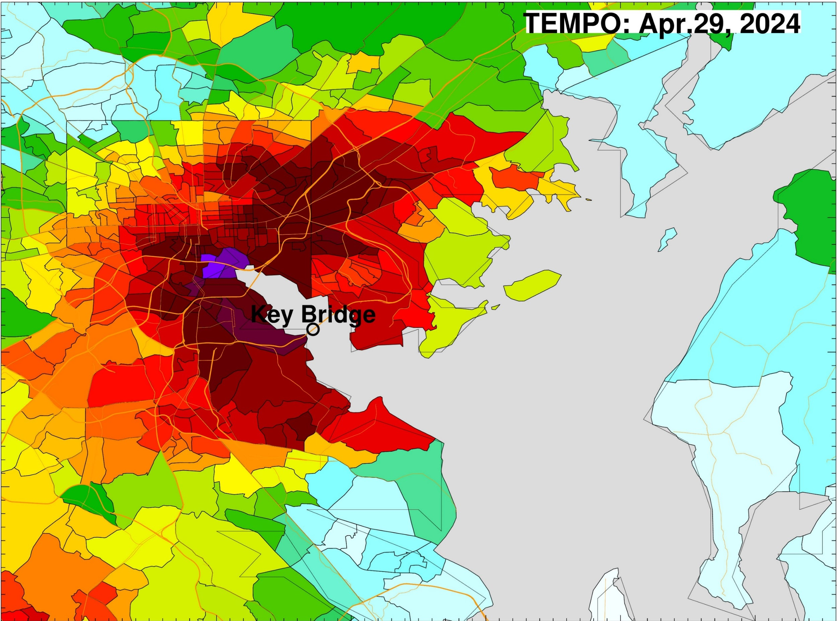
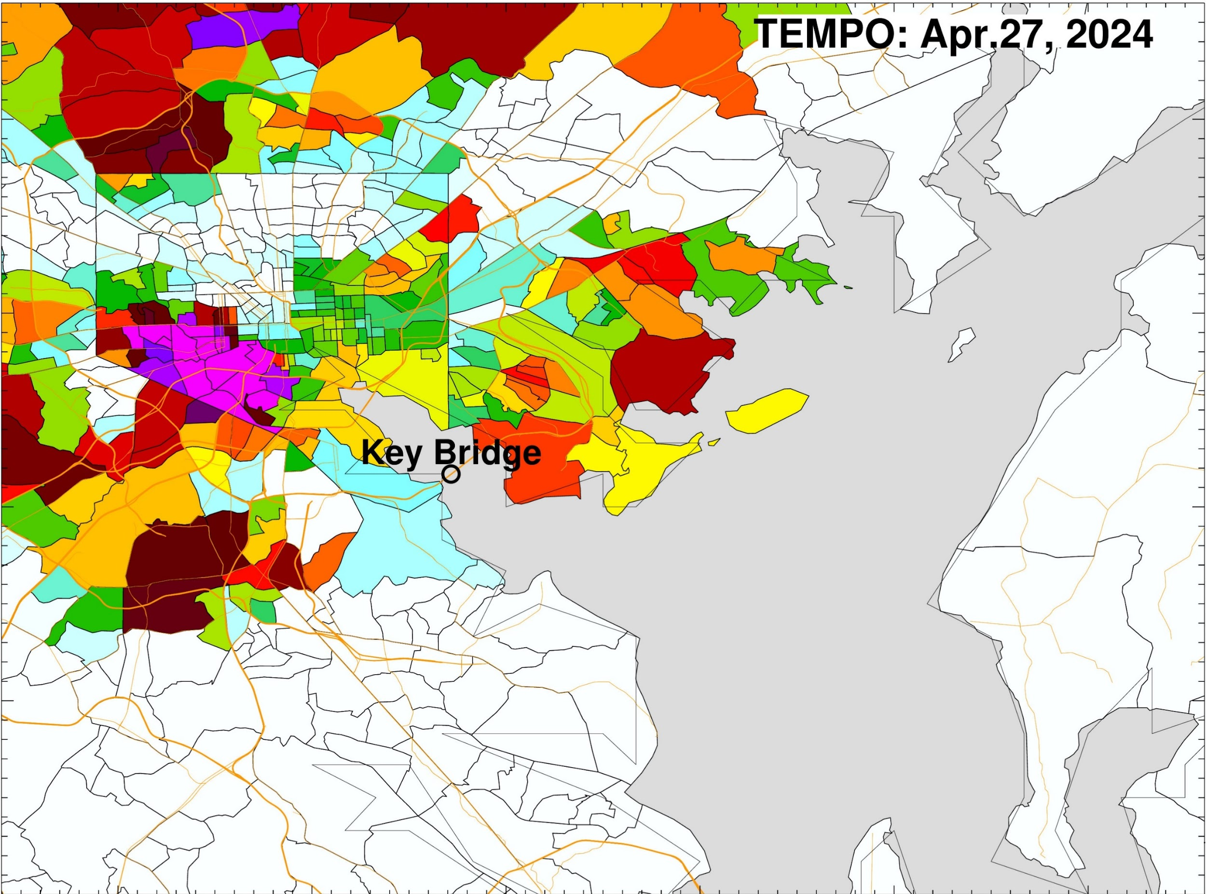
Air Quality and Environmental Justice
EJ / Sensors
Need to inform EJ efforts
MDE is collaborating with several community organizations throughout the state to look at community-scale needs
Sensors are a big part, but large-scale research / satellites can play a big role
Credit: Zigang Wei
MDE is collaborating NESDIS and Dr. Shobha Kondragunta on the ongoing impact of the Key Bridge Collapse and use of satellites by state agencies

Slide 5
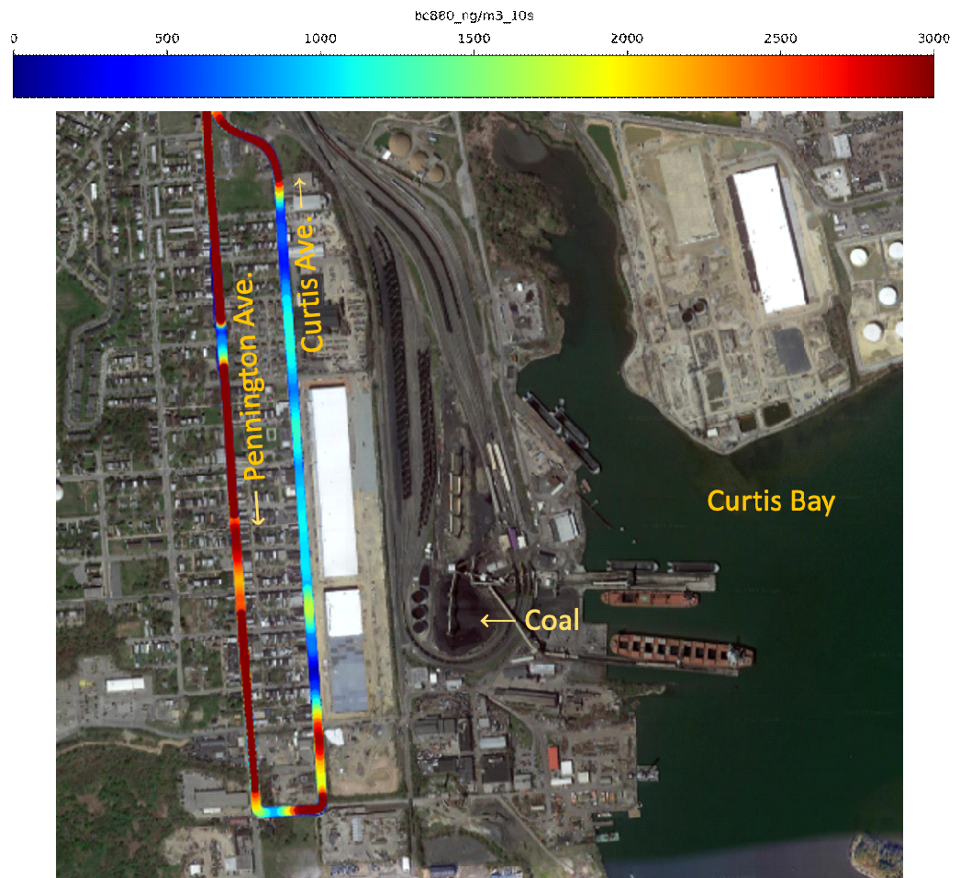
ARC Measurements in Curtis Bay
Curtis Bay Neighborhood
from NOAA’s ARC 4/27/2023
~Equal truck traffic
Black Carbon (BC) (µg m^{–3})
Pennington Curtis
Ave. Ave.
95th 10.9 1.8
Mean (s) 2.1 0.7
Median 0.8 0.5
5th 0.2 0.1
BC measurements offer insight:
High overall
Pennington Ave. >> Curtis Ave.
Due to stop-and-go traffic: turbo-lag.

Slide 6
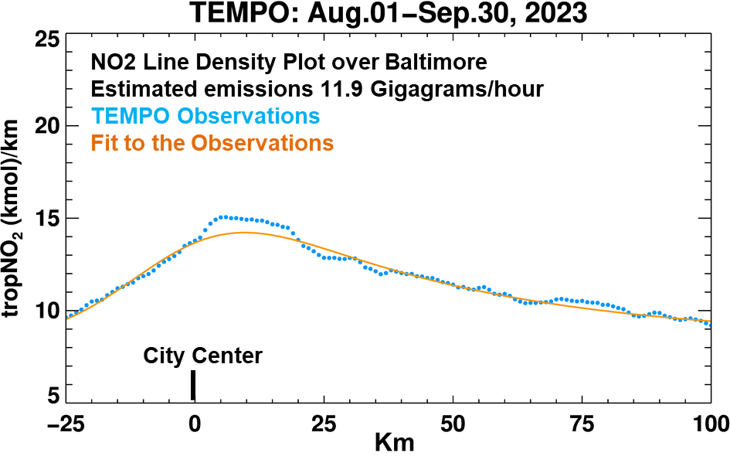
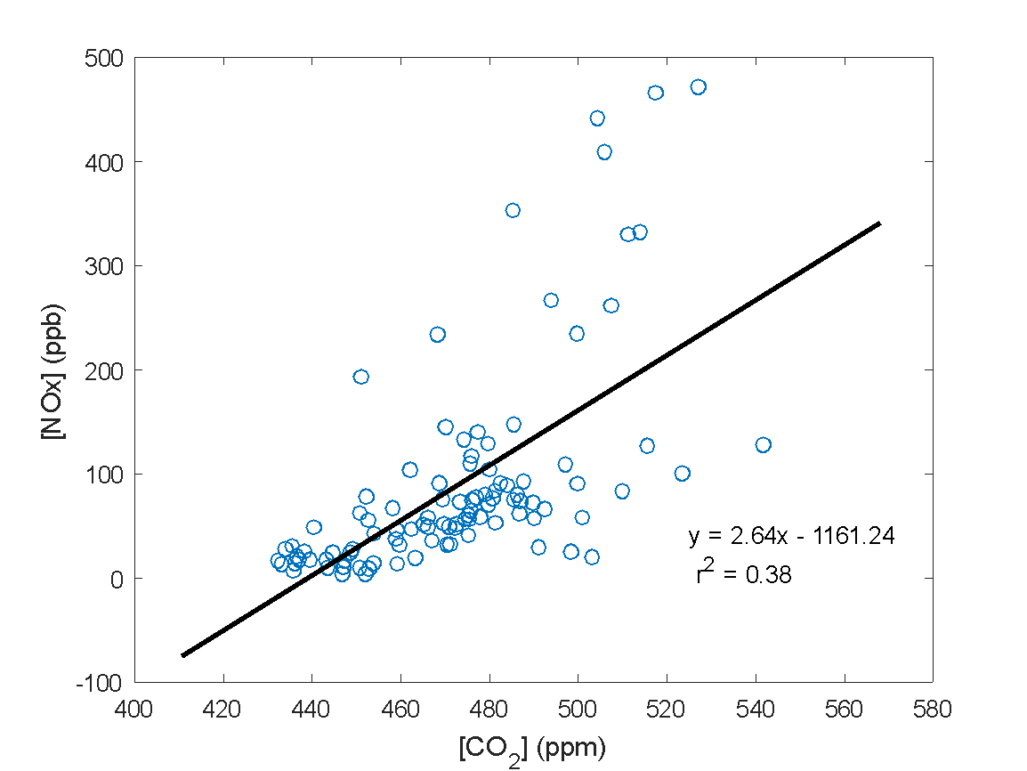
Deriving Hourly CO₂ Emissions using TEMPO NO₂ as a Proxy
E_{CO2} = E_{NOx} * Ratio_{CO2/NOx}
E_{CO2} = E_{NOx} * Ratio_{CO2/NOx}
Mobile NOx vs. CO₂ on I-95
km
Derive CO₂ emissions for top 50 urban areas in the US (population > 1 million) with winds from GOES, CO2M and GOSAT-GW CO₂/NO₂ ratios
Using high spatial resolution mobile observations of CO₂ and NO₂ to validate estimates of TEMPO CO₂

Slide 7
Takeaways
NOAA’s ARC mobile lab serves as an effective tool for studying air quality, greenhouse gases, and environmental justice in urban environments.
The high spatial resolution measurements obtained from the ARC mobile lab can enhance the evaluation of TEMPO and GEOXO satellite observations.
Ratios of species measured by the mobile lab can be used to derive emission rates and assess the accuracy of emission inventories.

