Slide 1
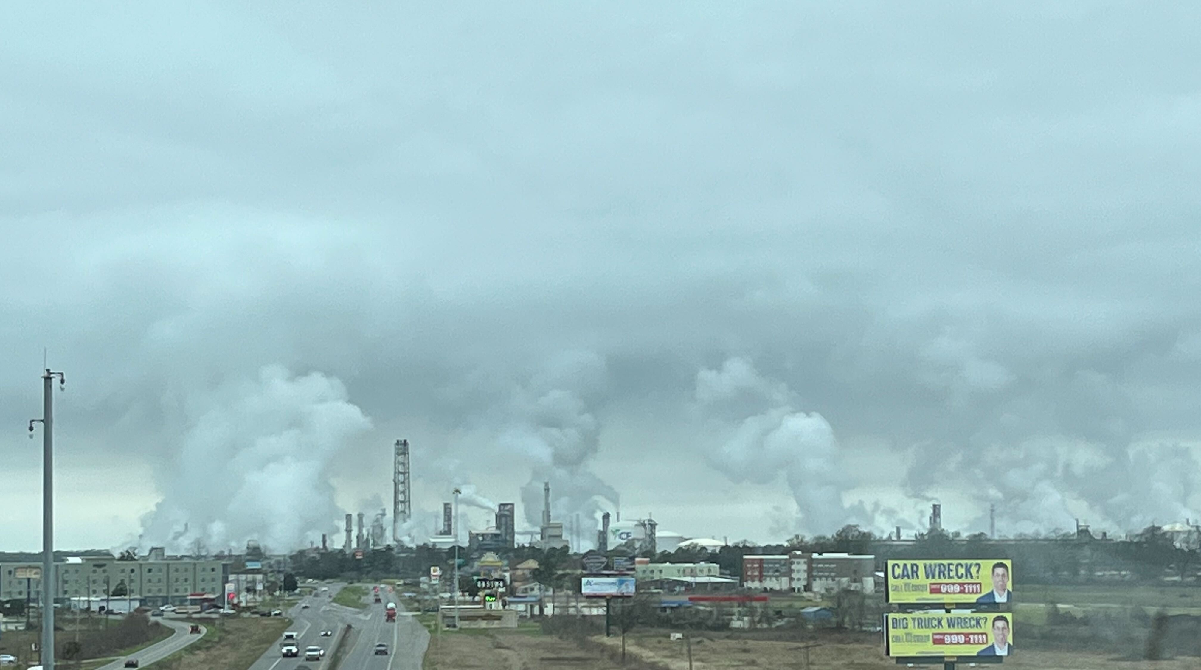
City of Baltimore (and Beyond) EJ Studies
Dr. Benjamin A. Nault
Dept. of Envr. Health & Engineering
Johns Hopkins University
NOAA’s Satellite Applications Symposium Series: Air
10/08/2024

Slide 4
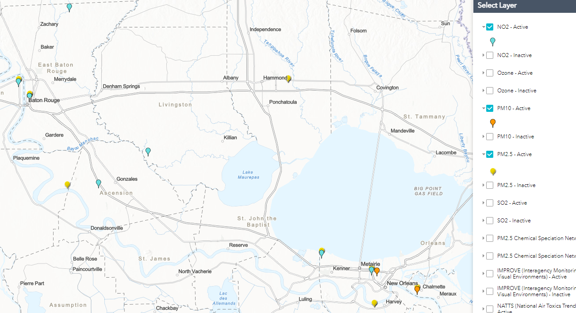
Current regulatory monitors cannot serve EJ communities

Slide 5
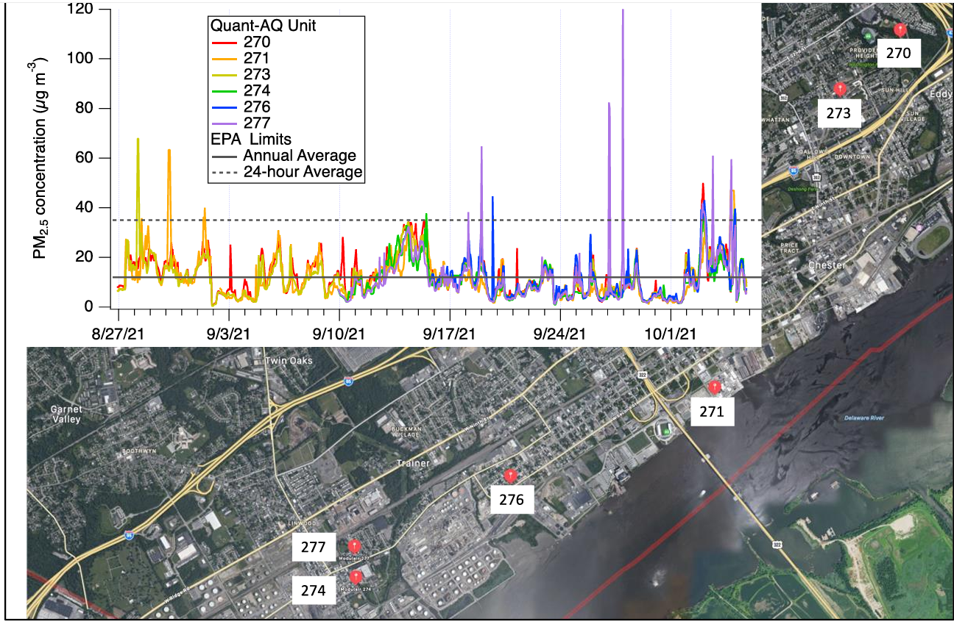
PM_{2.5} May Not be the Driver of EJ
Baltimore, MD
SE Pennsylvania
Heffernan et al., 2023, Annals of Applied Statistics
DeCarlo et al., 2022, Report on Chester HAP-MAP

Slide 6
PM₁₀ Currently Appears Bigger Driver of EJ than PM_{2.5}
Observed similar results in other locations; publications in prep.
Roy et al., 2023, Atmospheric Environment

Slide 7
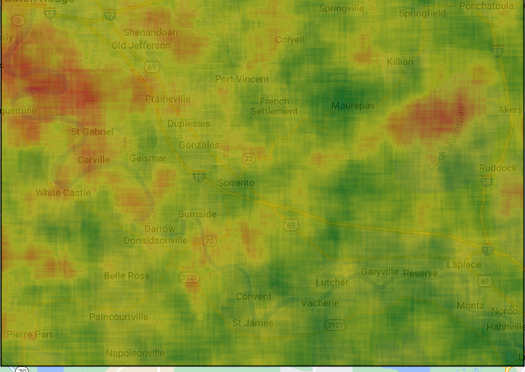
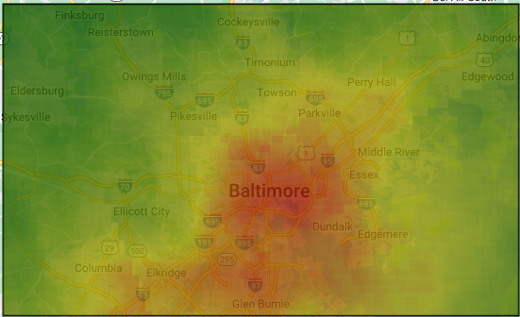
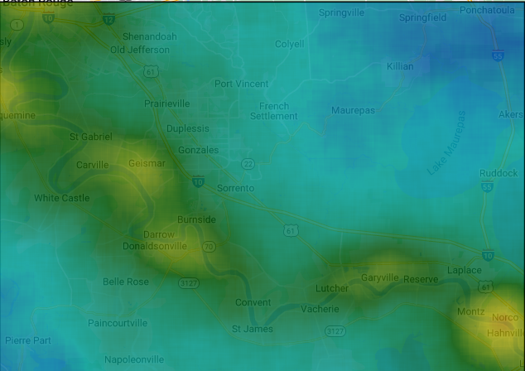
TropOMI on Google Earth Engine highlights EJ communities but differently
1.2×10¹⁶
1.2×10¹⁶
HCHO
HCHO
0
0
4.5×10¹⁵
4.5×10¹⁵
NO₂
NO₂
0
0

Slide 8
What can satellites do for EJ?
Can PM₁₀ be differentiated from PM_{2.5} for AOD, now that there is hourly data?
How can NO₂ + HCHO be used jointly for EJ communities?
What other information can be garnered from NO₂ &/or HCHO for EJ communities?
How can hourly (daily, weekly, monthly) data be made readily accessible and interpretable?

