Slide 1
Break until 315 PM EDT

Slide 2

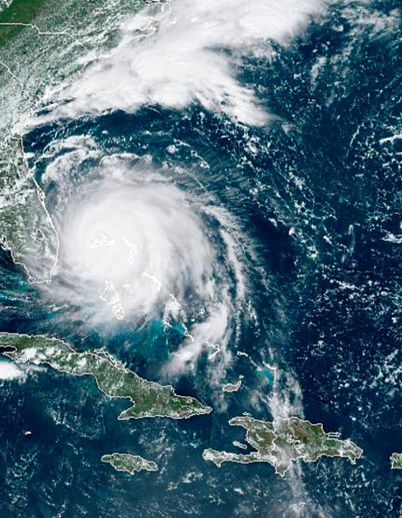


NOAA’s Satellite Applications Symposium Series: Air
October 2024
NOAA
National Environmental Satellite, Data, and Information Service
Andy Latto, GeoXO User Engagement Lead

Slide 3


User Engagement
Roadmap
FY 26-28
FY 28+
Finalize User Needs Assessments
User Readiness Activities
Product/Infrastructure/Process Readiness Development
Follow-on workshops
Finalize User Readiness
Organizational Readiness
Pathfinders
Training
Through FY 2025
GeoXO road shows and Symposiums
Support the User Scientists in their respective UE events and track progress
Identify prospective Pathfinders
Build contact database and stakeholder
relationships for future user readiness
campaigns
Notes:
The fourth stage in our process is developing user engagement milestones
These milestones are tied directly to the our stakeholder needs
This is not a complete list but I would like to highlight a few new user engagement activities we are doing this year
Also why these are very important

Slide 4

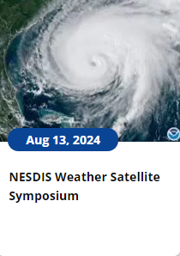
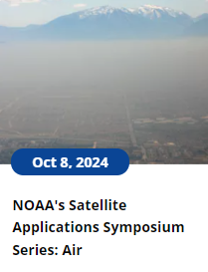
User Engagement Updates
Themed Symposium Series Repeating Every ~6 Months Through 2025
-Human Health/Air Quality TODAY
-Fire February 25th, Norman Oklahoma
-Water: Early April, TBD
-Weather: May, TBD
Road Shows Every ~6 Months through 2025
  South Florida July 16-18
  Southeast Louisiana (New Orleans Based) January
  San Diego or NW area (possibly August 2025)? TBD
User Scientist Related Events/User Readiness Workshops FY2026 and Beyond
Brief Program Updates, Quarterly
Newsletters, Semi-Annual
Based on Your Feedback, We Know When YOU Want to be Involved!

Slide 5
Stakeholder Session
Are there any air quality (or other) satellite products you use or desire to use now that you need assistance with training or access?

Slide 6
Stakeholder Session
How do you plan to utilize the new TEMPO and future GeoXO atmospheric composition information to do your job? We are interested in hearing from different levels of users.

Slide 7
Stakeholder Session
What are your plans to evaluate current air quality satellite data to help determine the uses of this data in the future.
  Example: creating a case study that reveals a certain minimum resolution of a product that works best to make your operational decision
    do you want us to come up some use cases or are you planning to do some of your own?

Slide 8
Stakeholder Session
Are there any major infrastructure changes in your organization planned over the next few years that will allow your systems to handle high bandwidth and quantities of data?

