Slide 1
Making the case for GeoXO
GHG instrument
Brian McDonald, Program Lead
Atmospheric Composition Modeling
NOAA Chemical Sciences Laboratory
NOAA’s Satellite Applications Symposium Series: Air
(10/8/2024)

Slide 2
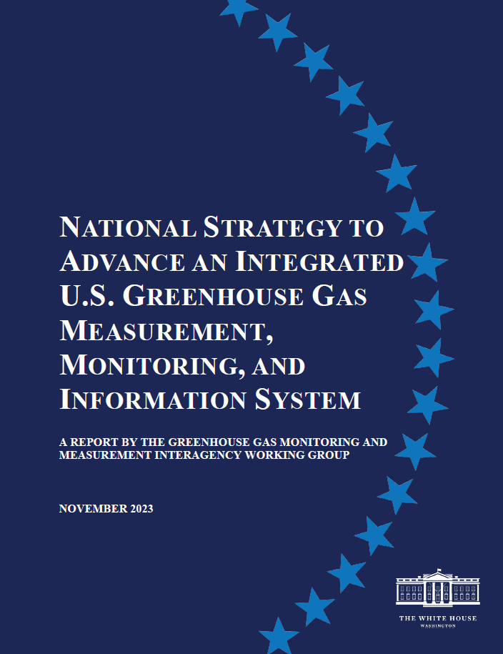
US GHG Measurement, Monitoring & Information System

Slide 3
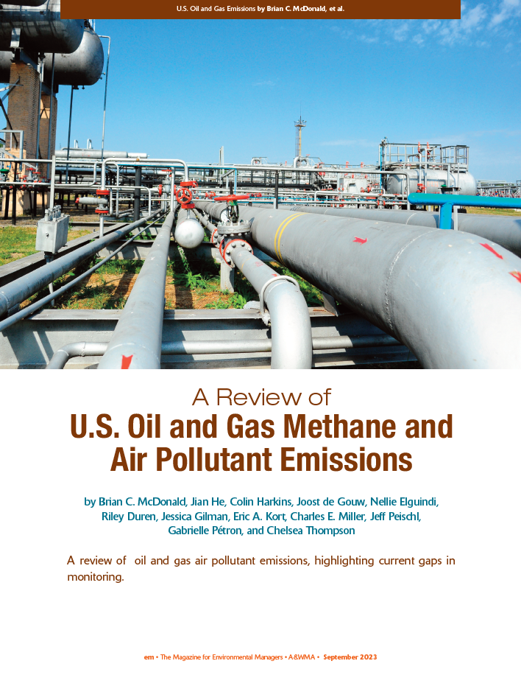
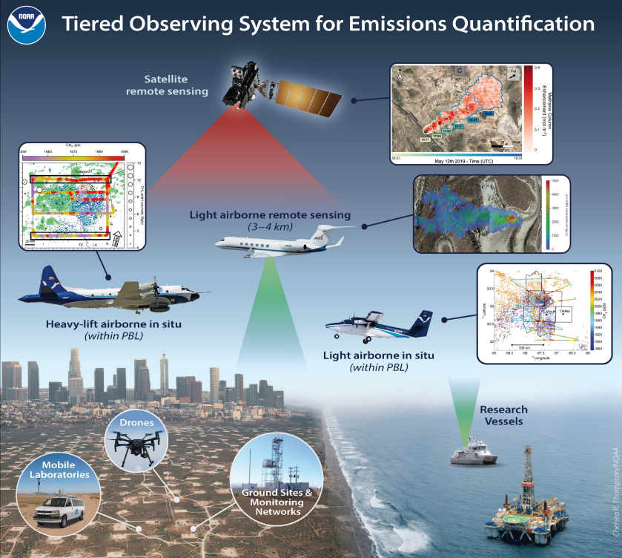
What Might a Tiered Observing System Look Like?

Slide 4
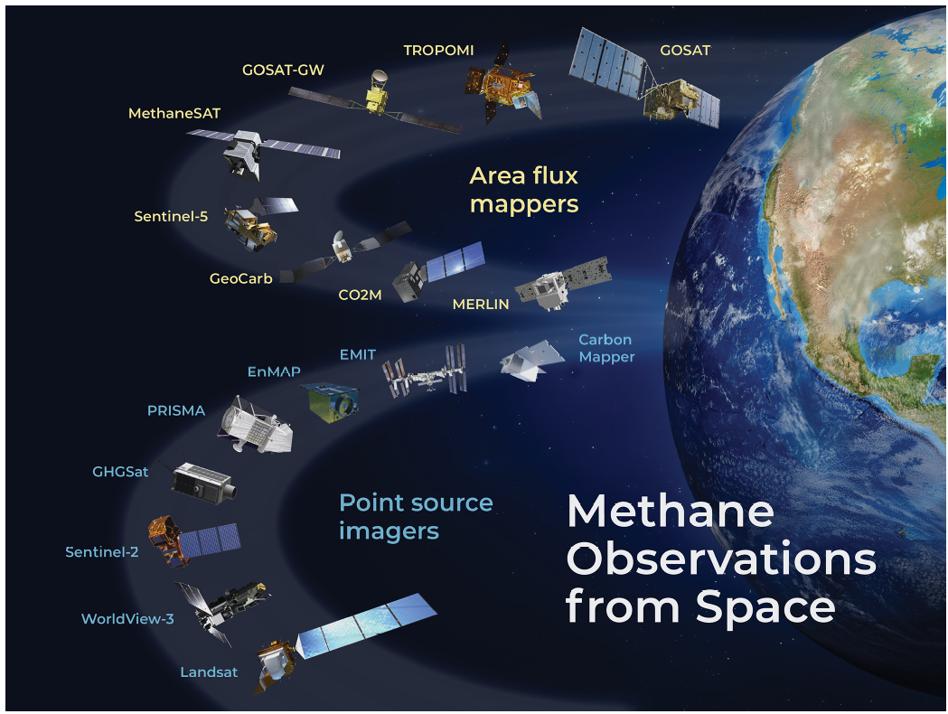
Satellite Constellation of Methane Observations (all polar-orbiters)
1 - 10 km
Goal to track emissions at the regional / basin-scale
Goal to identify leaks and notify operators to repair
(sensitivity ~100 kg / h)
25 m
Jacob et al. ACP 2022

Slide 5
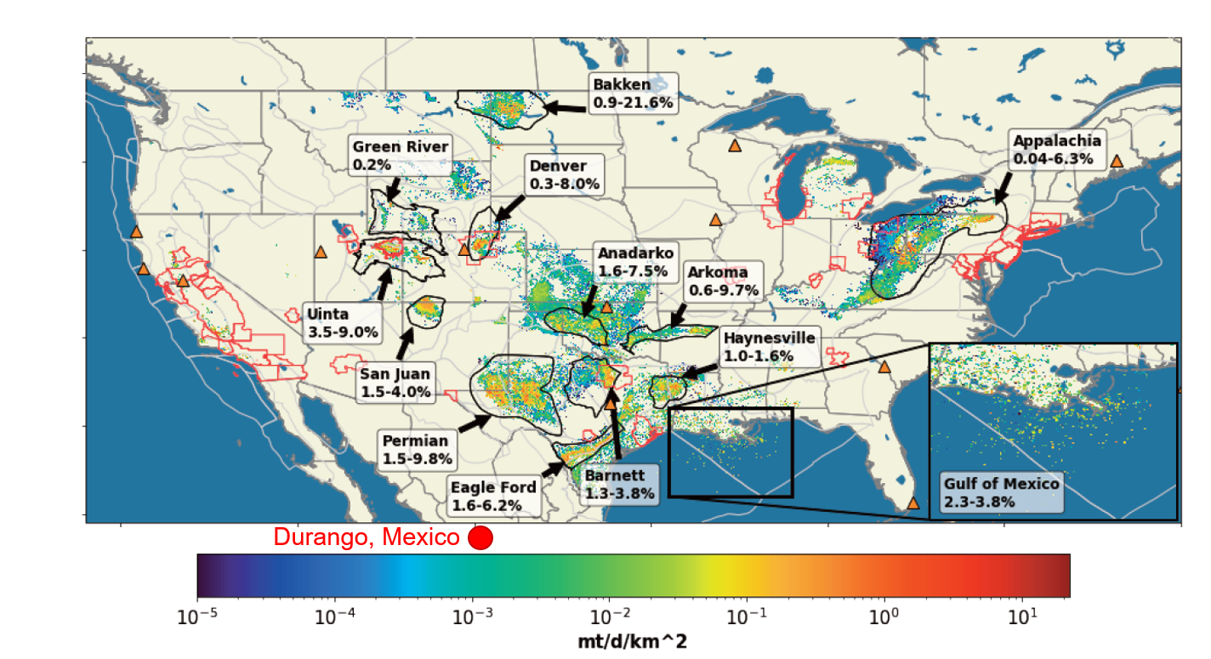
Geostationary Orbit Observes Transient Oil and Gas Emissions
Watine-Guiu et al., 2023
GOES ABI methane detection can improve:
accounting of super-emitter events in bottom-up inventories (intensity + duration)
methane anomaly detection in near real-time emissions satellite data assimilation system
EMIT
GOES ABI
Daniel Varon
(Harvard)
Shobha Kondragunta
(NOAA)

Slide 6
Observing System Simulation Experiments (OSSEs)
(2030s- 2050s)
Missing
NIR
Joint modeling work between NOAA CSL and GML to highlight value and cost-benefit of having NIR instrument on GeoXO through OSSE, GeoCARB retrieval provided by NASA GMAO
Building off similar worked performed for TEMPO-like instrument on GeoXO (Hsu et al., JGR 2024)

