Slide 1
Utilzing TEMPO / ACX for
Near Real-time NO_{x} Emissions
Brian McDonald, Program Lead
Atmospheric Composition Modeling
NOAA Chemical Sciences Laboratory
NOAA’s Satellite Applications Symposium Series: Air
(10/8/2024)

Slide 2
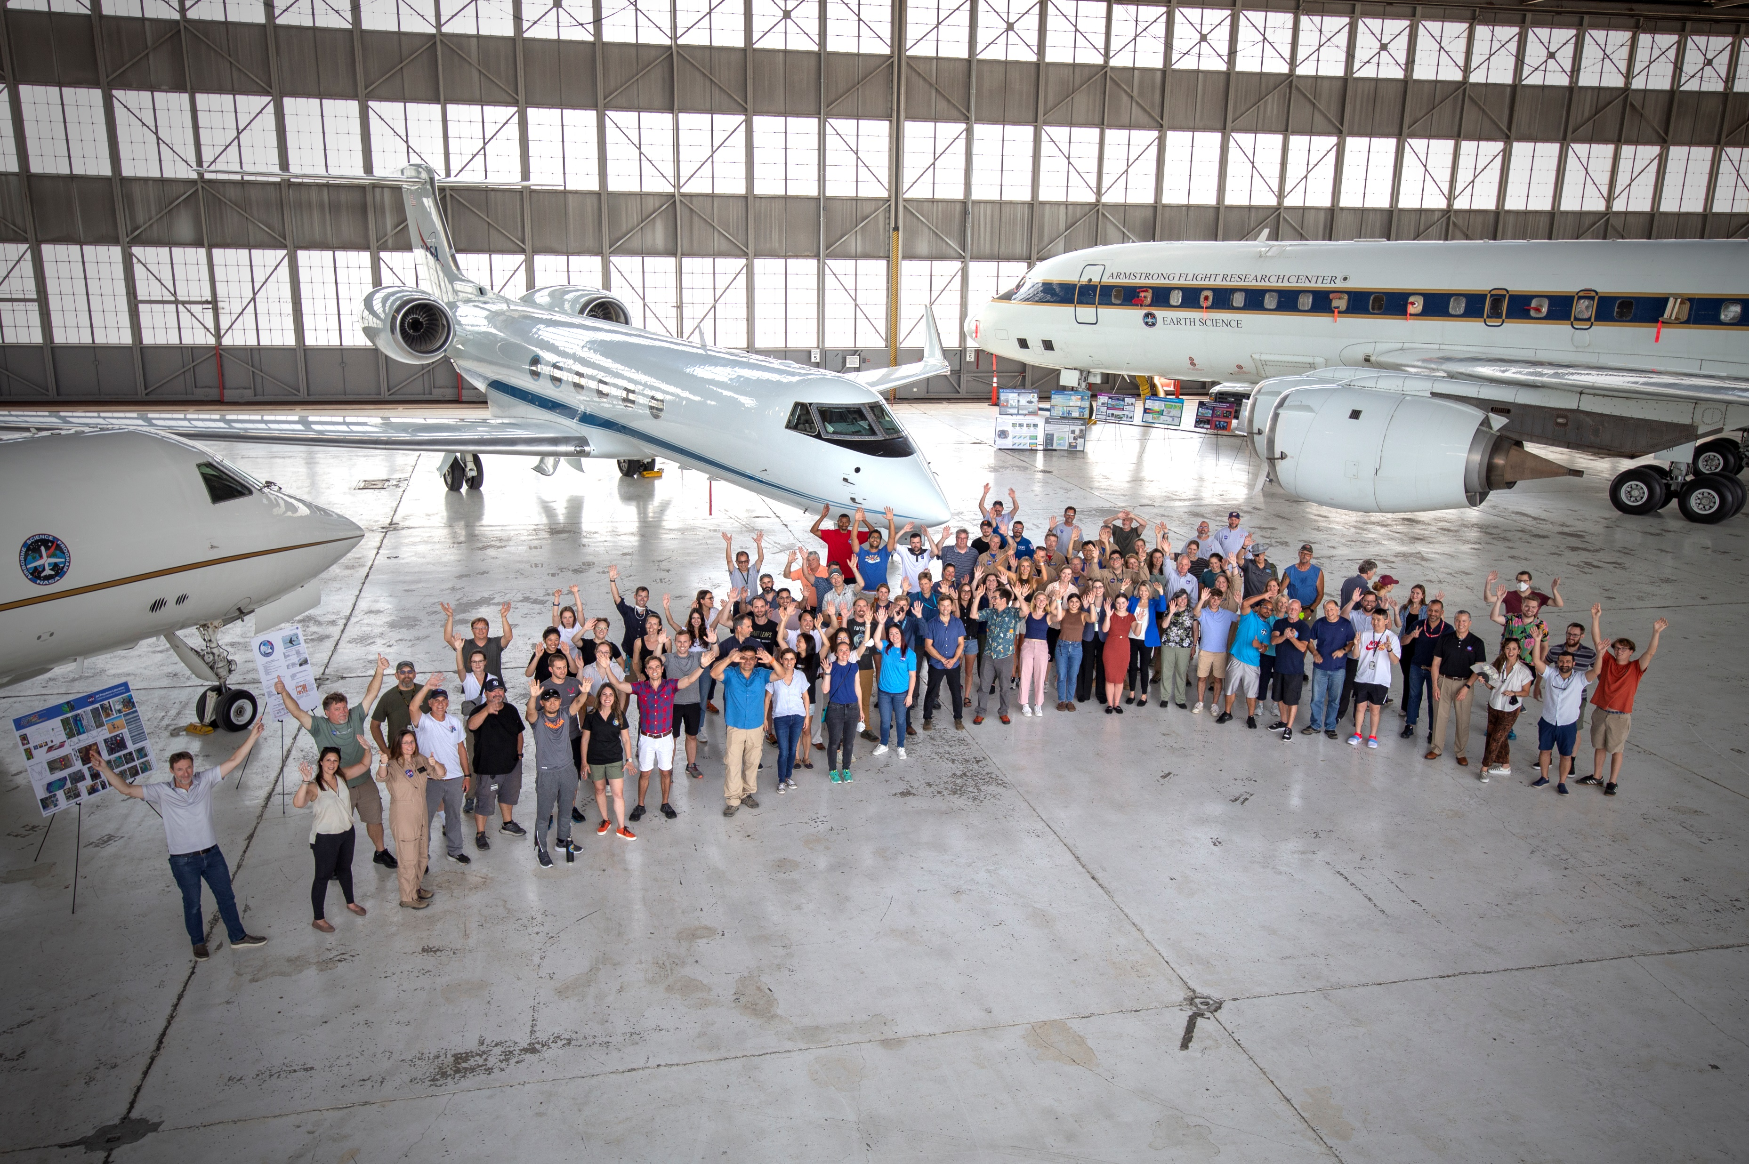
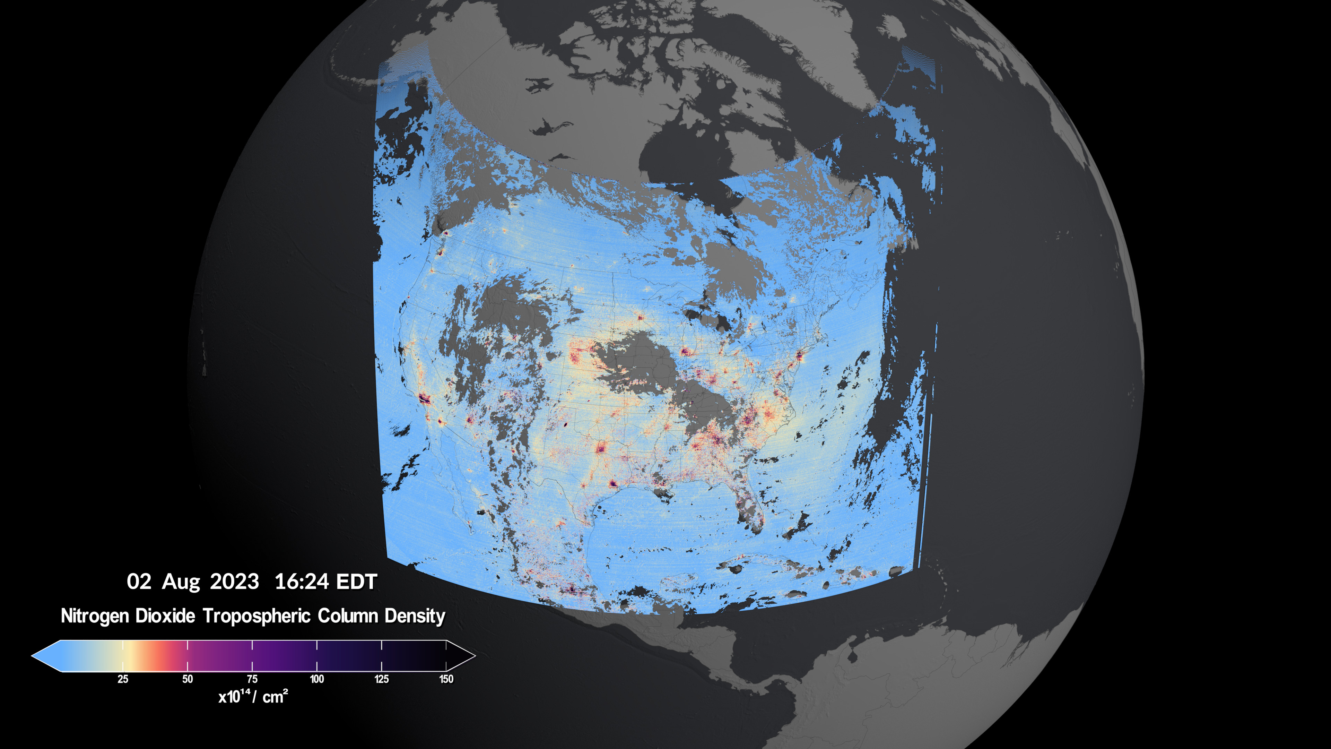
Key TEMPO retrievals for air quality research:
O₃
NO₂
CH₂O
C₂H₂O₂
SO₂
AOD
Top of aerosol layer
AEROMMA-STAQS group photo in Dayton, OH
Credit: NASA's Scientific Visualization Studio; Data provided by the Smithsonian Astrophysical Observatory| Harvard & Smithsonian.
Visualizers
Cindy Starr (Global Science and Technology, Inc.)
Kel Elkins (USRA) and Trent L. Schindler (USRA)
Scientists
Caroline Nowlan and Xiong Liu
Center for Astrophysics | Harvard & Smithsonian

Slide 3
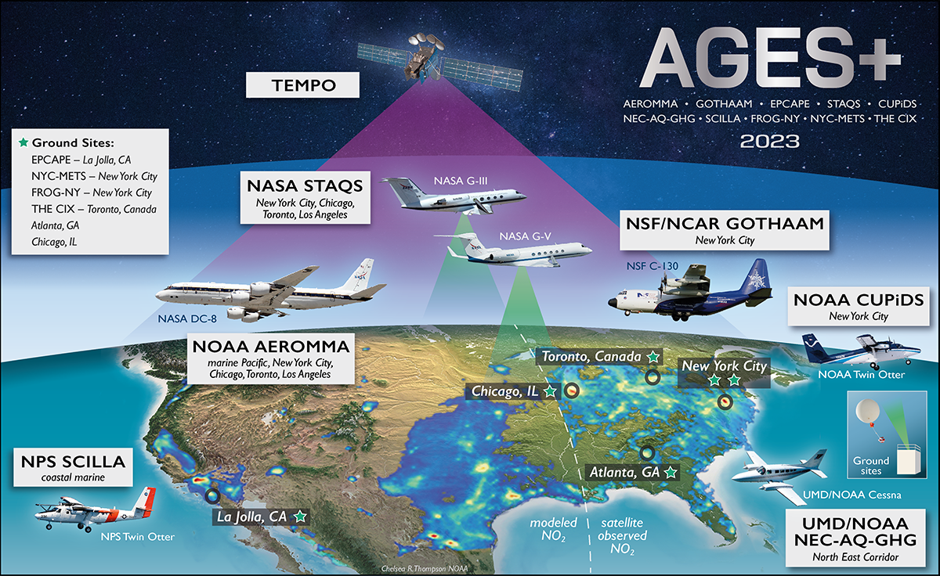
Airborne Field Campaigns in Summer 2023 under TEMPO
https://csl.noaa.gov/projects/ages/

Slide 4
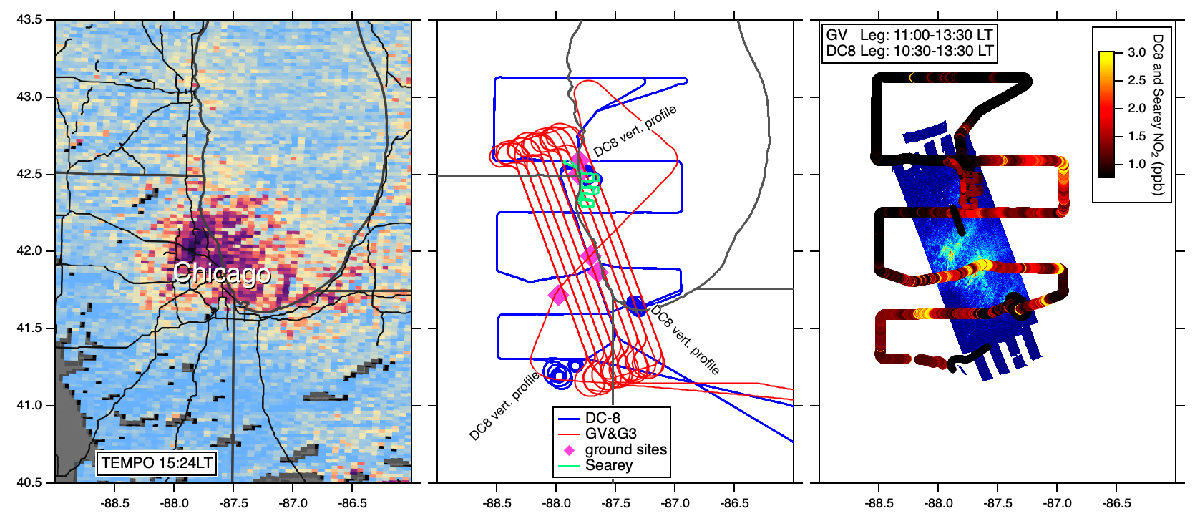
AGES+ Aircraft Coordination for TEMPO First Light
GV data courtesy of L. Judd NASA
TEMPO data AGES+ measurements AGES+ data

Slide 5
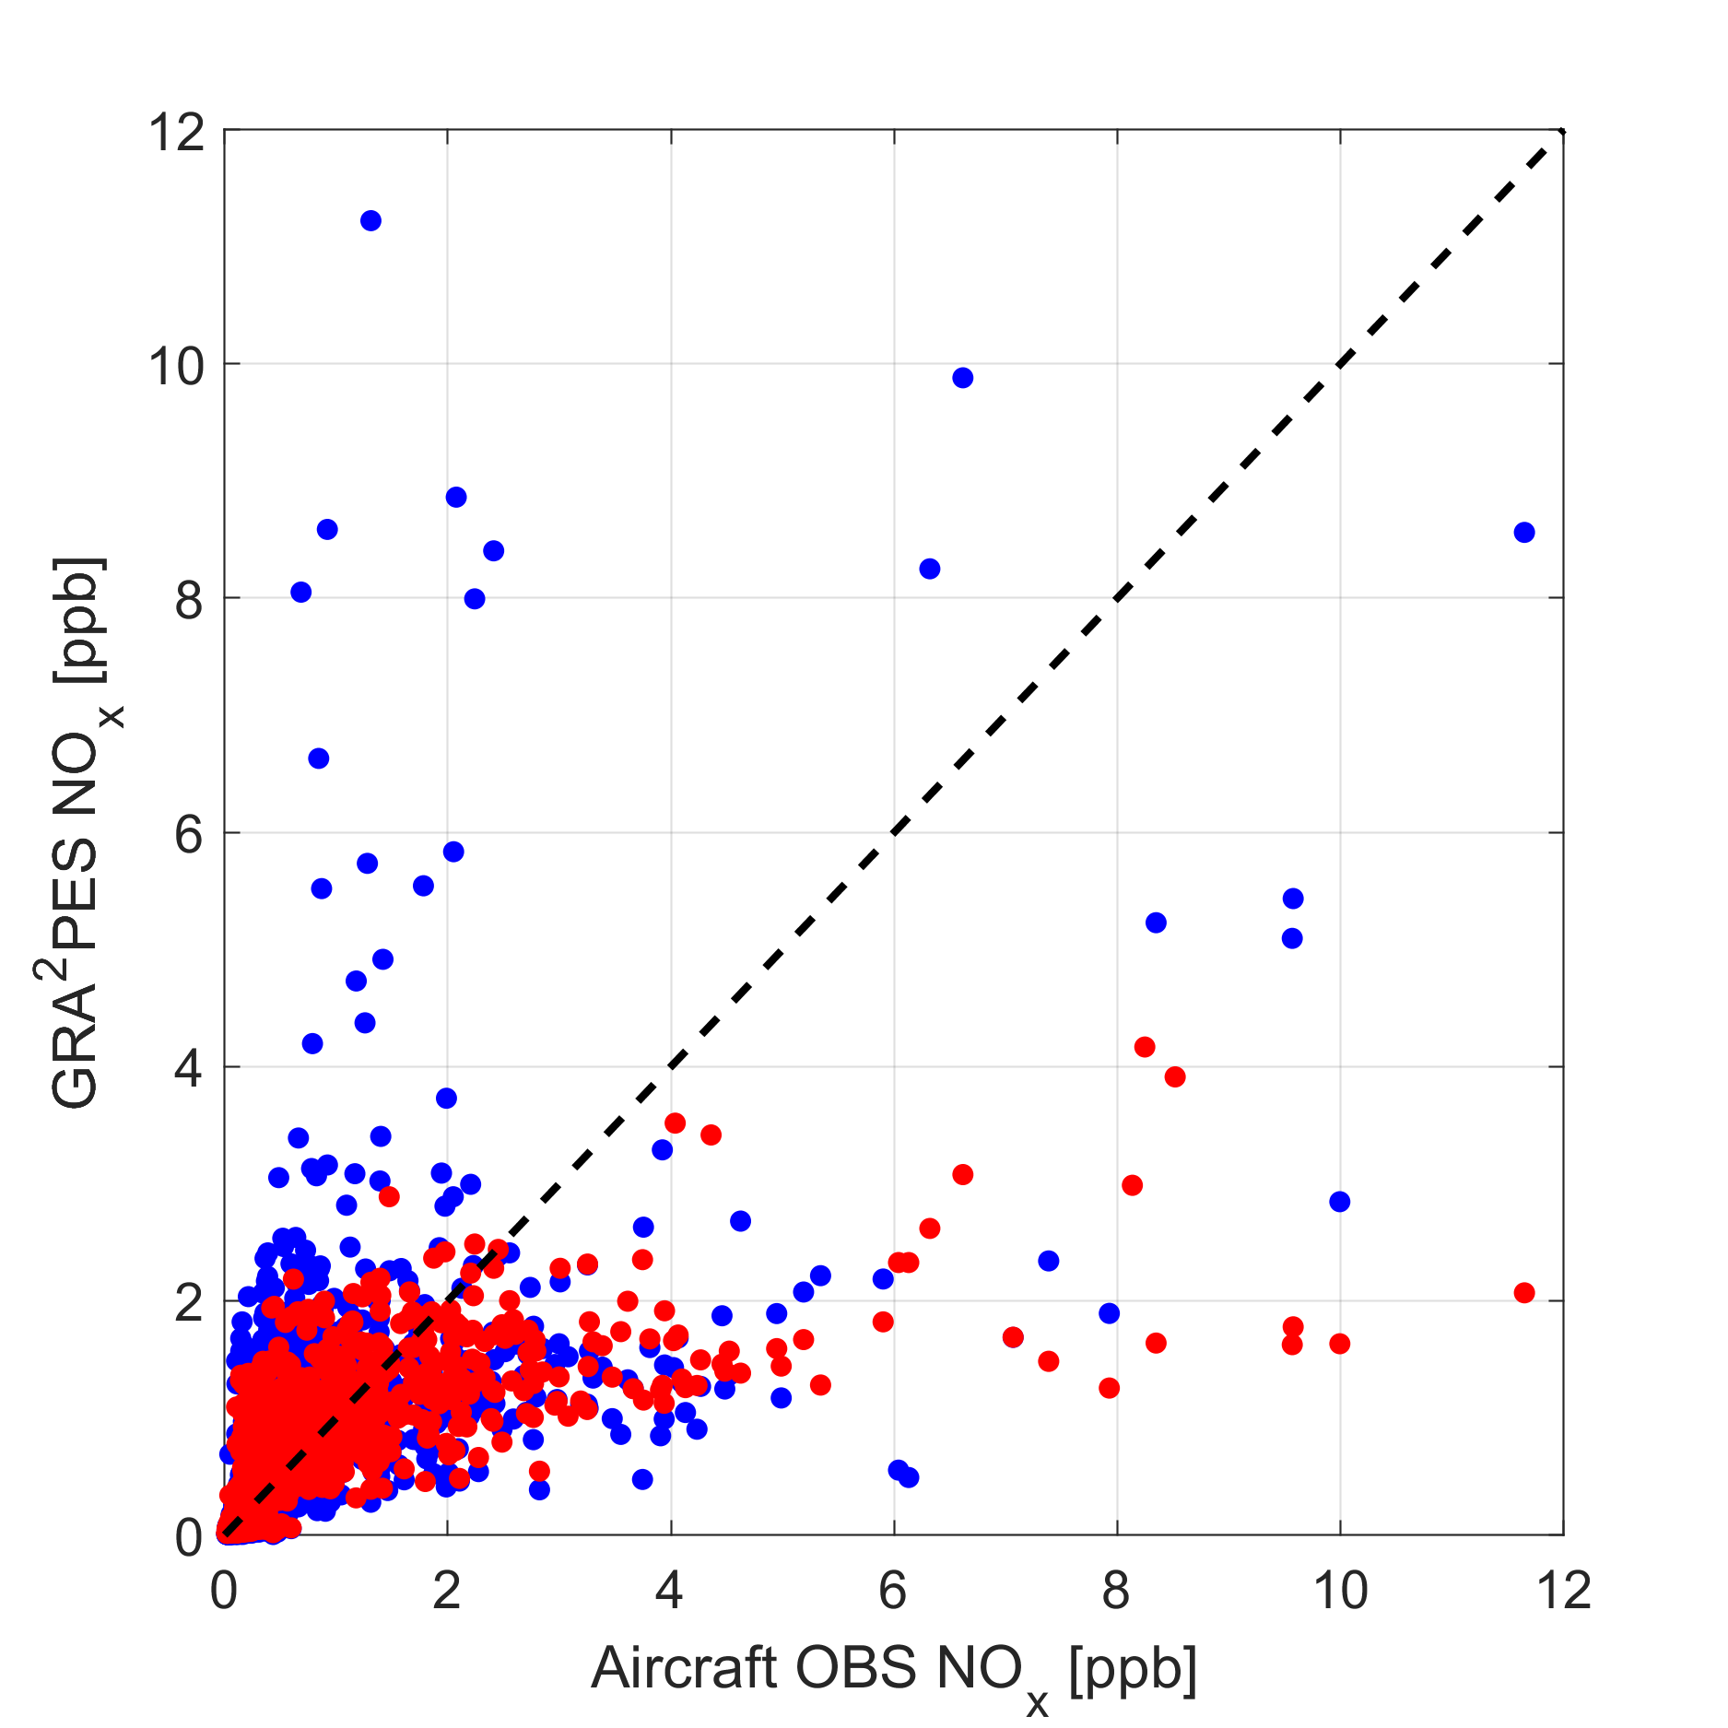
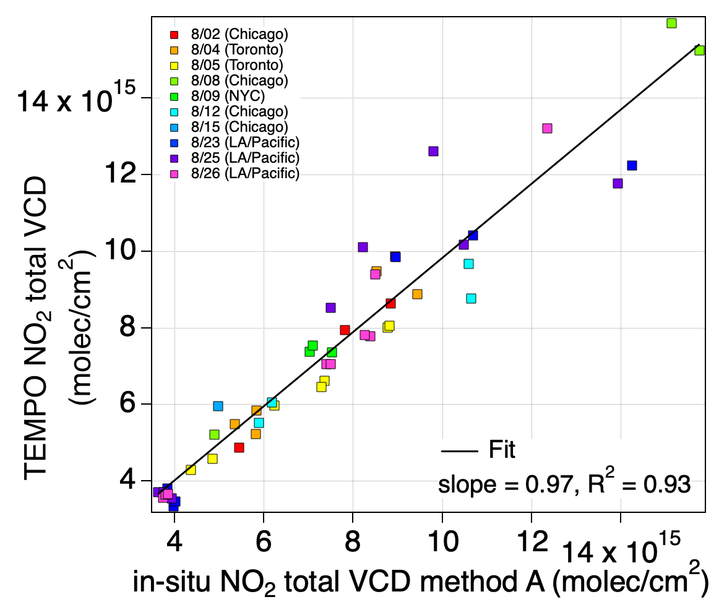
From TEMPO Validation to Assimilation in Air Quality Models
No DA (+11%, R² = 0.41)
w/ DA (-13%, R² = 0.48)
Model NO_{x} [ppb]
TEMPO NO₂ vertical column
[molec. cm⁻²]
Chia-Hua Hsu
(CU)
Eleanor Waxman
(CU)
Aircraft-derived NO₂ vertical column [molec. cm⁻²]
Aircraft NO_{x} [ppb]

Slide 6
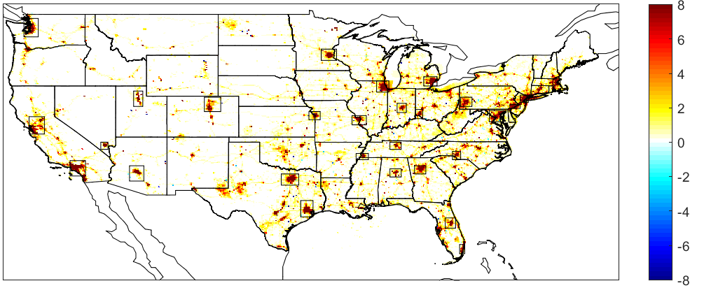
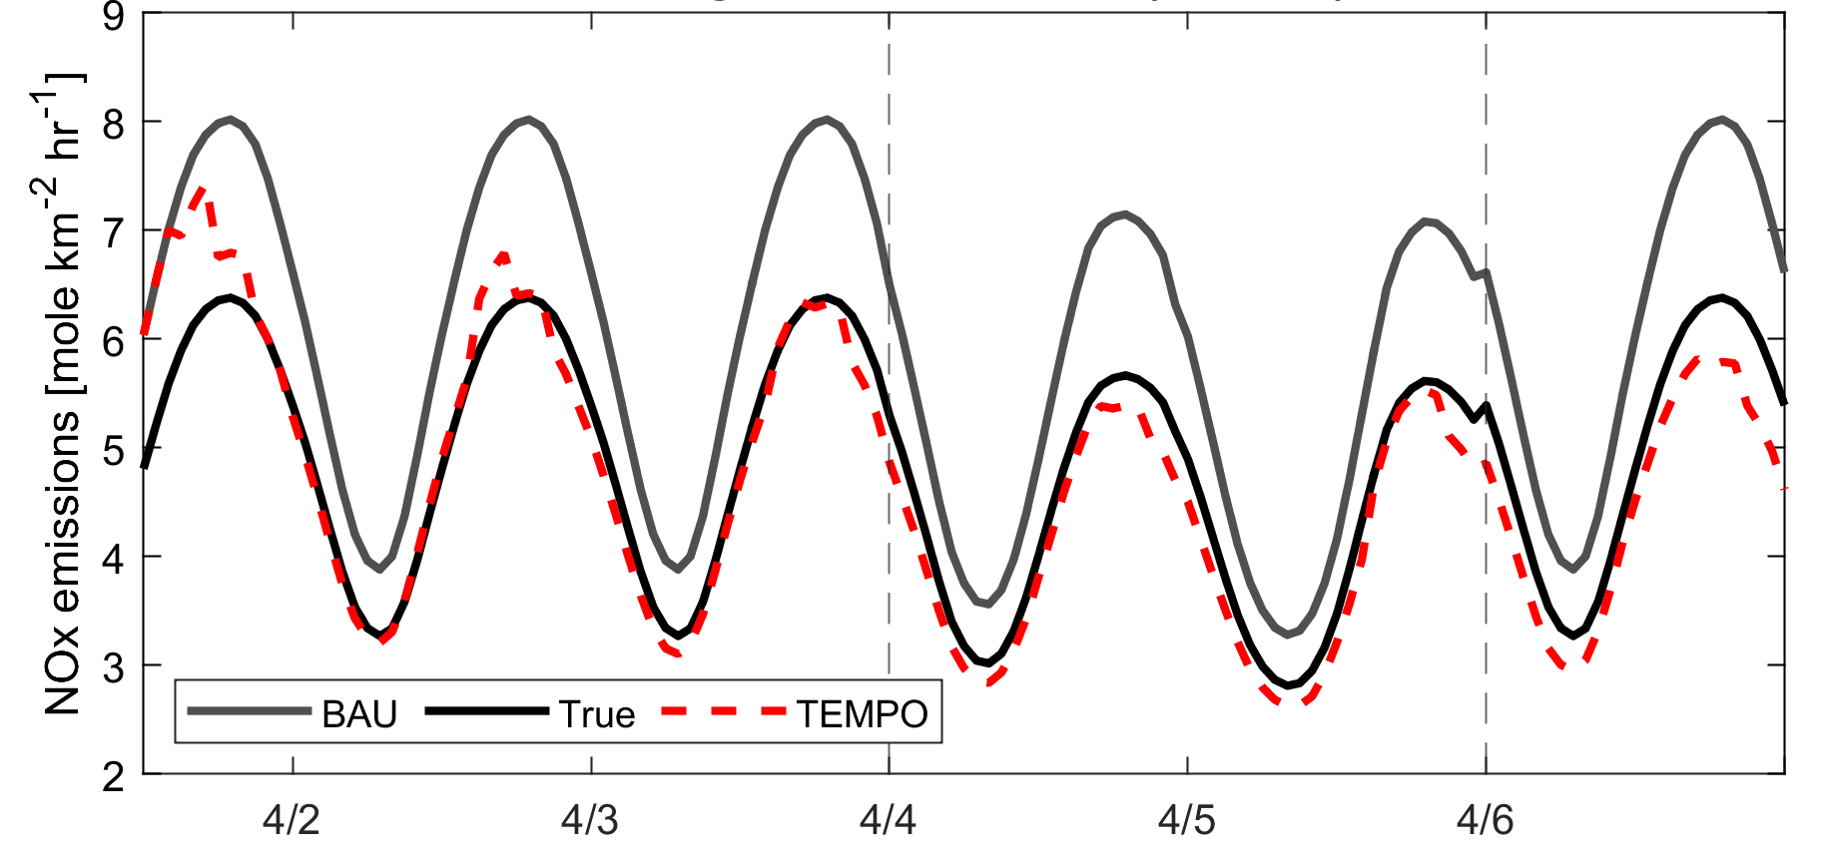
Building towards a Near-Realtime Emissions System
Business-as-usual (BAU) – COVID-19
NO_{x}
mole/km²/h
Business-as-usual (BAU) – COVID-19
Without COVID-19 pandemic, NO_{x} emissions
would be ~30% higher in April 2020
Geostationary NO₂ observations can update NO_{x} emissions within 1-3 days accounting for pandemic
Chia-Hua Hsu
(CU)
Arthur Mizzi
(NASA/CU)
Daven Henze
(CU)
Hsu et al. (JGR, 2024)

