Slide 1
GEO/XO Hyperspectral IR Sounder (GXS)
Presented by Jim Yoe ( james.g.yoe@noaa.gov )
Material from Tim Schmit, Zhenglong Li, Dave Tobin, Andrew Heidinger, Mat Gunshor, Yong Chen, Bill Smith, Mitch Goldberg, and Frank Alsheimer, and Others
NOAA's Satellite Applications Symposium Series: NWS and Weather, October 8, 2024

Slide 2
Overview
GXS - What Is It?
What Are Its Capabilities?
Where Does GXS fit into GEO/XO - and beyond?
Why Is GXS Needed?
How Will GXS Contribute to the Weather Enterprise?
Who Is Doing What to Prepare to Exploit GXS?
Your Questions?

Slide 3
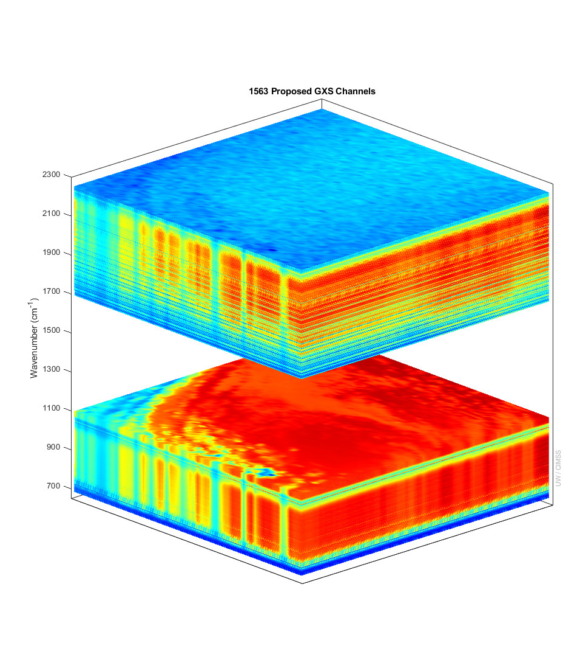
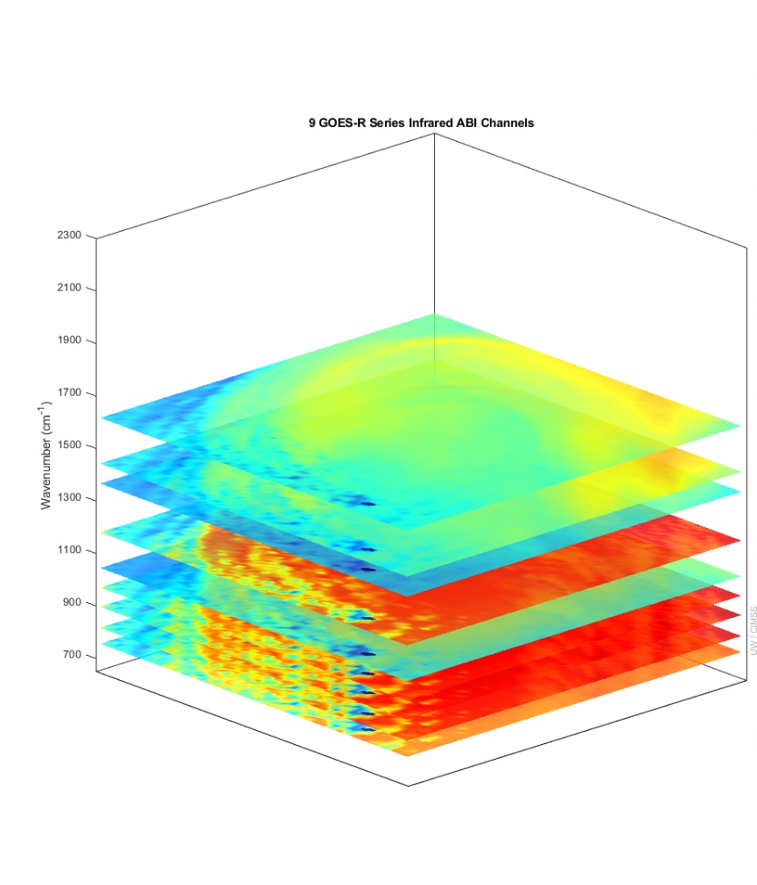
Sounder in GEO - Horiz, Time Res ~ ABI;
100x Spectral bands yield vertical info for T, Q
GXS ABI
IASI granule used to show the great improvement of the GXS over previous geostationary capabilities. Not shown are the improved temporal or spatial attributes of the GXS.
There is more than six times (temperature) and four times (moisture) of number of independent pieces of vertical information compared to the ABI.
Number of Independent Pieces of Vertical Information
Temperature | 13 | 2
Moisture | 11 | 2.5
Notes:
Y axis is wavenumber. ABI and GOES Sounder bands within the GXS range are shown. Credit: UW/CIMSS
Vertical pieces recently calculated by Z. Li, UW/CIMSS.

Slide 4
GXS Capabilities Summary (What and Why)
Attribute |  | What |  | Why
Coverage |  | Ideally: Sounding Disk as seen from both GOES-East and –West positions; Central satellite position currently planned |  | The Atlantic for hurricane development and model initializations, CONUS for the pre-convective environment monitoring and the Pacific for both upstream weather and monitoring moisture (and winds) over the huge area with little conventional data.
Spatial Resolution |  | 4 km (at the satellite subpoint) |  | Doubling the clear-sky yields, compared to LEO, for a given time. Also for finer moisture gradients to be monitored.
Temporal Resolution |  | Sounding Disks (60 min), CONUS (~30 min) and mesoscale (5 min) |  | Sounding Disk upstream information and hurricane monitoring (improved track and intensity), CONUS for pre-convective monitoring and the targeted for regions of extremely active weather. Allows for clouds to move out and obtain more clear sky information.
Spectral Coverage / Resolution |  | 680‐ 1095 cm‐1 14.7 – 9.13 μm 1689 – 2250 cm‐1 5.92 – 4.44 μm ) @ ~0.6 cm-1 |  | Spectral with information related to temperature, moisture and support select atmospheric compositions (ozone, NH3, isoprene, HNO3, N20 and CO). Need to resolve, not average out, the critical on/off spectral lines.
Other |  | Evolution of the radiances |  | Provides critical vertical information on atmospheric winds for both nowcasting and NWP applications.

Slide 5
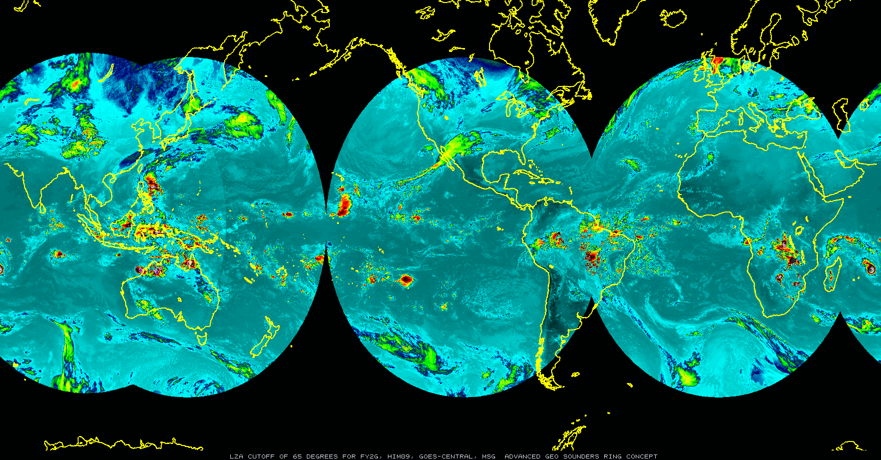
Critical Component of the GEO-RING of IR Sounders
CMA/GIIRS
2016
JMA/GHMS
2028
EUMETSAT/
IRS 2025
NOAA/GXS
2035
IRSO (India) also exploring geo hyper spectral IR
KMA currently exploring geo hyper spectral IR
UW/CIMSS/SSEC hosting long-term JMA visiting scientist
Let T. Schmit know if interested in the monthly GXS science calls (4th Monday’s).
Assumes 65º Scanning for Sounding Disks
WMO WIGOS 2040 includes geostationary hyperspectral IR sounders

Slide 6
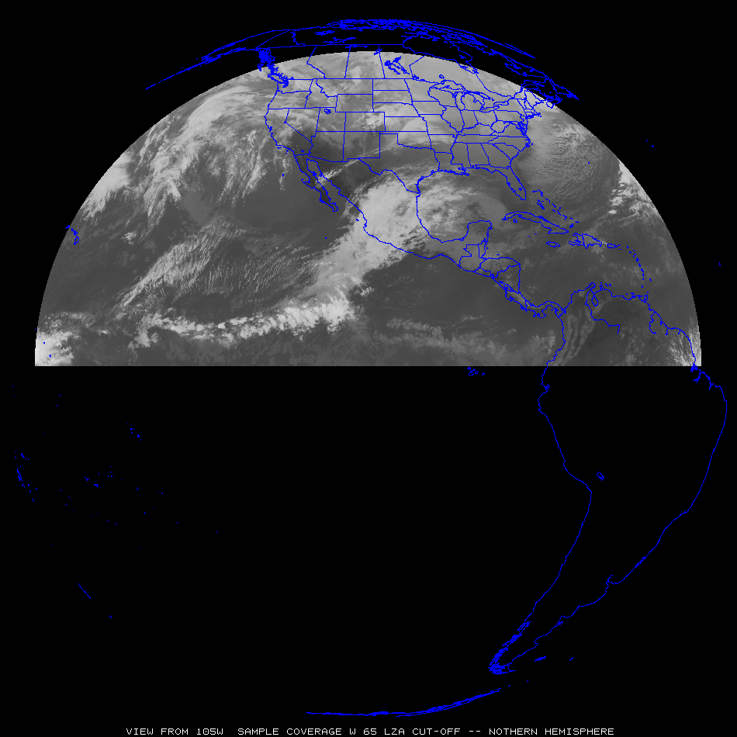
GXS Observation Applications
“clippers”
Most everywhere:
Pre-convection, stability, winds, moisture, high clouds, help AQ, etc.
“atmospheric
rivers”
“Nor-easters”
“dryline”
Sub-tropical jet
“return flow”
“Atlantic
Tropical
Cyclones”
“EastPac Tropical Cyclones”
Tropical winds for NWP
Tropical winds for NWP
Tropical winds for NWP

Slide 7
Where does GXS fit in to the local WX Forecast?
GXS data will fill in observational gaps to help with these and other operational issues:
Near-Storm Mesoscale Analysis (before and during an event; compare to model forecasts)
Convective
Winter
Warn on Forecast (provides nearly constant updates to users, not just one warning)
Precipitation Type (the improved temperature, moisture and wind profiles)
Fire Weather/Spot Forecasts (wind surges, low-mid level RH, etc. )
Aviation Forecasts (Icing levels, convective turbulence)
Air Quality (daily cycle and nighttime constraints)
Physical Modeling (input to models, especially on the regional scale)
Machine Learning (great opportunity to train with GXS for many critical parameters
Flash Floods (Moisture transport; Low-mid level boundaries)
From NWS Briefing on “Day in the Life at NWS Columbia” by Frank Alsheimer

Slide 8
Science Team Preparing to Exploit GXS Observations
Prioritize activities and assess what we can do with available resources
Develop an integrated science activities plan.
Sub-teams for
Proxy
Advocacy
Retrievals
Data Assimilation
Nowcasting
Innovation
Cloud
AI/ML

Slide 9
Thank You!
Questions?

Slide 10
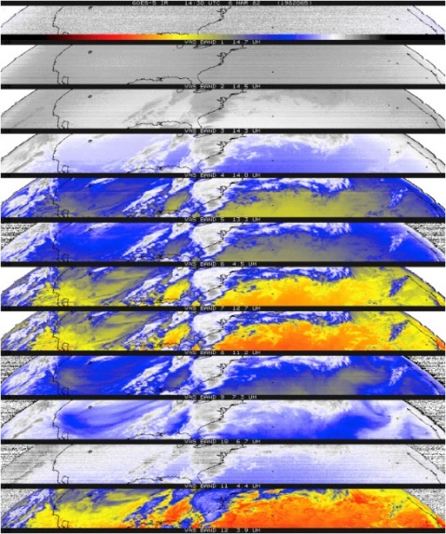
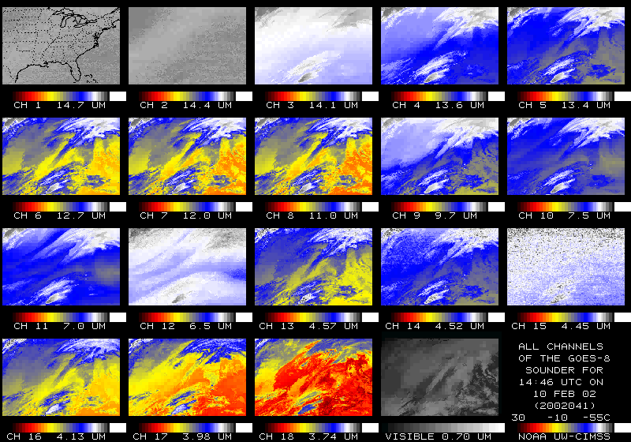
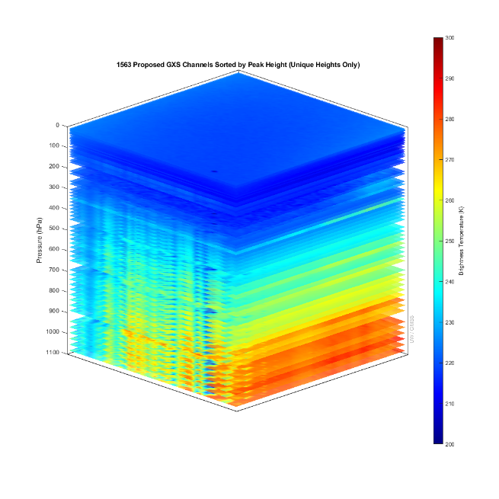
GXS: NOAA’s 1st HIR Sounder in GEO
Item | # IR bands | Sounding
First Experimental | 12 | GOES-4 VAS (1980)
First Operational | 18 | GOES-8 (1994)
100x improved | ~1500 | High-spectral IR (203X)
Consider NASA’s GIFTS (2000); built and ground-tested and shown to provide high quality high resolution spectra, but was not launched.
The GOES-R series included advanced imagers, the first geostationary lightning mapper and space weather instruments; high temporal and horizontal resolution, but NOT spectral resolution needed for sounding.
Notes:
T. Schmit AMS presentation in Boston.

Slide 11
Consider more frequent Northern Hemisphere scan
Swaths 1,2 and 3, then alternative for 4 and 5
Hence 20 min repeat over CONUS
Swaths 1 and 2 and then alternative for 3, 4 and 5
Meso-scale scans as well
Currently they are ABI-sized
1000 km x 1000 km
1
2
3
4
5

Slide 12
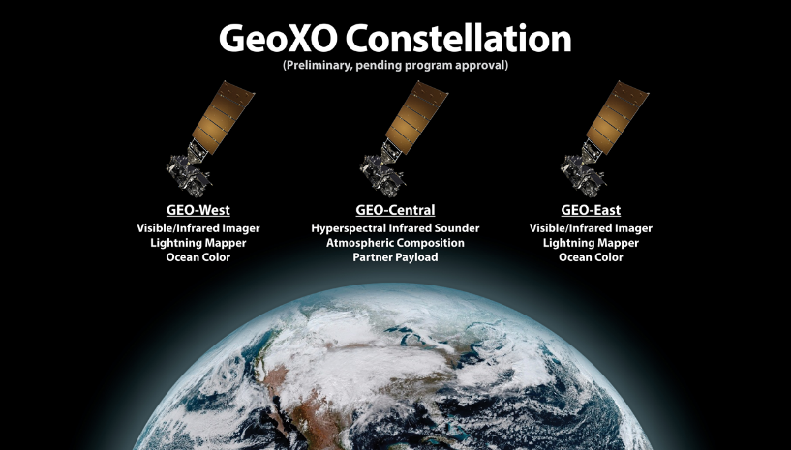
"For weather surveillance a geostationary hyperspectral infrared sounder would dramatically increase confidence in forecasts of hurricanes and other storms that originate over the ocean and head towards U.S. interests."
- Ken Graham, NWS Director (former NHC Director)

Slide 13
GWX Impact to Improve track and intensity forecasts
Improving tropical cyclone forecasts with high temporal/spectral IR observations.
Track & intensity forecasts for Typhoon Maria are most improved with 15 min data, the track (> 40%) and the intensity (18%).
Precipitation forecasts also improved.
Improved Typhoon Maria track forecasts (2018), based on observed geostationary high-spectral resolution infrared data. The red line indicate with 15 min data. https://agupubs.onlinelibrary.wiley.com/doi/10.1029/2021GL093672

