Slide 1
AirFuse A multi-pollutant fusion system
Shobha Kondragunta^{3,4}
Co-authors: Barron H. Henderson^{1,4} and Phil Dickerson^{1,4} Pawan Gupta^{2,4}, Yang Liu^{4,5}, Alqamah Sayeed, Hai Zhang^{3,4}, Janica Gordon⁵, Halil Cakir¹, Brett Gantt¹, Benjamin Wells¹, Marcus Proctor^{6,7}, Steven Proctor^{6,8}, Youngsun Jung⁹, and the HAQAST AirNow Teams⁴
¹US EPA Office of Air Quality Planning and Standards; ²National Aeronautics and Space Administration; ³National Oceanic and Atmospheric Administration / National Environmental Satellite, Data, and Information Service; ⁴NASA Health and Air Quality Applied Sciences Team and Tiger Teams; ⁵North Carolina Agricultural and Technical State University; ⁶AirNow Data Management Center; ⁷Tantus Technologies Inc.; ⁸GoldSystems Inc.; ⁹National Oceanic and Atmospheric Administration / National Weather Service
Disclaimer: The views expressed in this presentation are those of the authors and do not necessarily reflect the views or policies of the U.S. Environmental Protection Agency.

Slide 2
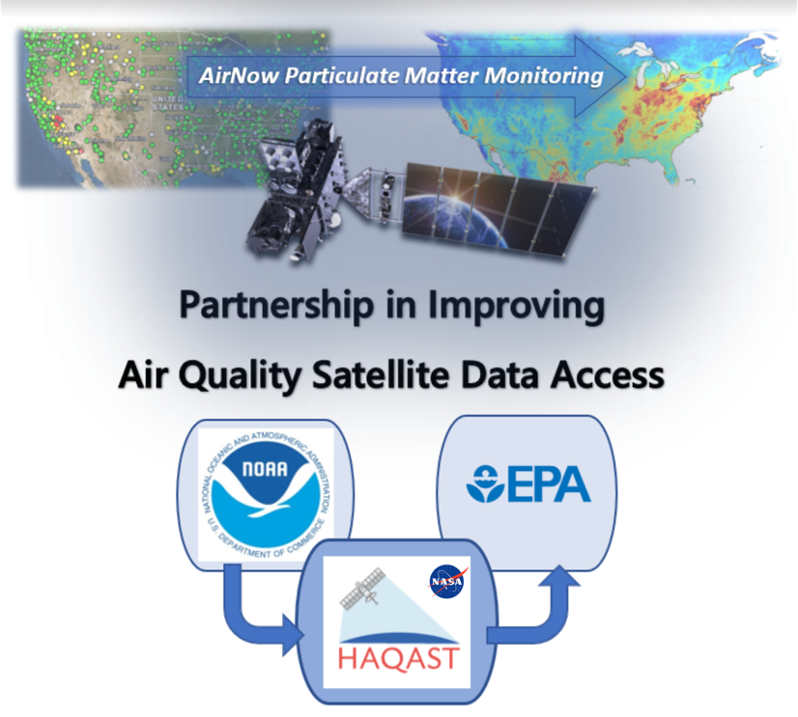
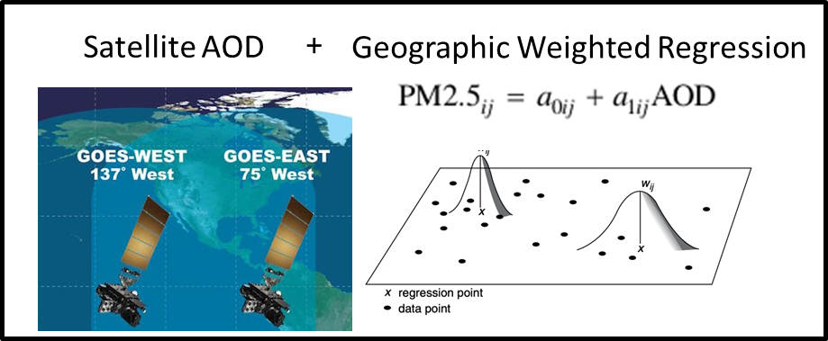
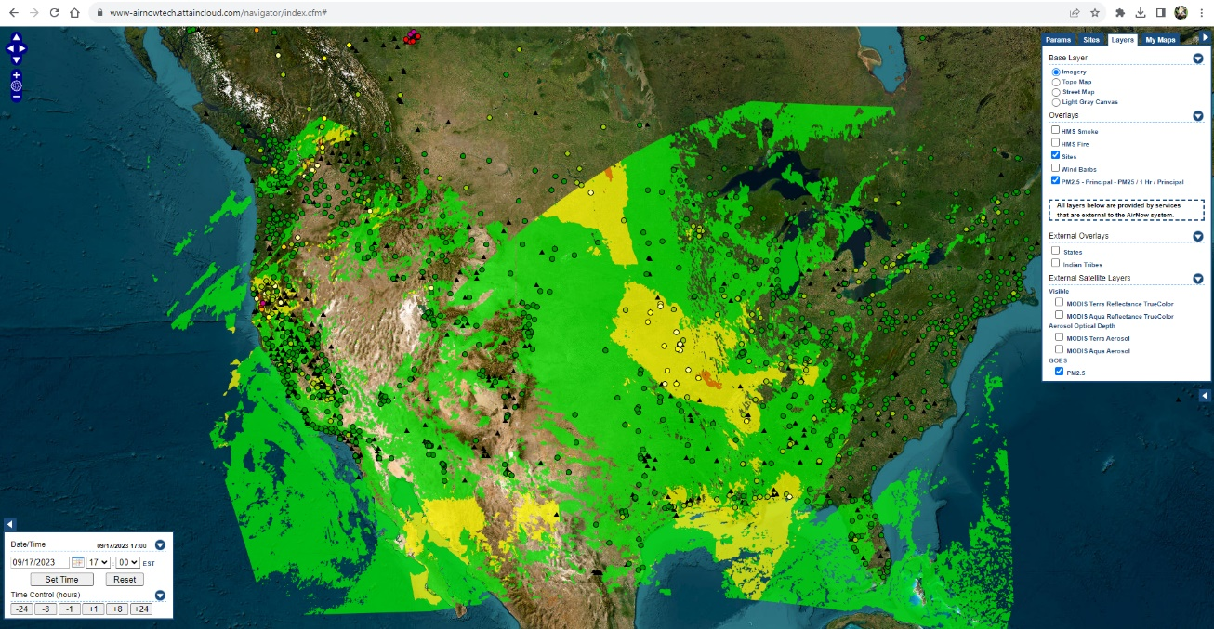
GOES-PM25
2024 Team led by Yang Liu
https://haqast.org/tiger-teams/#2021-tiger-teams
DNN Bias Correction
Sayeed et al: Deep Neural Network bias corrections.
O'Dell et al.: Public Health Benefits from Improved Identification of Severe Air Pollution Events with Geostationary Satellite Data, submitted to GeoHealth, 2023.
Zhang et al.: Nowcasting Applications of Geostationary Satellite Hourly Surface PM2.5 Data. Weather and Forecasting, 37(12), 2313-2329, 2022. doi: 10.1175/WAF-D-22-0114.1
Bratburd et al.: Air Quality Data When You Need It: Incorporating Satellite Data Updates into AirNow, EM Plus, 2022.
Zhang and Kondragunta.: Daily and Hourly Surface PM2.5 Estimation From Satellite AOD, Earth Space Sci, 8, doi: 10.1029/2020EA001599, 2021.
Hourly product with gaps
Notes:
Geostationary satellites are home bodies while polar satellites are globe trotters.
Geostationary Operational Environmental Satellites (GOES) stare at the US all day long.
Not like polar satellites passing once at 10am and once at 2pm (if you have two satellites)
From an US perspective, GOES satellites view the western US from the pacific and the eastern US from the atlantic.
Shobha Kondragunta and Hai Zhang fused with AirNow monitors by a geographic weighted regression.
Pawan led a tiger team to connect that data back to EPA.
There are a lot of technical details, but the upshot is simple.
We extensively evaluated the data, applied machine learning corrections, and we’re putting that data into various airnow systems like AirNowTech.
This is a great idea: federal agencies working together to provide tangible benefits to the American people from satellite data.
This project is taking that data a step further.
We’re going to bring the satellite data

Slide 3
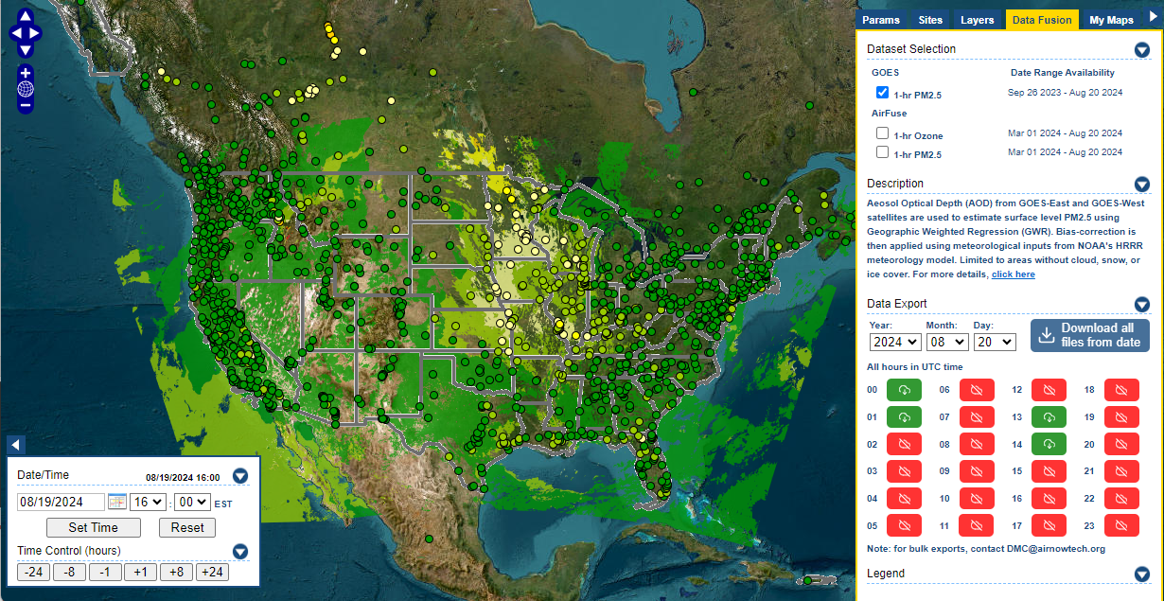
GOES-PM25 in https://airnowtech.org/
Login
Choose Navigator
Choose Data Fusion tab.
Select the GOES Layer
Green/Red indicates hour availablility
Thanks AirNow team!

Slide 4
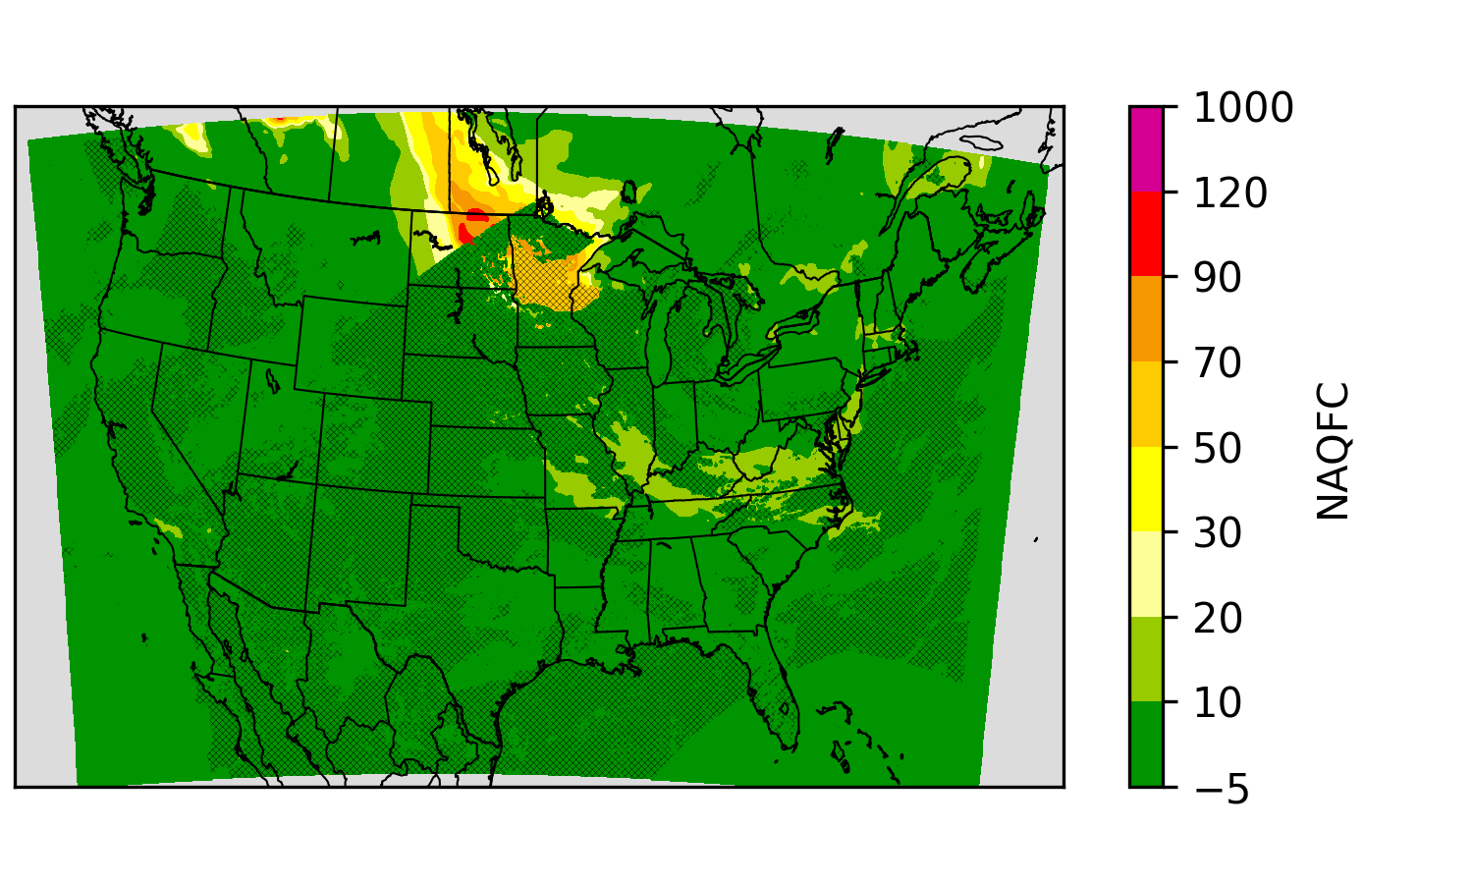
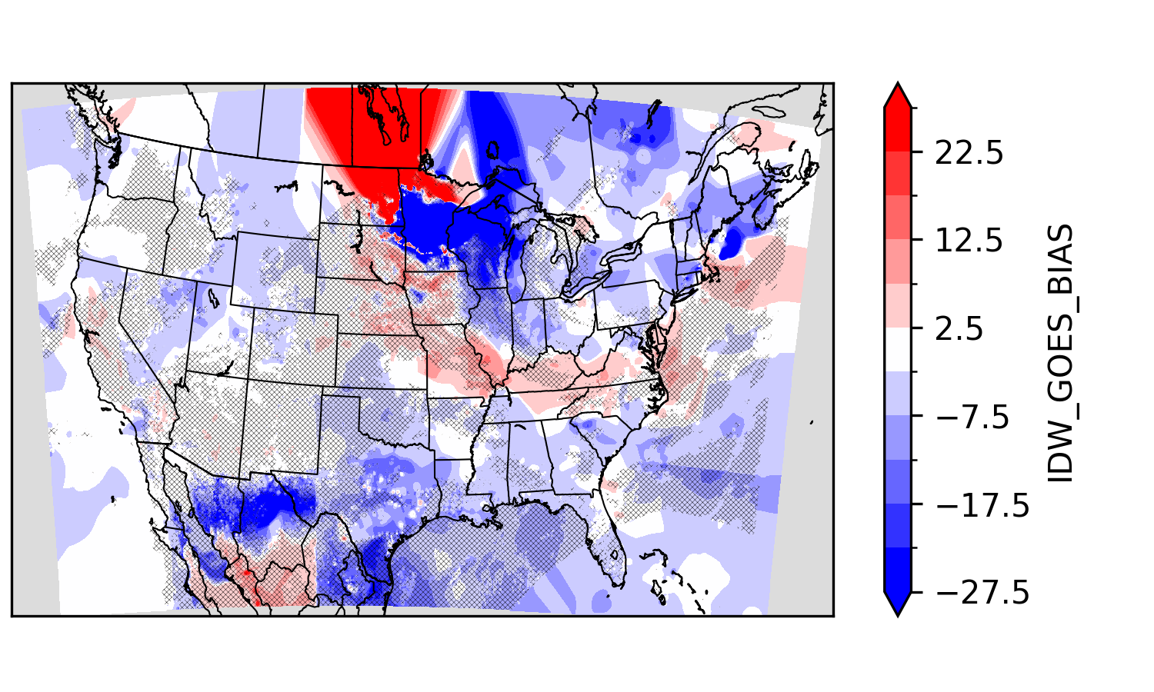
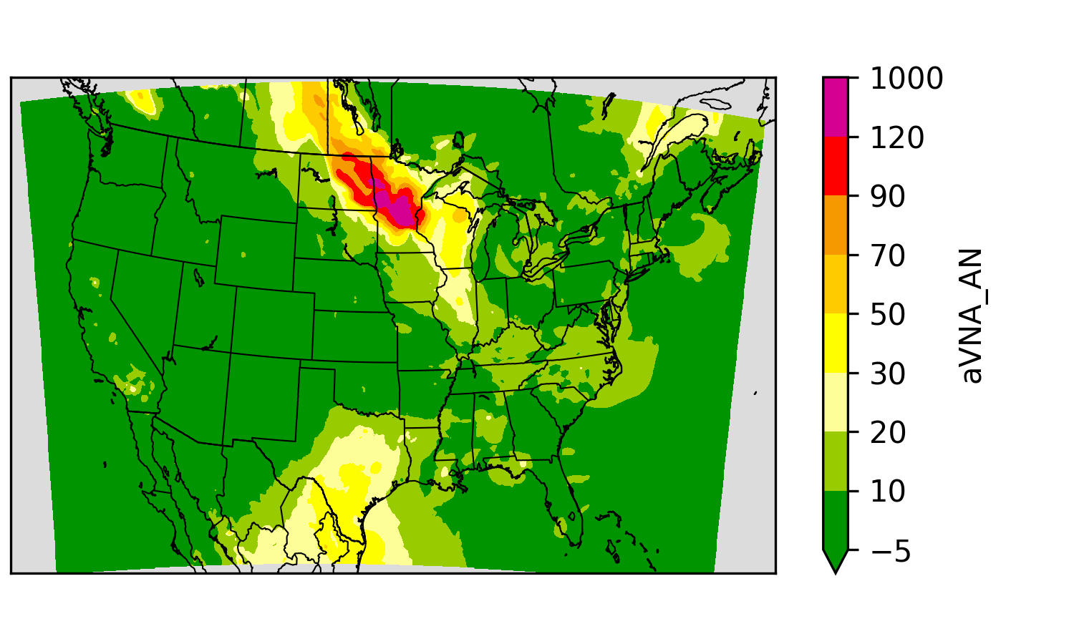
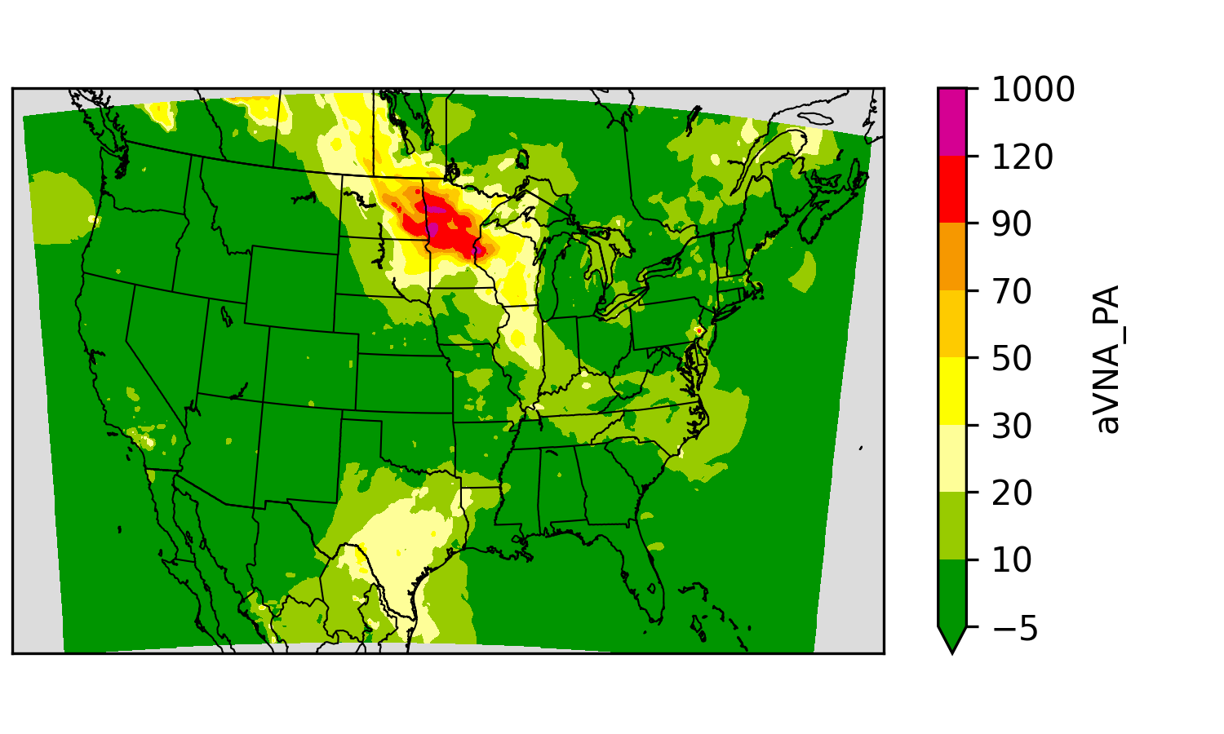
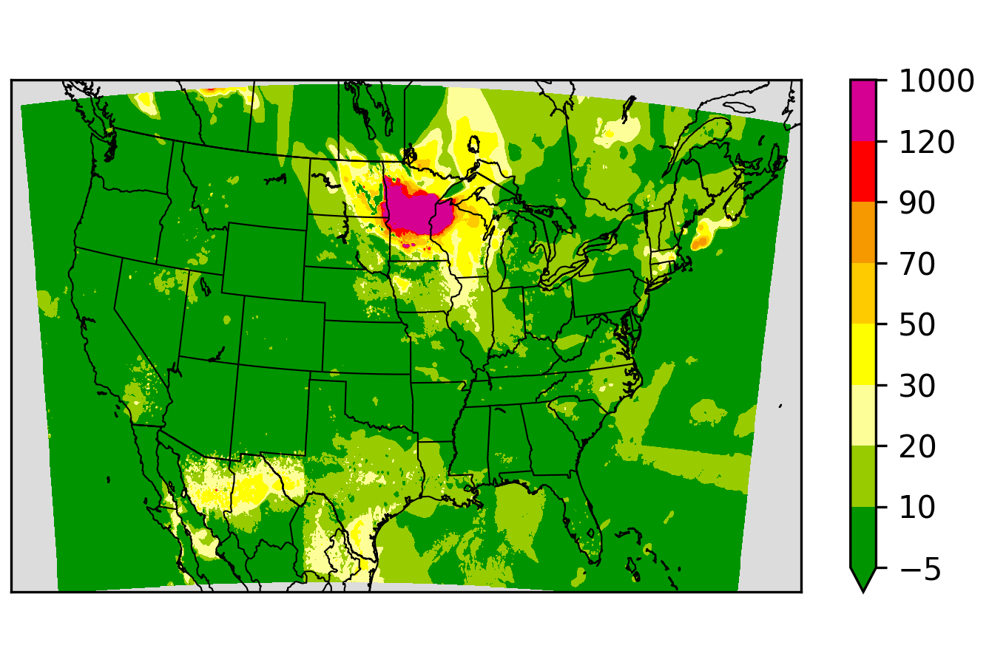
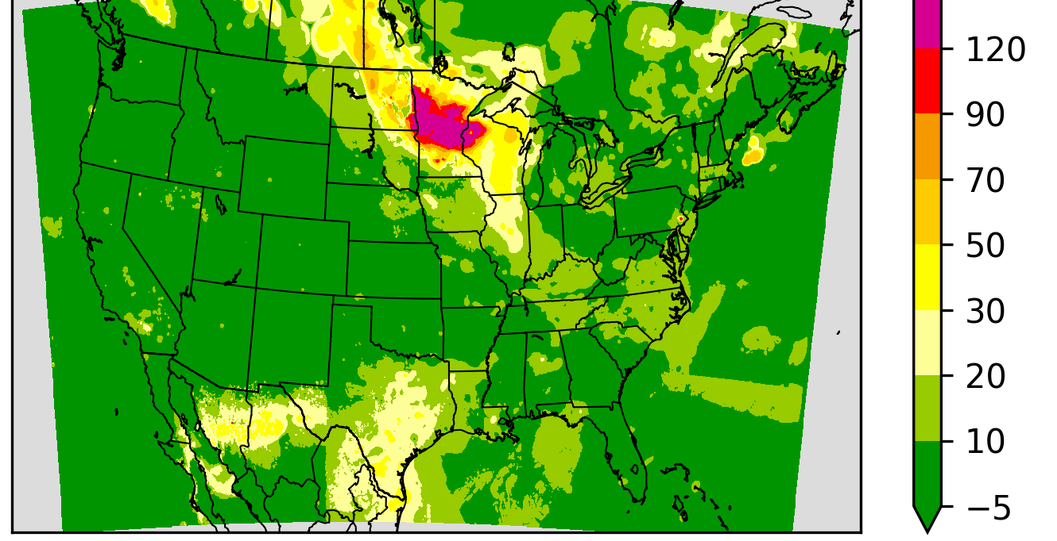
AirFuse: Bias Correction Ensemble
Layer “correct” the NOAA forecast (NAQFC) by interpolating bias
One layer from AirNow monitor (Y_{A}) observations:
Regulatory grade hourly observations paired with collocated grid cell.
Voronoi interpolation to account for network spatial structure.
One layer from PurpleAir (Y_{P}) observations:
Low-cost sensors corrected (Barkjohn 2021) then averaged in grid cells.
Voronoi interpolation to account for network spatial structure.
One layer from GOES-PM25 (Y_{G}) “observations”
GOES-R AOD regression with machine learning correction.
Not clustered like monitors, so simple inverse distance interpolation.
Layer weights (a, p, g) a function of distance to obs and uncertainty.
NAQFC & GOES
Hatches: GOES-PM
GOES-PM Bias
Y_{A}
Y_{P}
Y_{G}
Final Fused
Y_{A} = f(mod, AirNow)
Y_{P} = f(mod, PurpleAir)
Y_{G} = f(mod, GOES-PM)
aY_{A} + pY_{P} + gY_{G}
Notes:
Hatches: GEOS

Slide 5
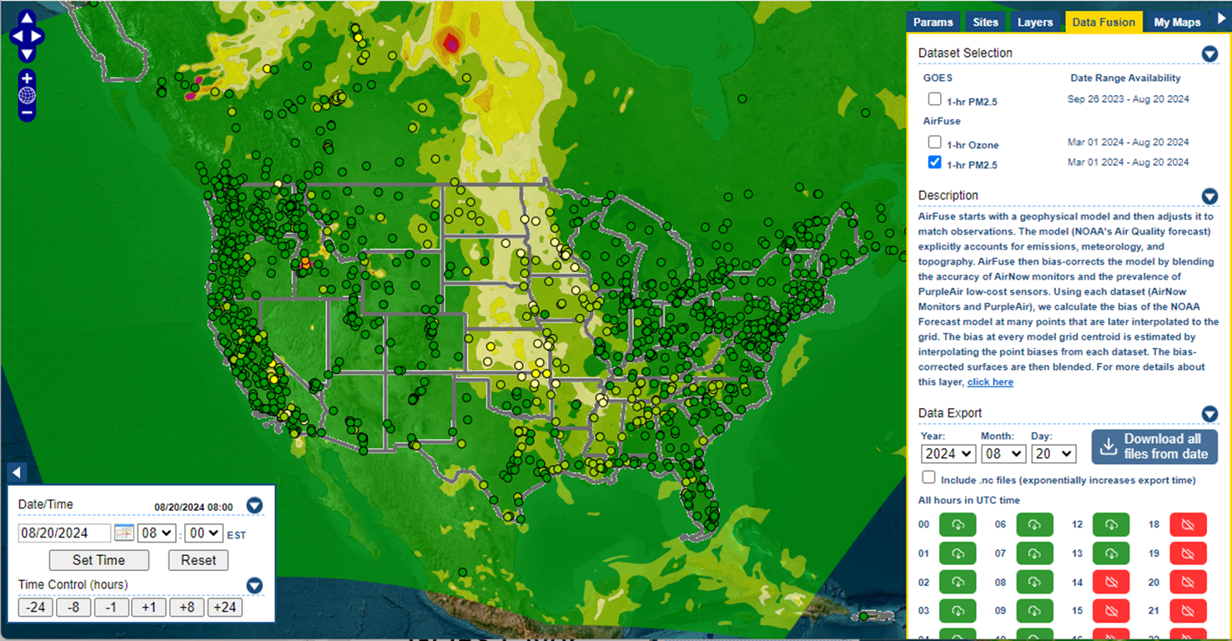
AirFuse in https://airnowtech.org/
Currently includes AirNow and PurpleAir
PM25:
Currently uses NAQFC, AirNow and PurpleAir only
GOES-PM25 incorporation in AirFuse still under testing
Ozone:
Currently uses NAQFC and AirNow only
Thanks AirNow team!

