Slide 1

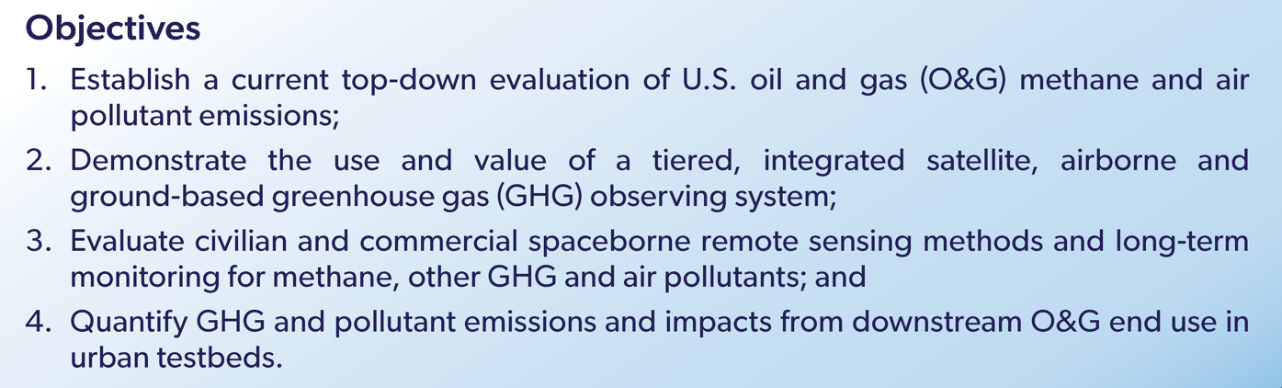


AiRMAPS
Airborne and Remote Sensing Methane and Air Pollutant Surveys
https://csl.noaa.gov/projects/airmaps/
NOAA Office of Atmospheric Research (OAR)
  Chemical Sciences Laboratory (CSL): Steven Brown, Brian McDonald, Carsten Warneke, Sunil Baidar
  Air Resources Laboratory (ARL): Xinrong Ren, Winston Luke
  Global Monitoring Laboratory (GML): Colm Sweeney, Arlyn Andrews, Jeff Peischl
  Climate Program Office (CPO): Monika Kopacz, Annarita Mariotti
NOAA National Environmental Satellite, Data and Information Service (NESDIS)
  Center for Satellite Applications and Research (STAR): Shobha Kondragunta
  National Centers for Environmental Invormation (NCEI): Jeff Privette

Slide 2
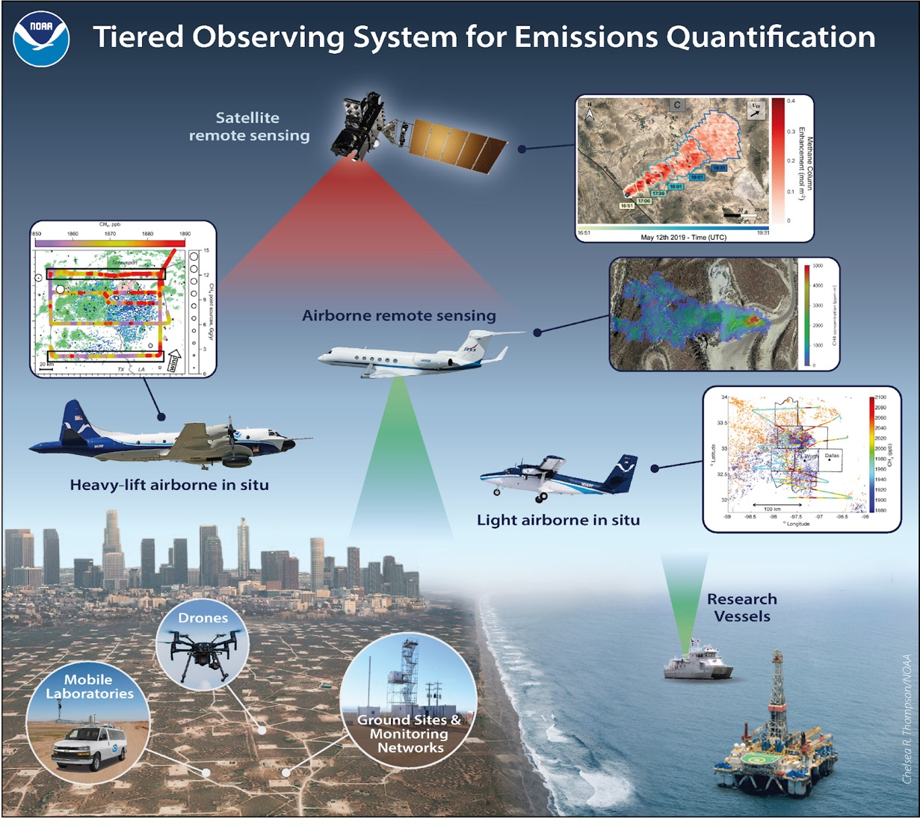









NOAA OAR (CSL, ARL, GML, CPO): 3-5 year deployments of Twin Otter and P-3 aircraft
NOAA NESDIS: Partner with airborne observations to augment and validate satellite based air quality (UV-VIS) and GHG (SWIR) instruments
Partners: NOAA intends to execute this strategy in collaboration with other agencies and stakeholders
State agencies
Academic partners
Industry

Slide 3




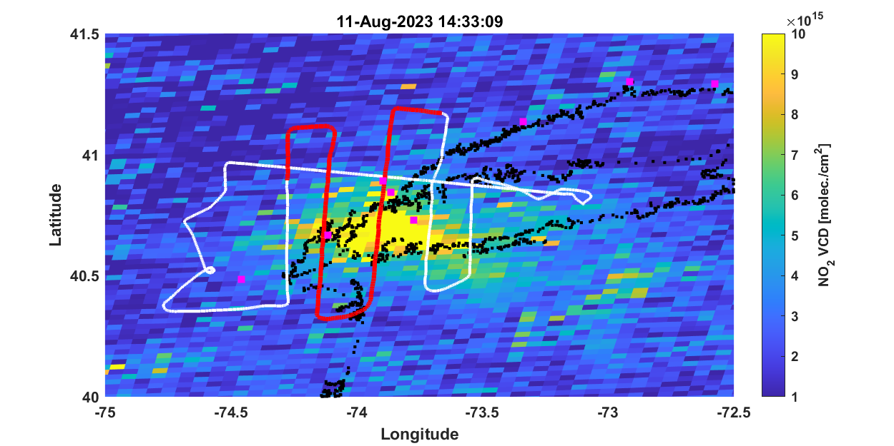
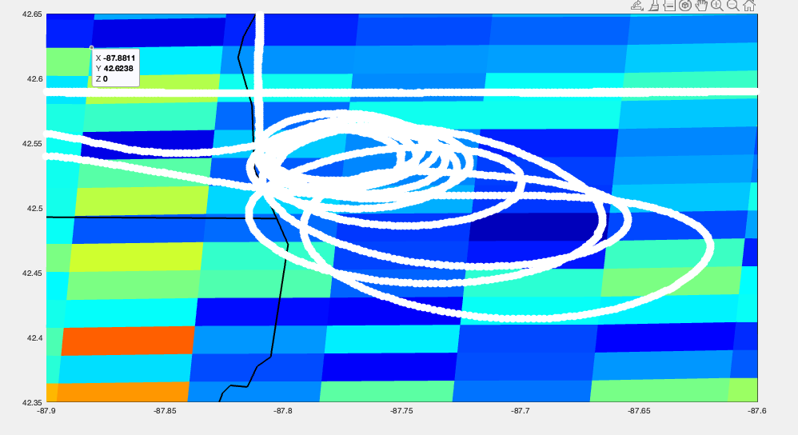
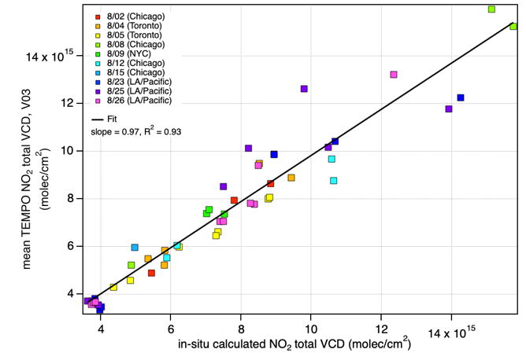
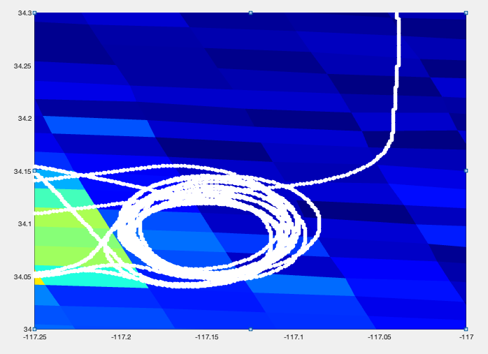
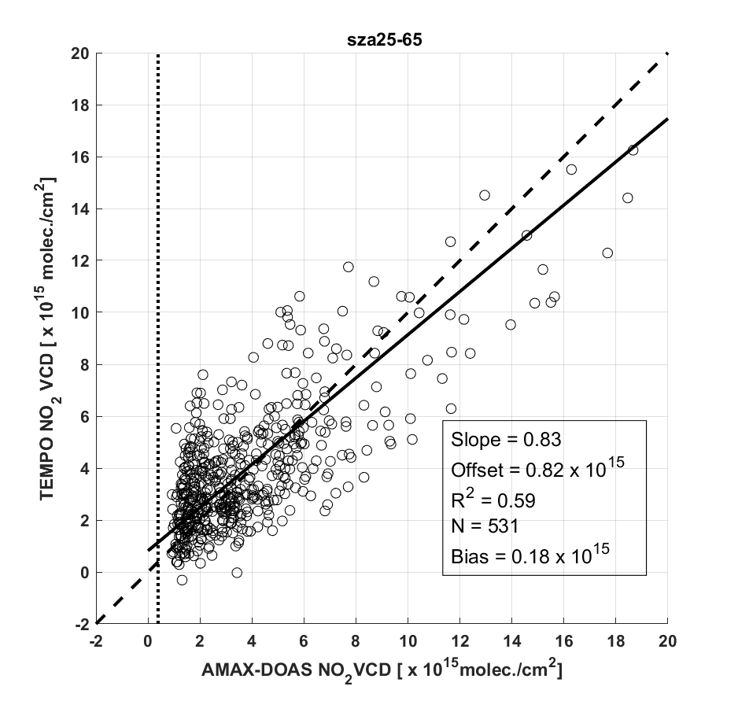
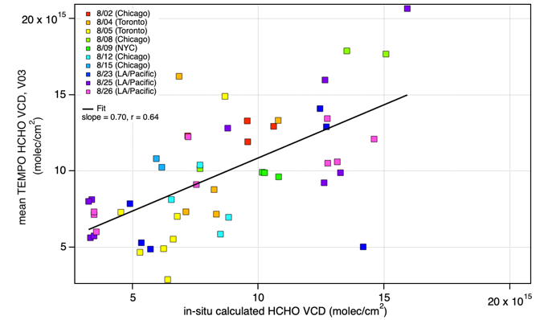
Satellite – Aircraft Comparisons: 2023 AGES+ Campaigns
CUPiDS
NOAA Twin Otter
New York City
AEROMMA – NASA DC-8
New York, Chicago, LA
Spirals and TEMPO pixels VCD comparison
Lake Michigan. 8/02
NO₂
Slope 0.97
R² 0.93
San Bernadino, 8/23
HCHO
Slope 0.70
R² 0.64
Rainer Volkamer
Sunil Baidar
Eleanor Waxman, Drew Rollins, Glenn Wolfe

Slide 4


AiRMAPS Airborne Surveys & Schedule
2024
Oil & Gas: Denver Julesburg Basin, CO; Uinta Basin, UT
Urban: Denver, CO; Salt Lake City, UT
2025
Oil & Gas: Marcellus
Urban: Baltimore – DC
2026
Oil & Gas: TX, OK, LA, AR, Gulf of Mexico
Urban: Dallas, Houston

Slide 5
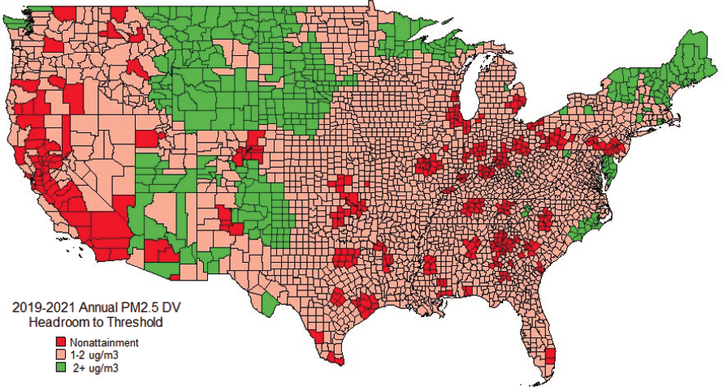
AiRMAPS 2028: Southwest U.S. & PM_{2.5}
Hallar et al., BAMS 2021
Winter 2028
Spring / Summer 2026
Stella Environ. Mag. 2023
Counties in non-attainment with new 9 µg m⁻³ annual PM standard
High winter season PM in western U.S.
Heavy lift aircraft envisioned for deployment early in 2028
Discussions ongoing at this time with partner agencies
Focus on both urban air quality and GHG emissions

Slide 6
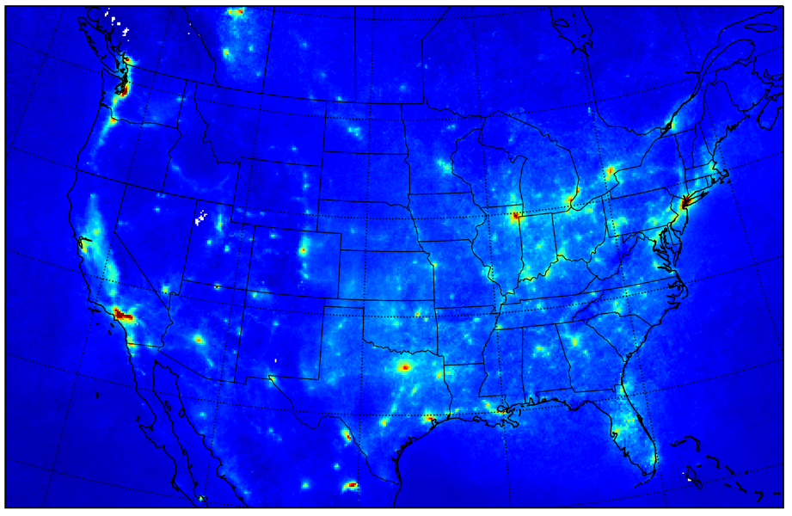
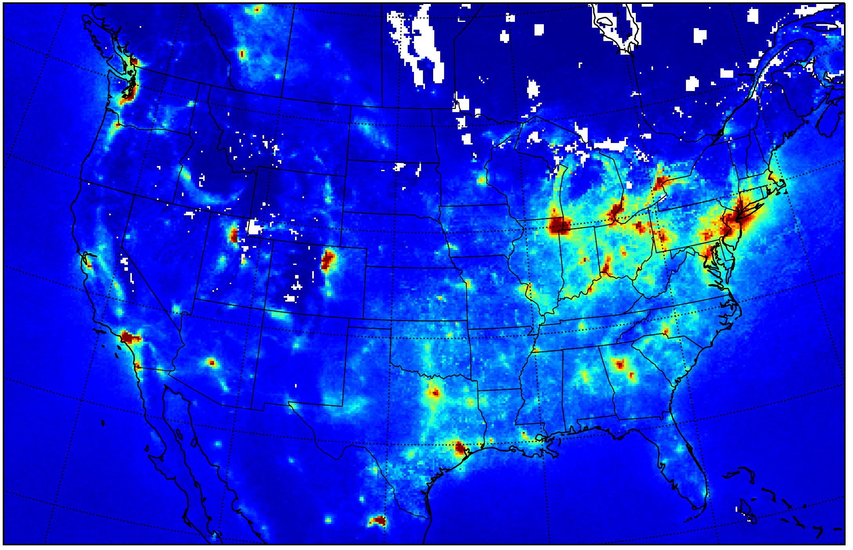

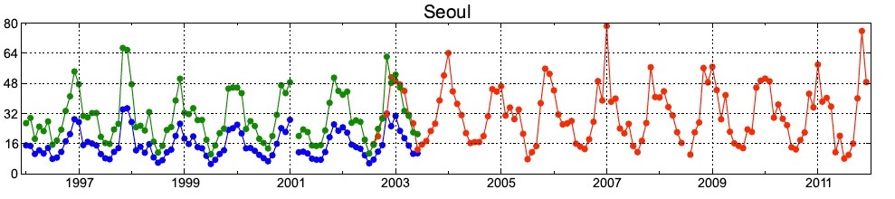
Seasonality in Remote Sensing NO₂ Columns
July 2018
March 2019
Well-known seasonal cycle in satellite NO₂ columns (factor of ~3)
Differences in chemical lifetimes, oxidation mechanism, boundary layer dynamics
Limited suborbital validation work in the winter season (e.g., DISCOVER 2013)
Hilboll ACP 2013

