Slide 1

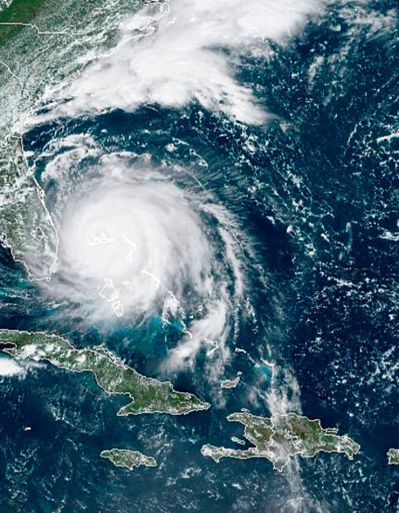


GeoXO Program Update
October 8, 2024
Air Symposium, College Park MD
NOAA
National Environmental Satellite, Data, and Information Service
Pam Sullivan, Director of GEO Observations

Slide 2

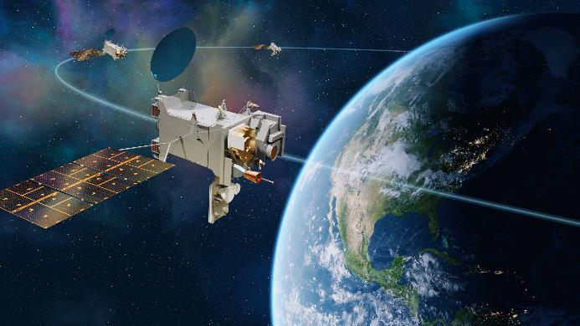
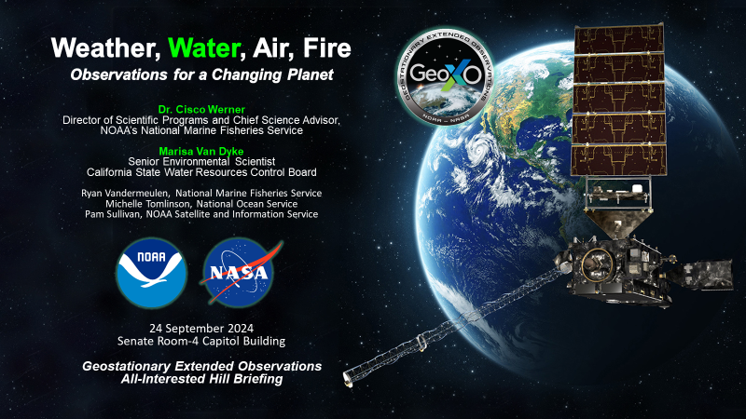
GeoXO Recent Progress
Implementation developers selected:
Ocean Color instrument announced May 2024: BAE
Spacecraft announced June 2024: Lockheed Martin
Lightning Mapper announced Sep 2024: Lockheed Martin
System Requirements/System Definition Review (SRR/SDR) completed for Sounder (July 2024)
OCX, ACX, and Spacecraft SRR/SDRs upcoming in Oct/Nov
Preparing for Program Mission Definition Review Dec 2024
KDP-B planned in February 2025
User engagement, advocacy, readiness activities underway
Weather, Water, Air, and Fire Symposiums – 3Q/4Q CY24
Congressional staff briefing on Water (ie OCX applications) Sep 2024; staff briefing on Air planned in late Oct (tbc)
Quarterly constituents briefings – next on Oct 30th
Lockheed concept of GeoXO spacecraft and constellation

Slide 3

GeoXO Budget Update
Program FY24 funding was below baseline funding profile; expectation is FY25 will also be low:
FY24 enacted budget ($285M vs MS2 baseline $417M)
FY25 began with a Continuing Resolution (limiting program to $285M); program directed to plan to Senate ‘mark’ of $625M (vs President’s Budget $798M)
Program is replanning work to meet lower FY24/25 funding:
Work on instruments/satellites with later launch dates (2035+) is being deferred:
Most Sounder and ACX instrument work being deferred
Work on 3rd/4th Imager, LM, and OC instruments, and 4th/5th/6th Spacecraft being deferred
No impact to launch dates is expected at FY25 @ $625M level, but costs will increase due to deferrals
Action Plan for FY25:
Make as much forward progress on program as possible
Communicate funding needs and impacts if budget not received
Develop plans in response to various potential budget scenarios
Continue to study, document, and distribute societal and economic value assessments
Continue to build awareness and advocacy with users, public, and stakeholders through briefings, workshops, news releases, social media, etc.
3

Slide 4
Key Near Term Milestones
Element | Actual/Target Announcement | Actual/Target Kickoff | Actual/Target SRR/SDR
GXI | √Mar 2023 | √Apr 2023 | √Aug 2023
GXS | √Sep 2023 | √Mar 2024 | √Jul 2024
LMX | √Sep 2024 | Oct 2024 (tbc) | Mar 2025 (tbc)
OCX | √May 2024 | √Aug 2024 | Oct/Nov 2024
ACX | √May 2024 | √Aug 2024 | Oct/Nov 2024
Spacecraft | √Jun 2024 | √Aug 2024 | Nov 2024
MDR/KDP-B Event | Target Date
MDR Dry Run | Oct 22-23 (revised)
MDR Review Readiness | Nov 8
MDR Dress Rehearsal | Nov 19-21 (revised)
MDR Charts to SRB | Dec 2
MDR Review | Dec 10-12
KDP-B DPMC, APMC | Feb 13, Feb 19

Slide 5
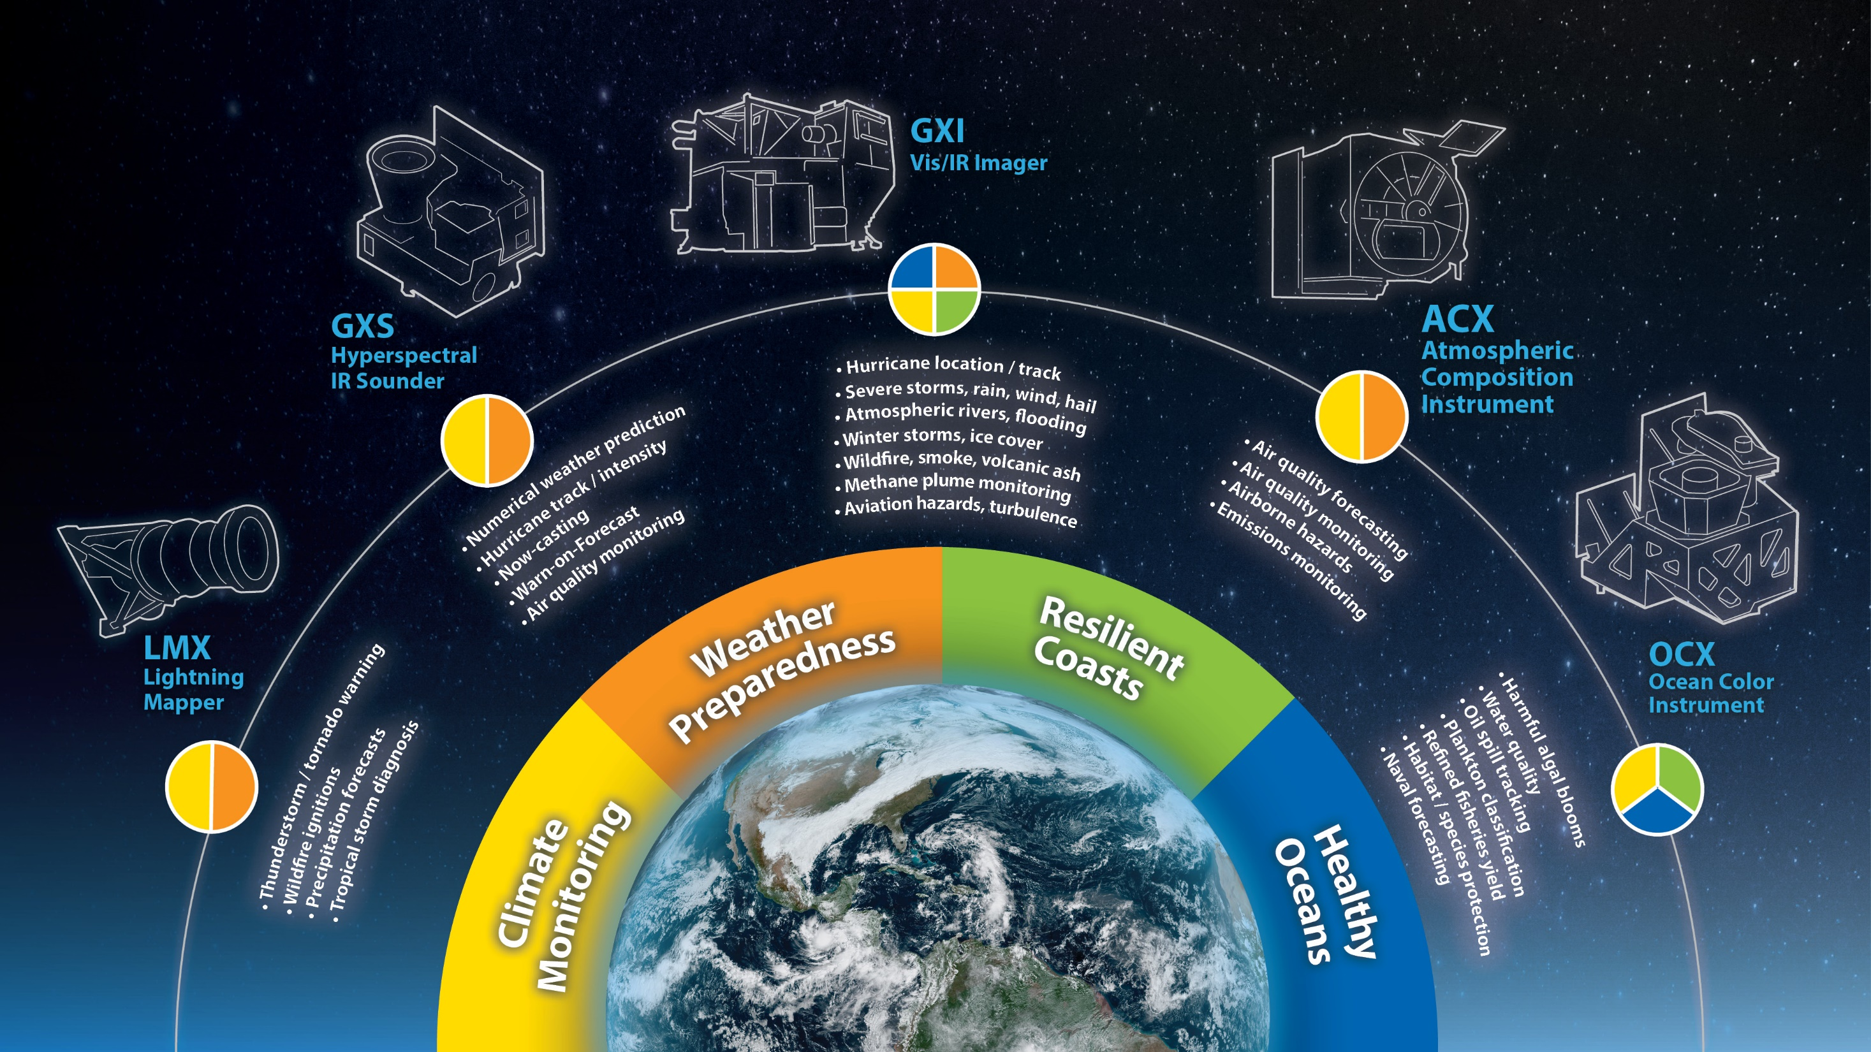
GeoXO Observations
To be developed by L3Harris
To be developed by BAE Systems
To be developed by BAE Systems
To be developed by BAE Systems
To be developed by Lockheed

Slide 6
GeoXO Instrument Performance
Performance | Imager (GXI) | Lightning Mapper (LMX) | Hyperspectral Sounder (GXS) | Atmospheric Composition (ACX) | Ocean Color (OCX)
Spectral | 18 Vis/IR channels 0.47 to 13.3um | Single channel (ozone spectral line) | Hyperspectral IR 4.4-5.9 & 9.1-14.7um | Hyperspectral UV/Vis 300-500 & 540-740nm | Hyperspectral Vis/NIR 350-1020nm
Temporal | 10min full disk 5min CONUS 30sec meso (x2) | >800Hz full disk | 30min full disk | 60min CONUS | 2hr EEZ revisit
Nadir Spatial Resolution | Vis: 250, 500m IR: 1, 2km | 5.85km | 4km | 5km | 300m
Coverage Area (specification shown, actual coverage may be greater) | Full disk from 75W + 137W | Full disk from 75W + 137W | Full disk from Central 105W | Extended CONUS | US Exclusive Economic Zones (EEZs)

Slide 7
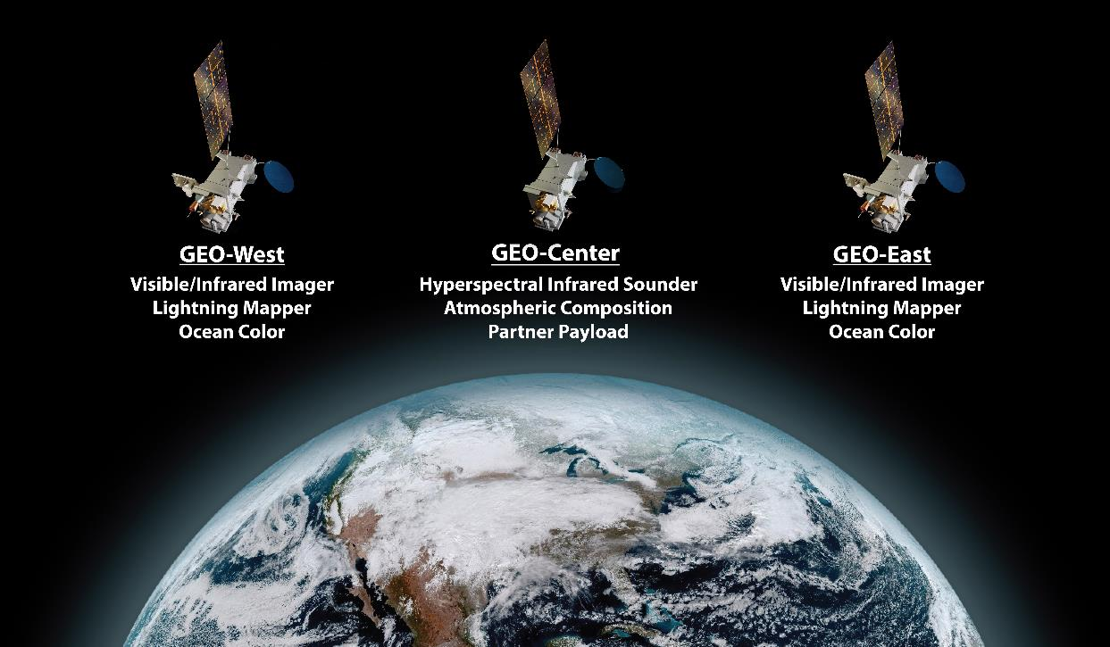
G
GeoXO Constellation
Updated graphic using Lockheed Martin Spacecraft concept
Notes:
Main Message: We are currently defining and designing the satellite systems that will be operating beyond 2050. Beyond the current generation we also have major milestones for our next generation infrastructure and instrumentation. We are planning our Geo-XO mission with multi-instrument synergy for atmospheric composition observations.
Our next generation GEO missions will have expanded capabilities. We will continue and improve our core weather and climate observations while also expanding to provide additional observations to support air quality, resilient coasts and a healthy ocean.
Our next-generation geostationary program, GeoXO, will follow the GOES-R Series. In December 2022, the GeoXO Program reached DOC Milestone 2, securing the DOC commitment to the proposed architecture, which includes (5) instruments. Two are legacy instruments: an imager and lightning mapper, but the other three show how GeoXO will be our first all-NOAA geostationary satellite, adding observations for ocean color, atmospheric composition and hyperspectral IR sounding. This all NOAA mission is a recognition that we must observe and understand the earth as a whole, and not only as distinct separate processes.

Slide 8

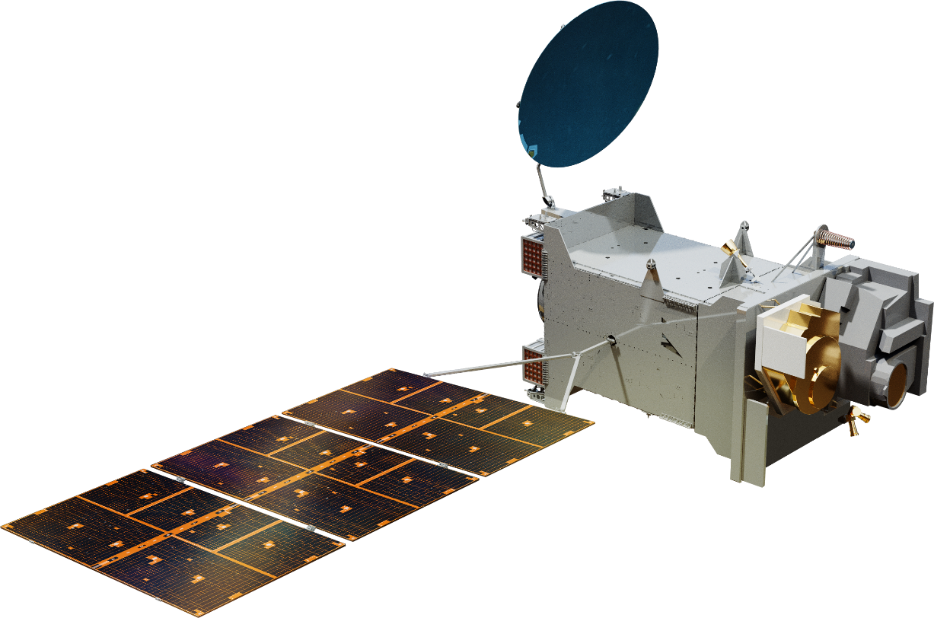
More GeoXO Spacecraft Graphics
GeoI Spacecraft
GeoS Spacecraft

Slide 9
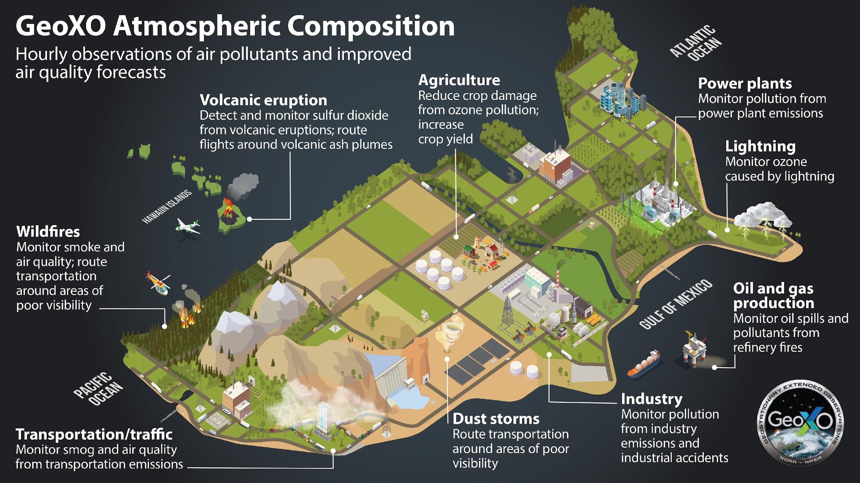
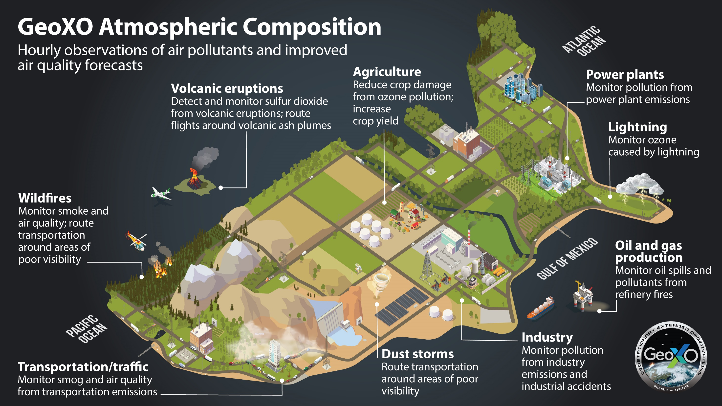

Slide 10
GeoXO Timeline
User Reqts
Working
Group
Convened
NOAA
Endorses
Observation
Set
GeoXO-I1
Launch
We are here
Form.
Auth.
KDP
A
KDP
dA
Contract
Awards
KDP
B
KDP
C
KDP
D
KDP
E
MCR
SRR
MDR
PDR
CDR
SIR
ORR
FY20 | FY21 | FY22 | FY23 | FY24 | FY25 | FY26 | FY27 | FY28 | FY29 | FY30 | FY31 | FY32 | FY33
MS0
MS1
MS2/3
(DOC Baseline)
Congressional Baseline
(Tentative)
Ops
Pre-formulation
Formulation
Implementation
Implementation contracts:
Imager: L3Harris
Sounder: BAE Systems
Atmo. Comp.: BAE Systems
Ocean Color: BAE Systems
Spacecraft: Lockheed Martin
Lightning Mapper: Lockheed Martin

