Slide 1
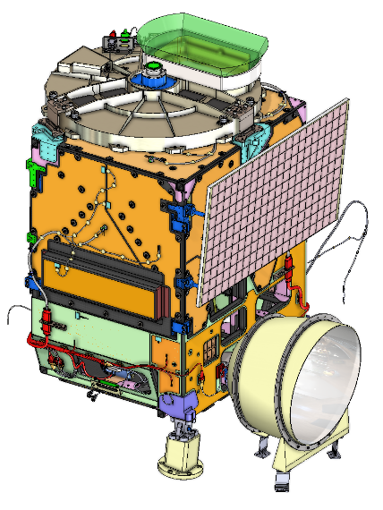

The GeoXO Atmospheric Composition instrument (ACX) performance
GeoXO ACX instrument team:
Joanna Joiner, NASA GSFC, ACX Instrument Scientist, GeoXO flight project scientist
Dennis Nicks, BAE systems, Space & Mission Systems, TEMPO, GEMS, ACX architect
Shobha Kondragunta, NOAA/NESDIS STAR, ACX Product Scientist
Greg Frost, NOAA/OAR/CSL, ACX User Scientist
Larry Flynn, NOAA/NESDIS STAR, ACX Calibration Scientist
Sergey Krimchansky, NASA GSFC, ACX Instrument Manager, GeoXO Instrument Systems Manager
Paul Markie, NASA GSFC, ACX Deputy Instrument Manager
Eric Roback, NASA LaRC, ACX Instrument Systems Engineer
Ruth Cholvibul, Orbital Sciences Corporation, Systems Engineer
Dan Lindsey, NOAA/NESDIS, GeoXO deputy project & program scientist, GOES-R program scientist, GXI instrument scientist
And many others in the GeoXO Program and Flight Project and BAE systems including
Andrew Heidinger, Pam Sullivan, Candace Carlisle, Monica Todirita, Chris Wheeler, Alexander Krimchansky, Monica Coakley…

Slide 2
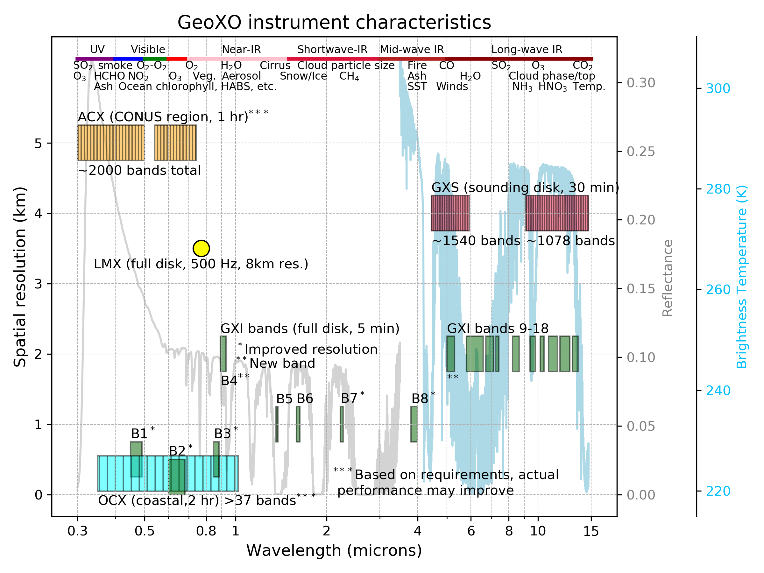
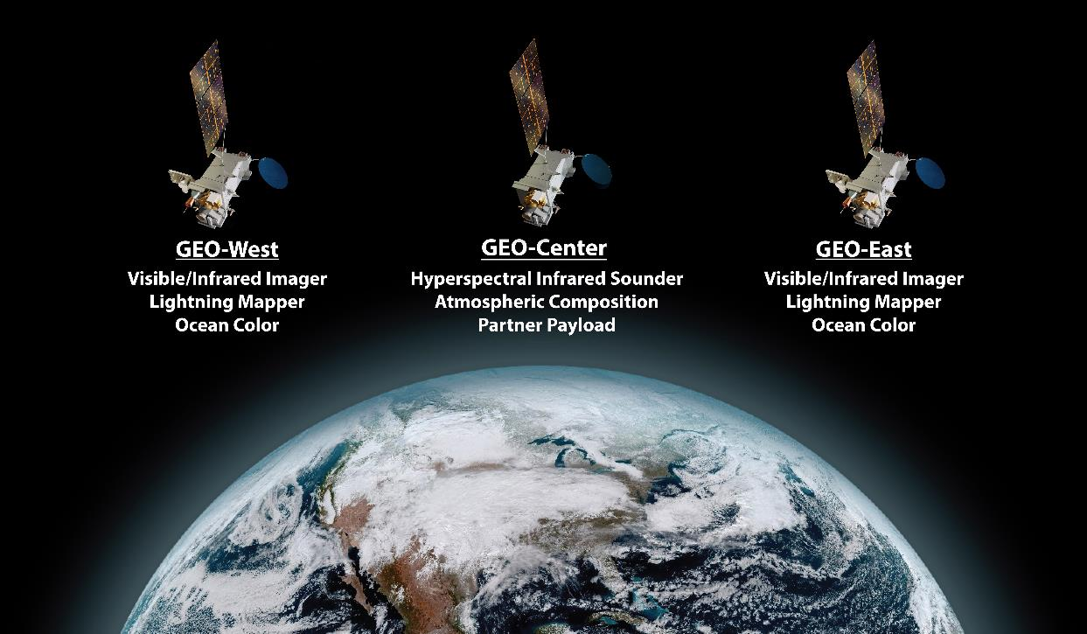
ACX works together with other GeoXO sensors to provide an enhanced composition observatory
GeoXO sensors measure complementary species (e.g., CO and isoprene from sounder and CH₄ leaks from imager); Species like ozone can be measured with multiple sensors to enhance vertical resolution.
GeoXO Constellation
Notes:
Just providing some overall context here, where ACX fits in with other sensors – not the only one doing atmospheric composition.

Slide 3
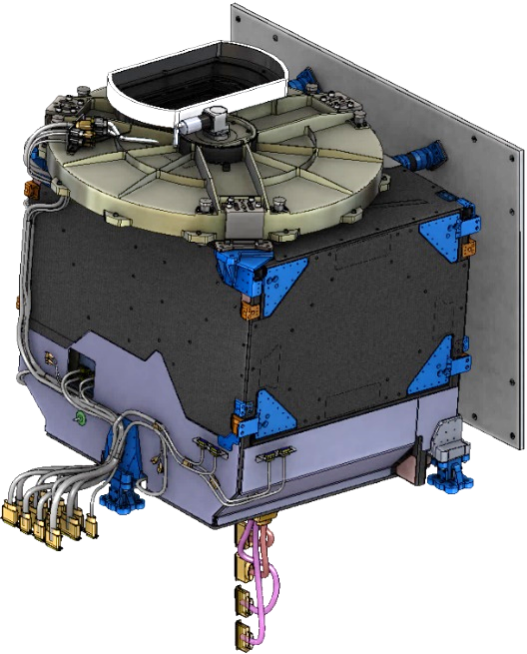
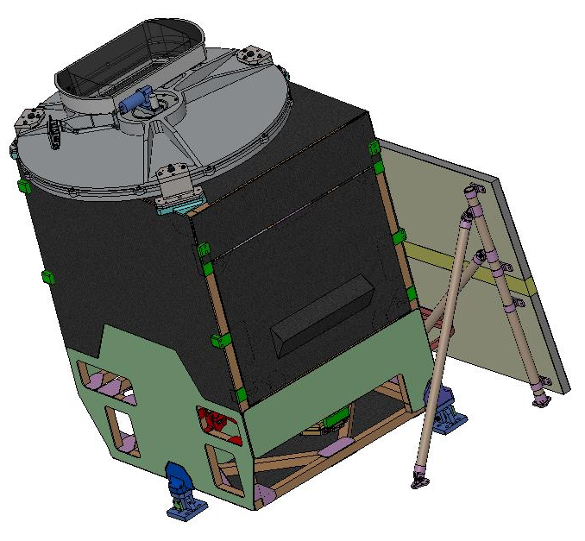
Comparison of instruments
Korean GEMS and NASA TEMPO were first GEO UV/Vis spectrometers
Parameters | GEMS | TEMPO | ACX
Mass | 145 kg | 137 kg | 157 kg (CBE)
Volume (x,y,z) meters | 1.0 x 1.1 x 0.87 | 1.4 x 1.1 x 1.2 | 1.4 x 1.1 x 1.2
Average Operational Power | 155 W | 139 W | 145.3 W (CBE)
Field of Regard | 7.8° N/S x 11.2° E/W | 4.76° N/S x 8.95° E/W | 4.76° N/S x 8.95° E/W
Ground Sample Distance | 6 km x 8 km (N/S x E/W) | 2.2 km x 5 km (N/S x E/W) | 2.2 km x 5 km (N/S x E/W)
Spectral Range | 300-500 nm | 290-490 nm, 540-740 nm | 300-500 nm, 540 – 740 nm
Spectral Bandwidth | 0.6 nm | 0.6 nm | 0.6 nm
Status | 2/2020 launch / 128° E | 4/2023 launch / 91° W | In development
All above parameters for ACX meet ACX requirements
Notes:
Here you could point out some of the obvious visual differences - the ACX thermal system incorporates a Winston cone that was not use on TEMPO and GEMS. ACX structure and optics are the same, leading to similar spectral and spatial performance as TEMPO.

Slide 4
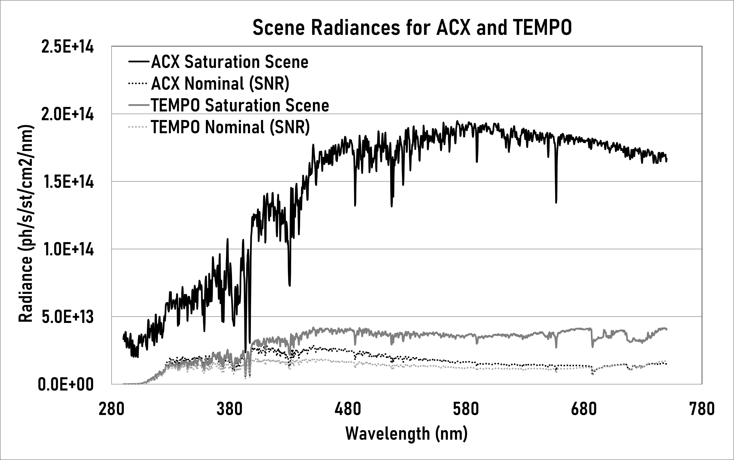
Modernized focal plane subsystem provides improved performance
ACX will use a digital CMOS focal plane
  3k x 3k
  nominal frame rate ~30 Hz to meet ACX’s more strict dynamic range requirement (right) (TEMPO was 9 Hz)
  Lower noise than CCDs
  programmable gain stages

Slide 5
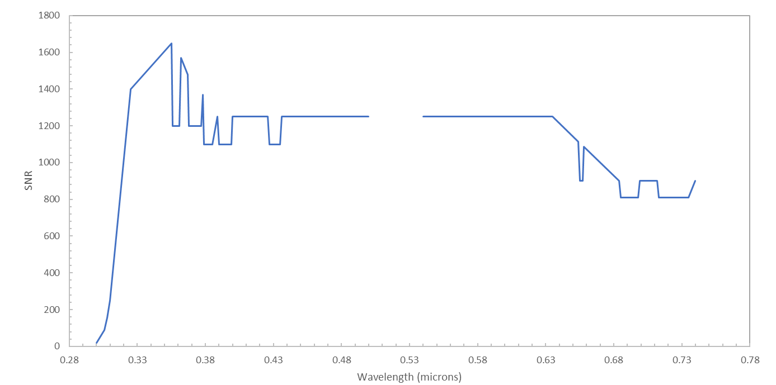
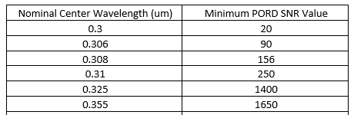
ACX SNR requirement
Relief given in Phase A for deep solar lines and telluric absorption features and in short UV
Notes:
If asked, current best estimate is that ACX will meet SNR requirements

Slide 6
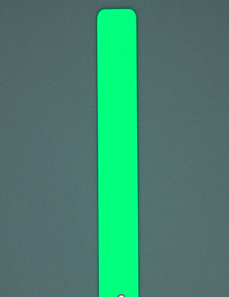
Improved slit for spectral bandpass
New silicon slit width variability is much improved over TEMPO (better than +/-0.5μm)
55 μm, example slit
TEMPO:
52 μm
Slit variability (~4μm) caused non-compliance in spectral bandpass in TEMPO (ACX expected to meet requirements)

Slide 7
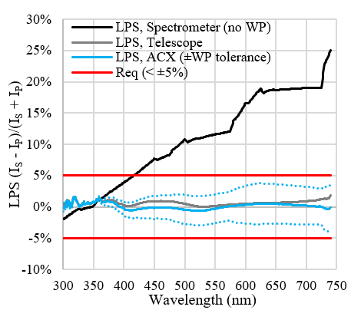
More stringent polarization requirement than TEMPO
ACX requirement, linear polarization sensitivity (LPS) <5% at all measured wavelengths (TEMPO was <20% for 540-740nm)
Acromatic waveplate WP) design to meet requirement

Slide 8
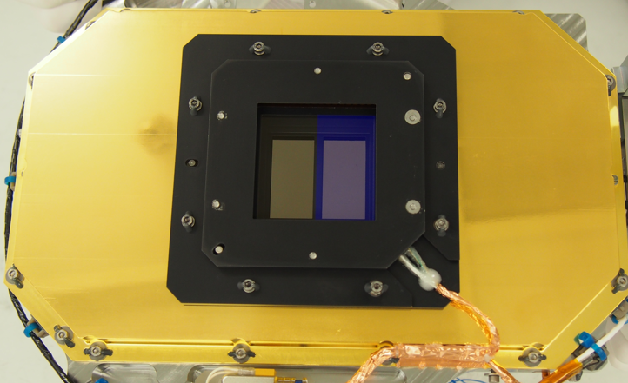
Improvements in stray light performance
ACX incorporates a short-pass filter over UV channel (not in TEMPO design)
Will use updated stray light model for additional mitigation
ACX to incorporate short-pass filter over UV channel
order-sorting long-pass filter
TEMPO FPA

Slide 9
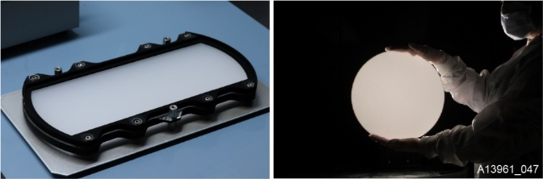
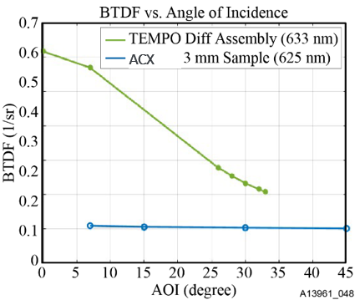
Updated solar calibration diffuser
New ACX diffuser material has more uniform bi-directional transmission distribution function (BTDF) over large angles
UV exposure testing will be done to validate on-orbit life
Angle of Incidence (degrees)

Slide 10
Summary
ACX has high heritage built on success of GEMS and TEMPO
Currently in implementation phase
Improvements over current sensors include
  Modernized focal plane subsystem (new 3k x 3k digital CMOS focal plane to mitigate saturation, etc.)
  Improved optical performance (new silicon slit, filter to reduce stray light, waveplate to reduce polarization sensitivity)
  Improved calibration performance and stability (new diffuser material)

Slide 11

Thank You
For more information visit www.nesdis.gov/geoxo
www.facebook.com/GOESRsatellite
www.youtube.com/user/NOAASatellites
twitter.com/NOAASatellites
www.flickr.com/photos/noaasatellites

Slide 12
Questions

