Slide 1
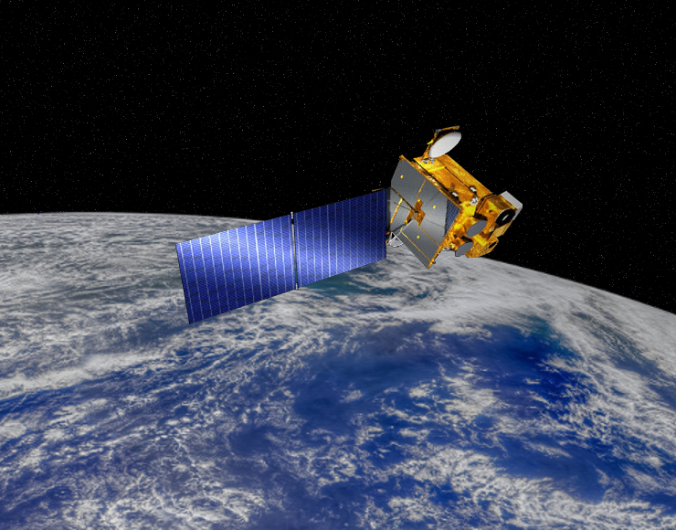
Sensitivity of reef-relevant ocean color phenomena to satellite data resolution
2011-2021
An analysis of GOCI-1 geostationary ocean color data utility in coastal Okinawa waters
NASA
Jessica Perelman, Hui Shi, Justin Suca, Ryan Rykaczewski

Slide 2
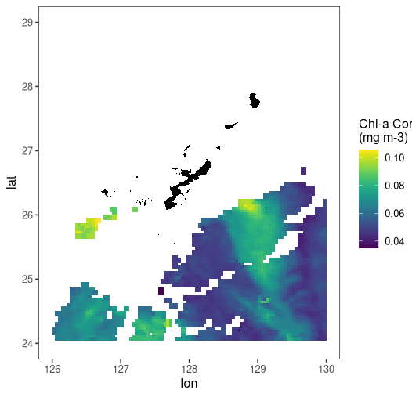
Coastal coral reef habitat conditions seen with current satellite products
8-day
4 km
MODIS
2022-06-14
[Chl-a] (mg m⁻³)
Latitude
Longitude
Notes:
This project came about as a way to address the limitations with using current satellite products in coastal waters that act as critical reef habitat and see how a geostationary satellite could improve data utility. Cloud cover and shallow water reflectance often lead to large amounts of missing data in coastal areas. So, even daily passes of a satellite over a particular region can result in low coverage if there happened to be clouds at the time of the measurements.

Slide 3
Primary Questions
How much spatial coverage is gained with higher resolution ocean color data in regions most relevant for assessing coral reef habitats along the coast?
How does the ability to detect episodic, extreme events (e.g., large freshwater outflows) that affect coral reefs change with spatial and temporal resolution?
Notes:
To do this, simulated various spatial/temporal resolution grids to imitate existing configurations

Slide 4
Methods
Configuration | Spatial Resolution | Temporal Resolution
Coarse (e.g., SeaWIFS) | 4 km | Daily
 |  | 8-day
 |  | Monthly
Moderate (e.g., VIIRS) | 750 m | Daily
 |  | 8-day
 |  | Monthly
Full GOCI resolution | 500 m | 8x per day
 |  | Daily
 |  | 8-day
 |  | Monthly

Slide 5
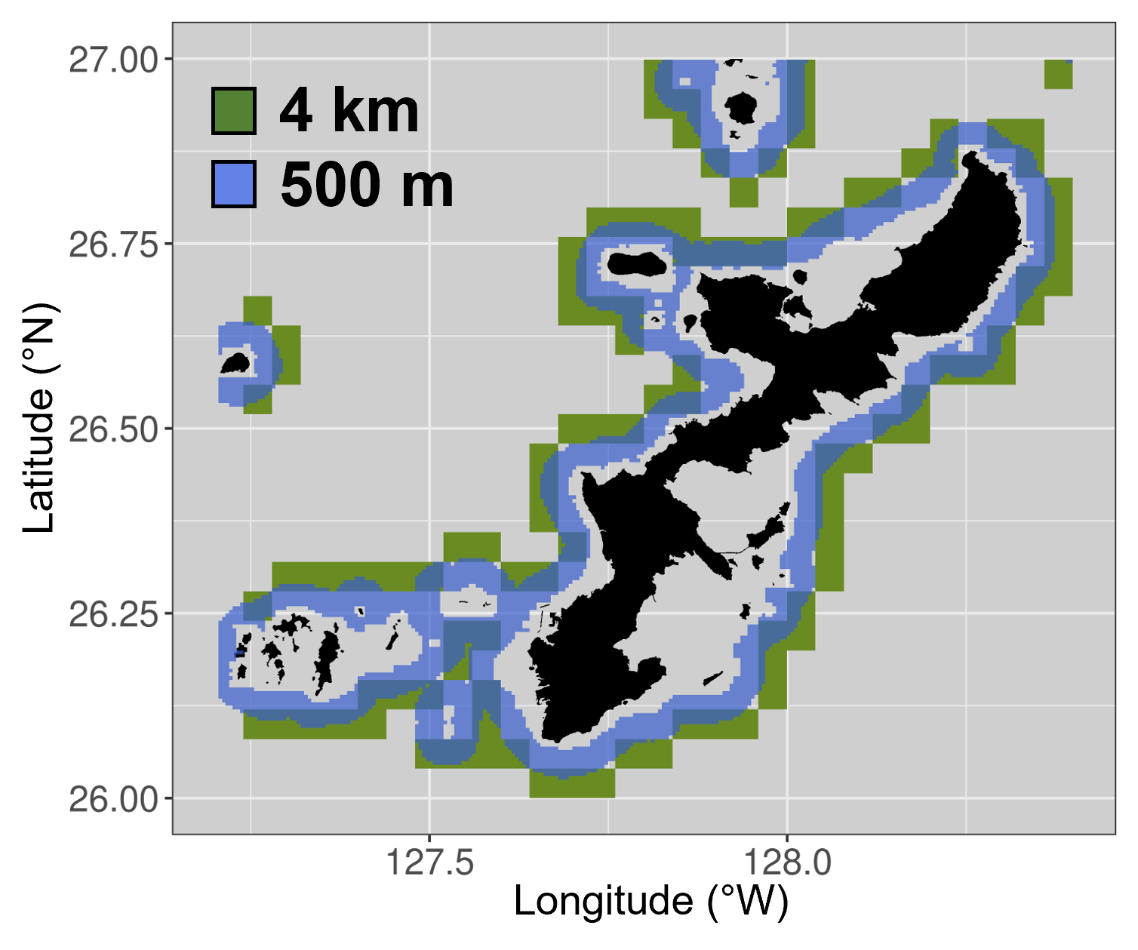
How much spatial coverage is gained with higher resolution ocean color data in regions most relevant for assessing coral reef habitats along the coast?
Shallow waters masked
High resolution grid cells are on average 3.3 km closer to the coast
(55% increase in coastal area observed)

Slide 6
How much spatial coverage is gained with higher resolution ocean color data in regions most relevant for assessing coral reef habitats along the coast?
Shallow waters masked
4km Shallowest grid cell: 54 m
500m Shallowest grid cell: 32 m
Substantially more data in regions most relevant for assessing coral reef habitats
High resolution grid cells are on average 3.3 km closer to the coast
(55% increase in coastal area observed)
Notes:
Substantially more data in regions most relevant for assessing coral reef habitats

Slide 7
How does the ability to detect episodic extreme events that affect coral reefs change with spatial and temporal resolution?
Kume Island, Japan (Yamano et al., 2015)
How do we define episodic events?
2 SD above seasonal mean (coarse)

Slide 8
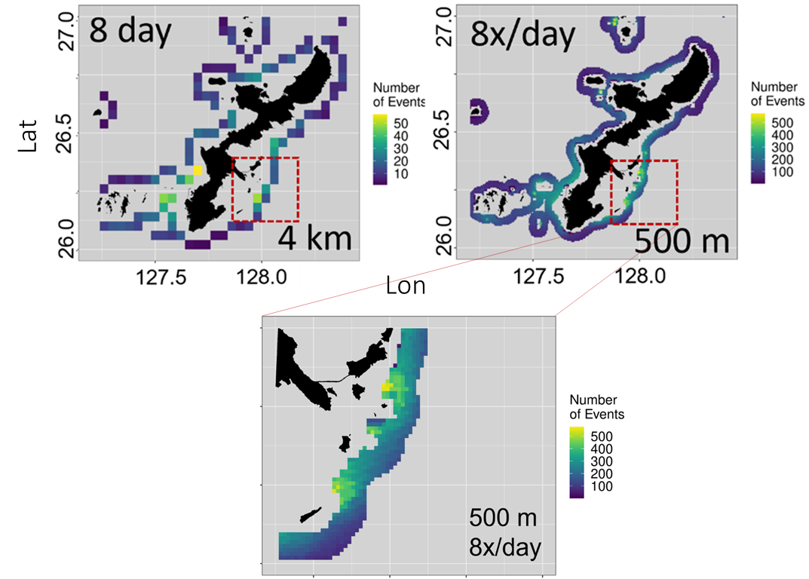
How does the ability to detect episodic extreme events that affect coral reefs change with spatial and temporal resolution?

Slide 9
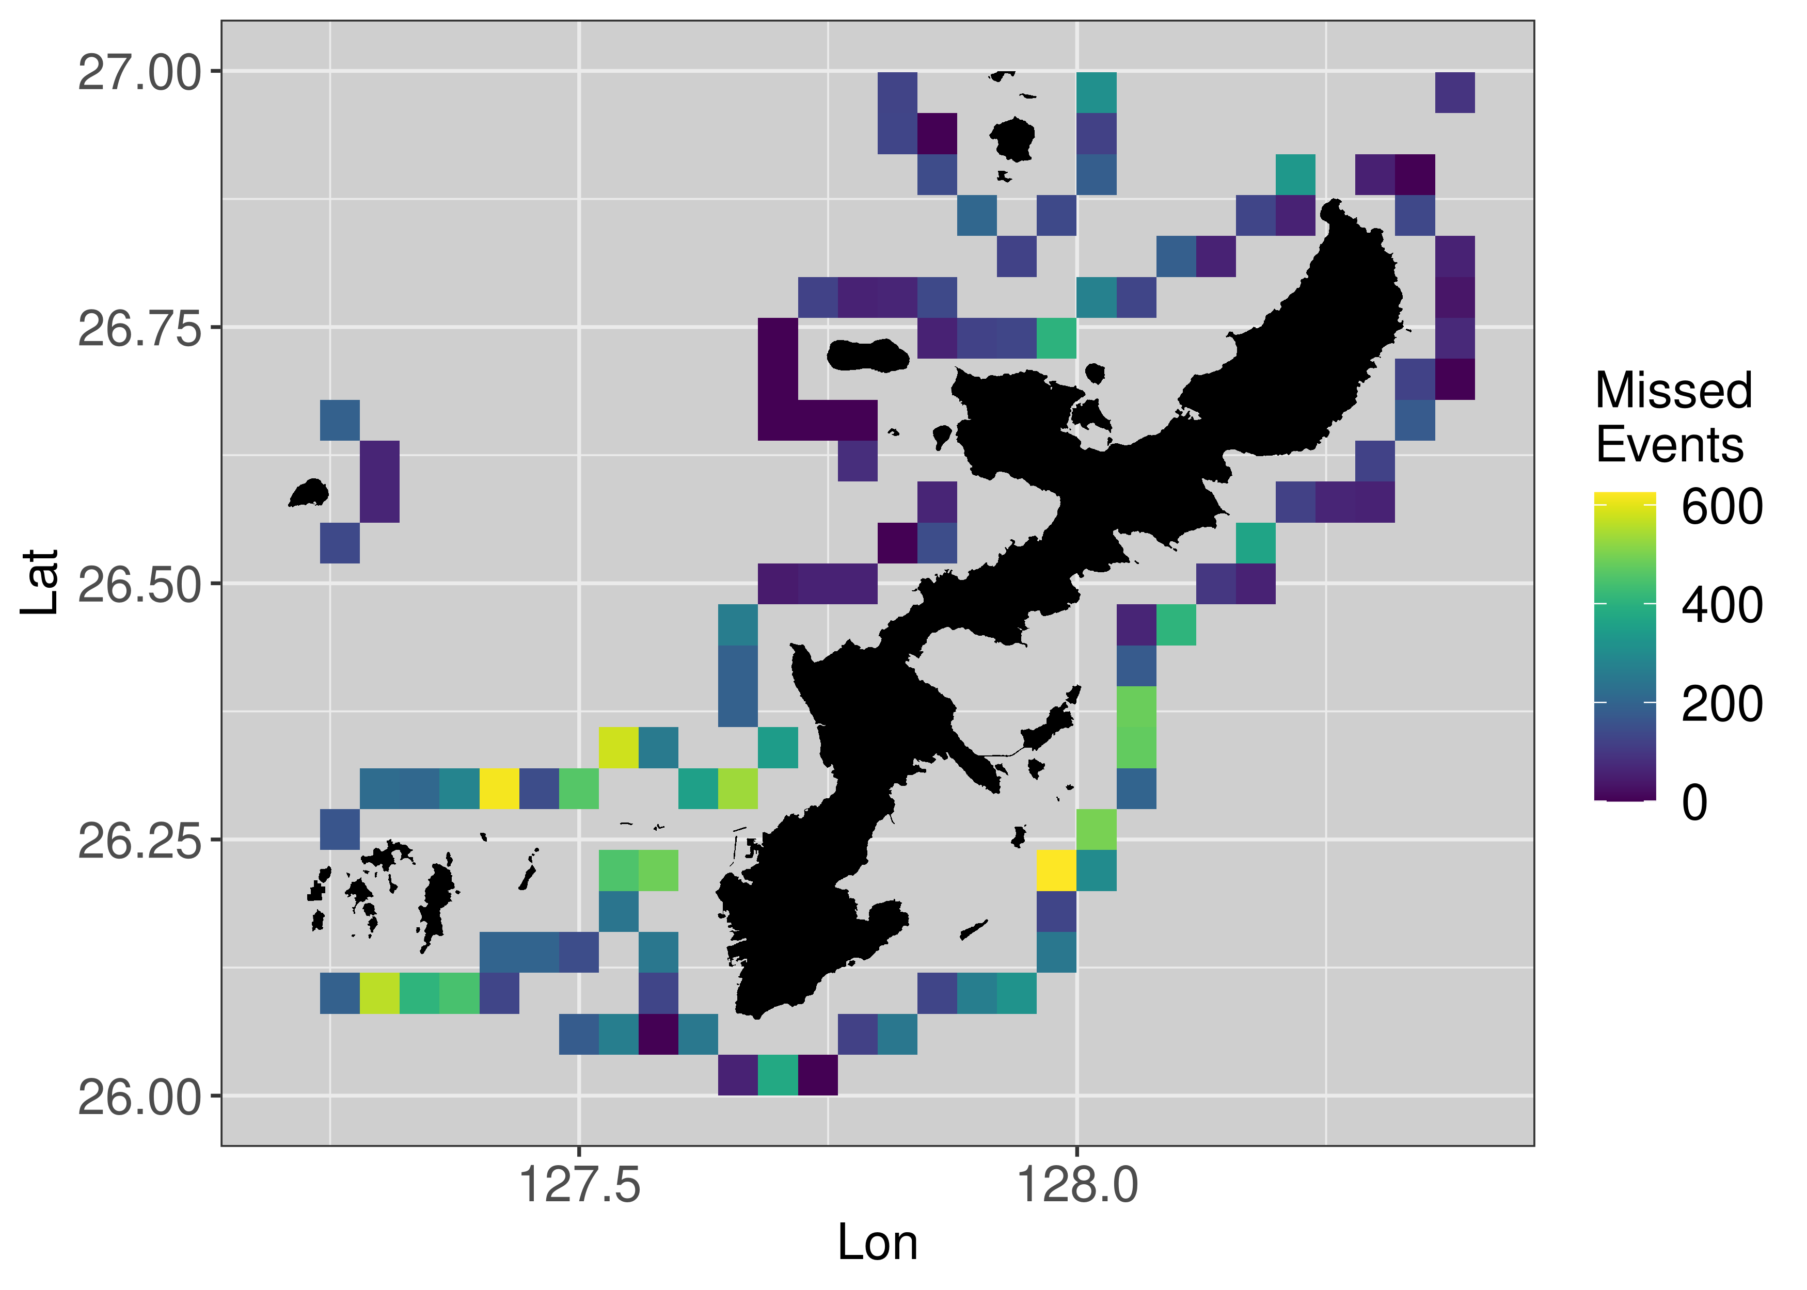
How does the ability to detect episodic extreme events that affect coral reefs change with spatial and temporal resolution?
Events missed at 8-day 4 km but captured by 8x/day 500 m data

Slide 10
Summary
High spatial resolution provides substantially more data in regions most relevant for assessing coral reef habitats along the coast.

Slide 11
Summary
High spatial resolution provides substantially more data in regions most relevant for assessing coral reef habitats along the coast.
The locations and persistence of episodic events change and become much more refined at higher spatiotemporal scales, and higher resolution grids capture a substantial number of events that are missed at the lower resolution grids.

Slide 12
Summary
High spatial resolution provides substantially more data in regions most relevant for assessing coral reef habitats along the coast.
The locations and persistence of episodic events change and become much more refined at higher spatiotemporal scales, and higher resolution grids capture a substantial number of events that are missed at the lower resolution grids.
Geostationary ocean color data allows us to assign much more reliable risk to coral reef areas that could be affected by more frequent episodic events.

Slide 13
Mahalo nui
Hui Shi
Justin Suca
Ryan Rykaczewski
Ryan Vandermeulen
Menghua Wang
Thomas Oliver
Jamison Gove
Kisei Tanaka
Dax Matthews
NOAA NESDIS
NASA

Slide 14
Summary
High spatial resolution provides substantially more data in regions most relevant for assessing coral reef habitats along the coast.
The locations and persistence of episodic events change and become much more refined at higher spatiotemporal scales, and higher resolution grids capture a substantial number of events that are missed at the lower resolution grids.
Geostationary ocean color data allows us to assign much more reliable risk to coral reef areas that could be affected by more frequent episodic events.
Email: jessica.perelman@noaa.gov

