Slide 1
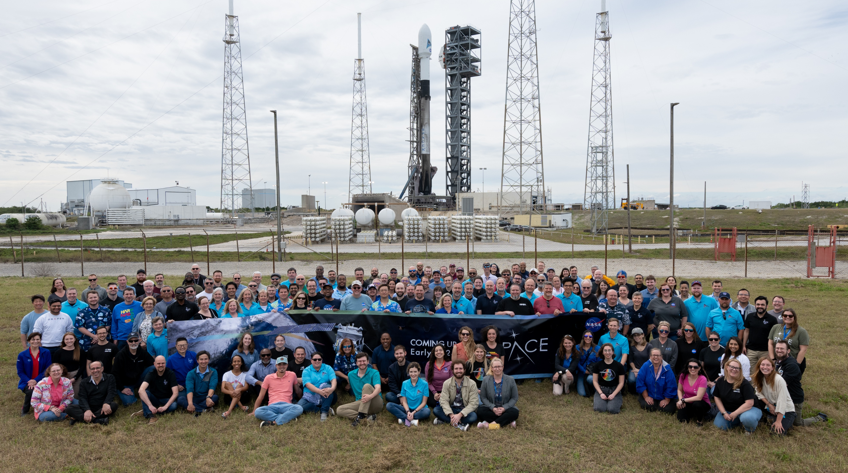
The roadmap to getting there with new capabilities from PACE and GLIMR
Antonio Mannino, PACE Project, GLIMR Project
NASA Goddard Space Flight Center, USA

Slide 2
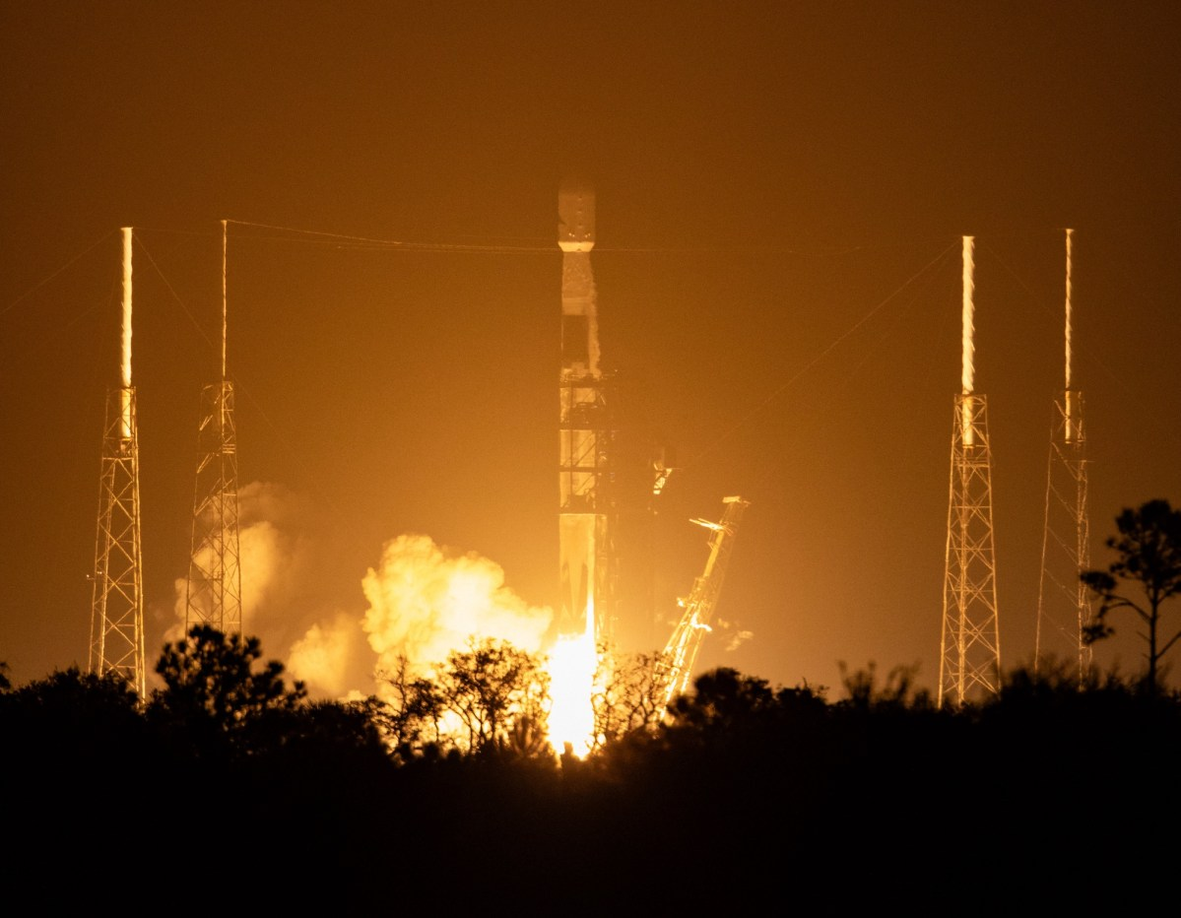

Cloud masking is the first step in most satellite retrieval processing
Satellite cloud masking algorithms (e.g MODIS) often use both solar and thermal infrared bands
  Clouds are (generally) bright, white, and cold
  … but many satellite imagers lack thermal bands (e.g. PACE OCI)
How much skill in the cloud mask could be obtained if we didn’t have the infrared measurements?
  Try and reproduce the MODIS cloud mask without using thermal bands
MODIS Aqua, Jan 3 2024
NASA Worldview
NASA/Kim Shiflett

Slide 3






PACE & GLIMR Mission Status
PACE
Launched 8 Feb. 2024
Public data release began on 11 April 2024
Data products available from ~late March
On-orbit solar calibration applied in version 2 data processing of OCI
Vicarious calibration forthcoming in version 3 OCI reprocessing (within 1-2 months)
GLIMR
Currently on-going instrument assembly, integration and testing
Instrument delivery by ~September 2025
Launch TBD – (late 2027/2028)
Longitude location TBD (86W to 110W)
PACE Data Table
How to access
PACE Data
About PACE Data
GLIMR Website

Slide 4

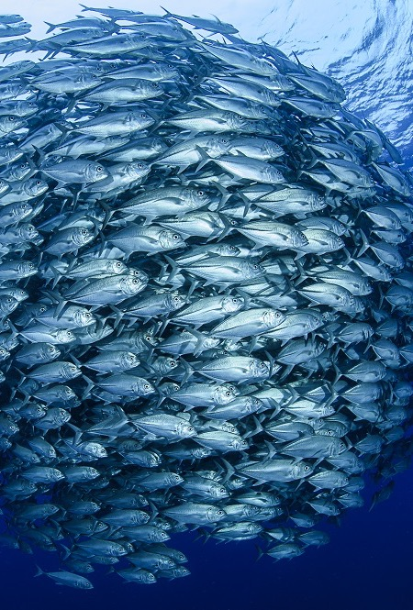
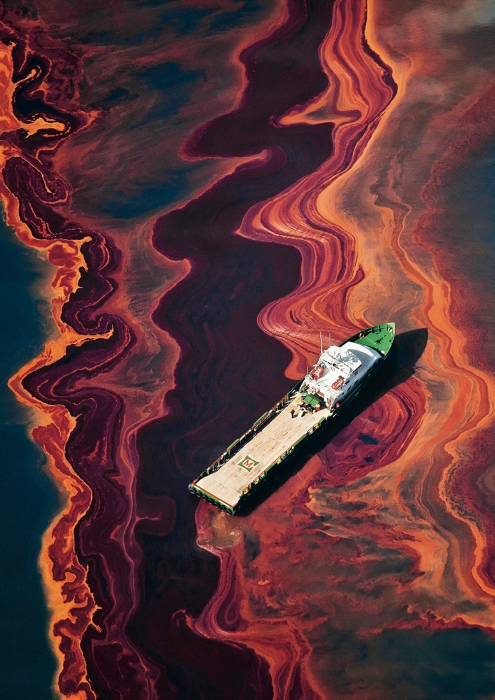
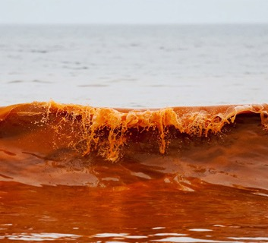
Aquatic Applications Enabled
harmful algal blooms
oil spills
fisheries
water quality
pathogens
surface currents
navigation
floating algae
food security
coastal management
conservation
tourism
recreation
forecasting

Slide 5
Much more Spectral Information
Dierssen et al. 2023

Slide 6
Spectral Content & Resolution Yields Improved Algorithms and Data Products
Dierssen et al. 2023

Slide 7
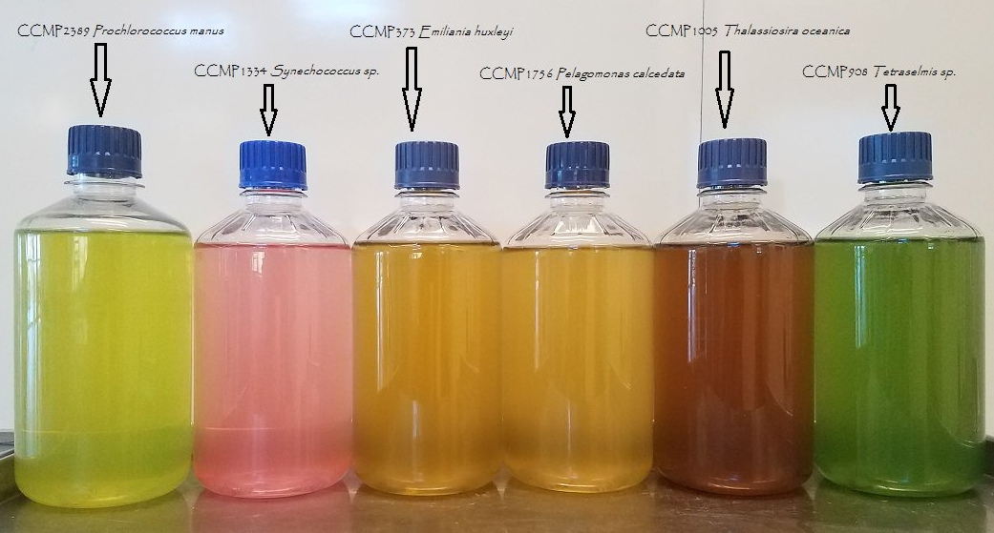
Phytoplankton Community Composition & HAB Detection
Pigments → Color → Hyperspectral Absorption (with Scattering)

Slide 8


Phytoplankton Community Composition & HAB Detection
Pigments → Color → Hyperspectral Absorption (with Scattering) → Composition
Scan QR codes for publications

Slide 9

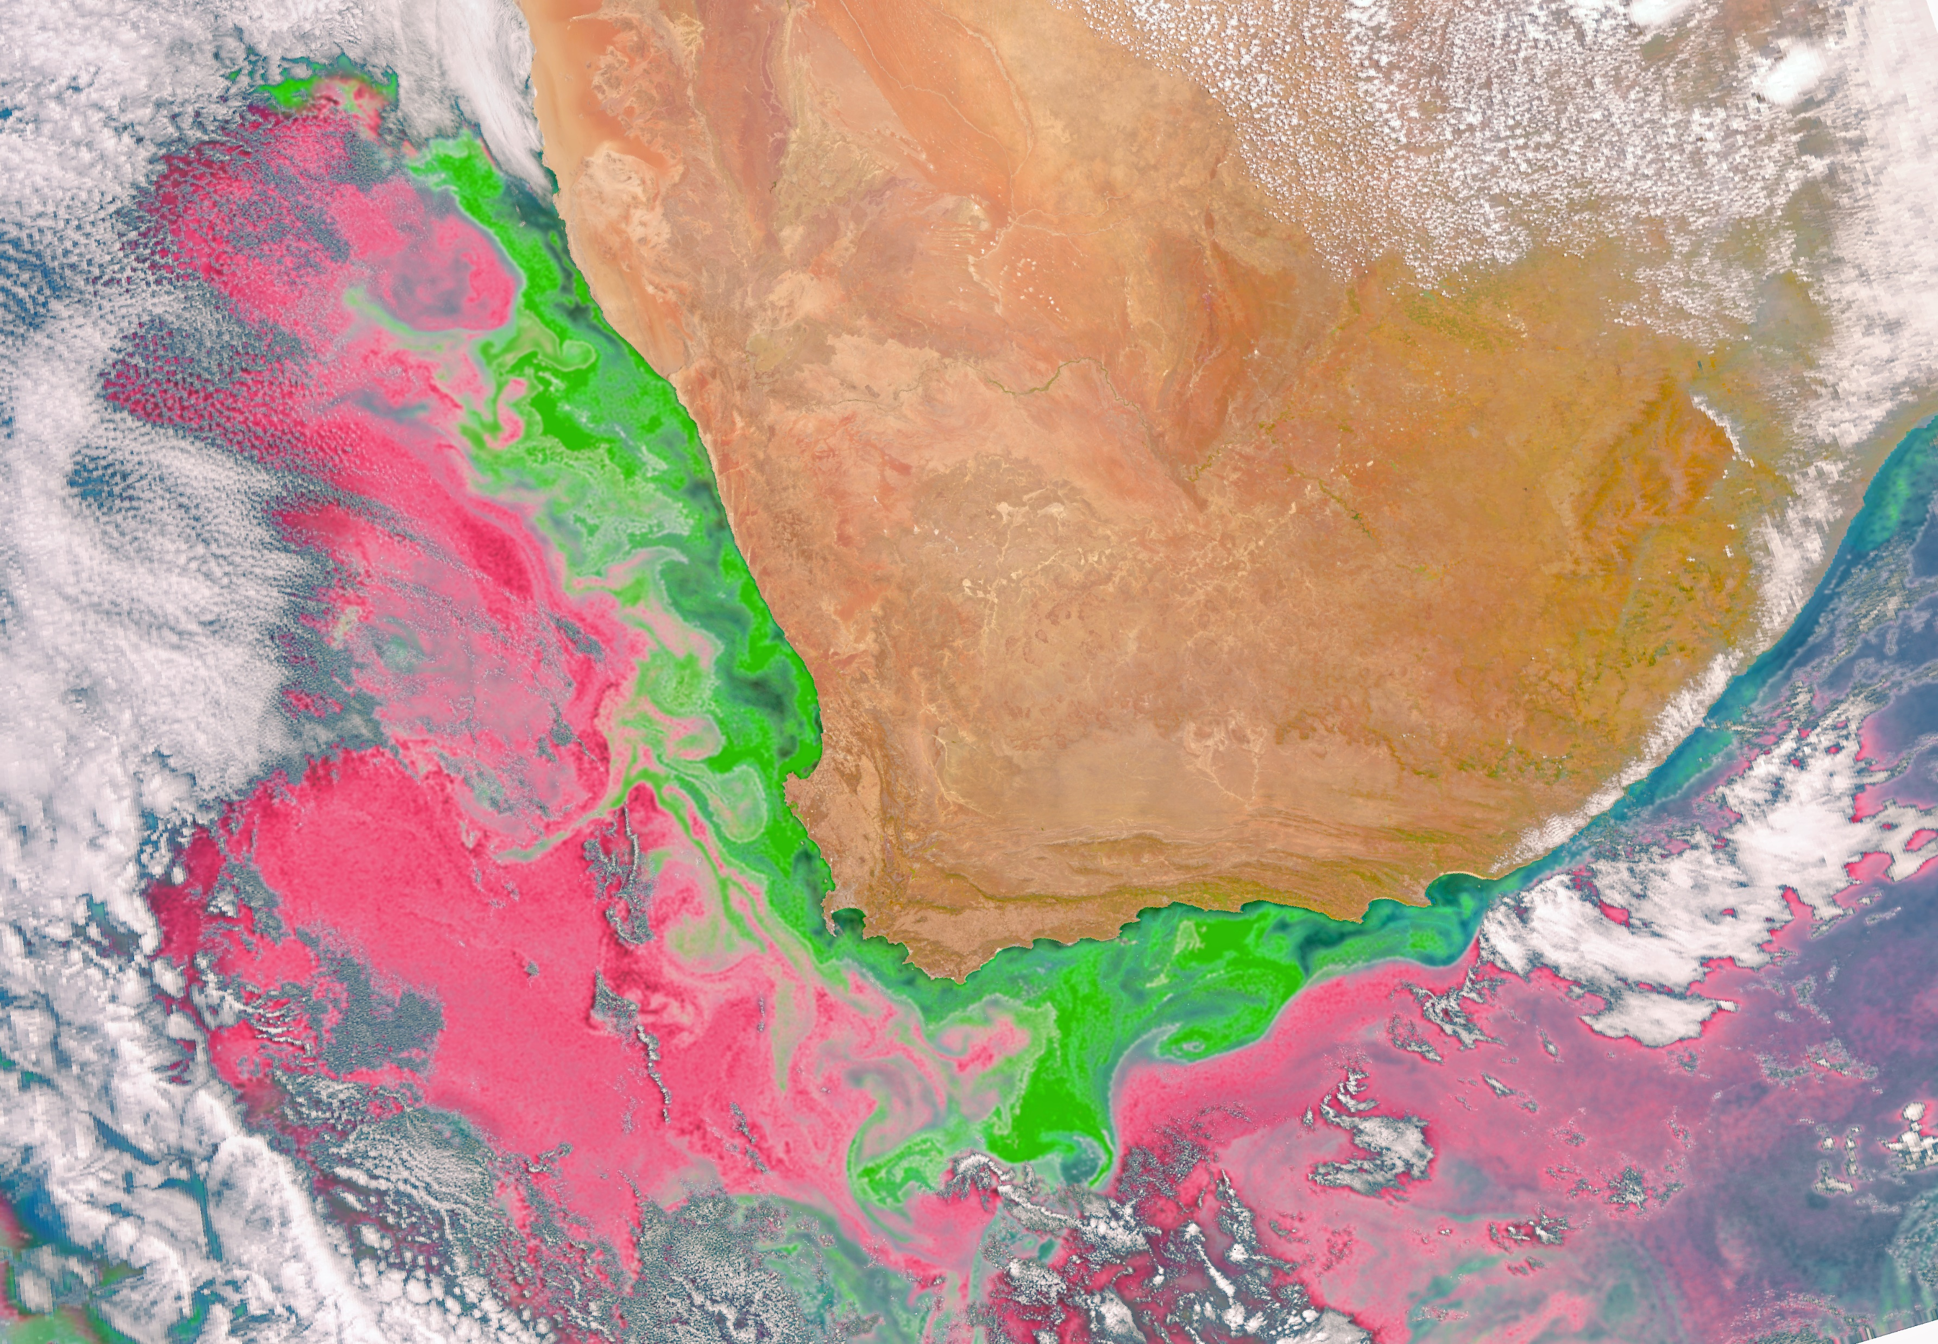
PACE Phytoplankton Community Composition
Algorithms/Approaches
Lange et al. 2020 (MOANA)
  PRODUCT: Distinguishes picophytoplankton in Atlantic waters
Kramer et al. 2022
  Pigments and Absorption
  PRODUCT: phytoplankton groups
Chase et al. 2022
  Diatom carbon relating absorption and phytoplankton imaging flow cytometry
  PRODUCT: Diatom biomass
See Cetinic et al. 2024
Synechococcus and autotrophic picoeukaryotes, as seen by PACE OCI off South Africa – 03/09/2024
MOANA Algorithm from Lange et al. 2020

Slide 10
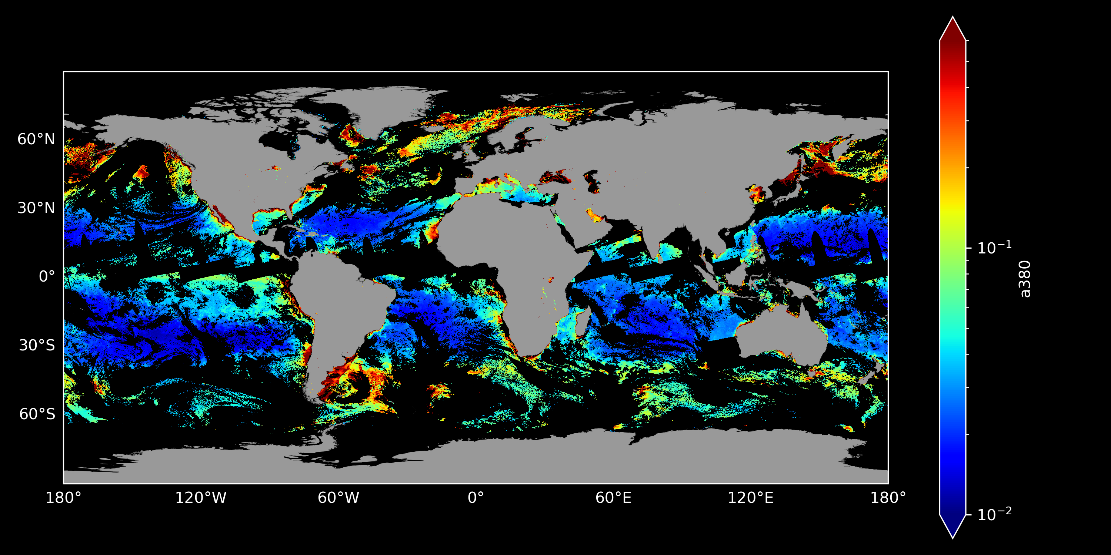
PACE OCI – 1 day quasi-global
OCI Tilt location staggered each orbit to enable Global Coverage in 2 days

Slide 11

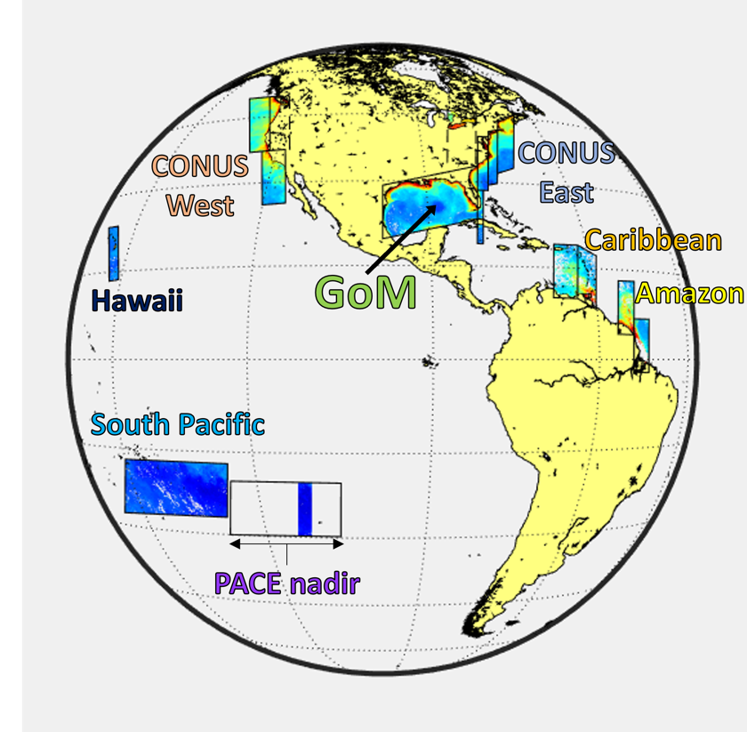
Diurnal Observing Frequency and Regions
Baseline Scan Regions | Frequency
Gulf of Mexico | 6x/ day
East & West CONUS coastal waters | 2x-3x/ day
Amazon River Plume region | 2x-3x/ day
Caribbean Sea region of interest | 2x-3x/ day
Hawaii region of interest | 1x/ day
Other HAB target sites | 3x/ day
*
*
*
*
Multiple daily and day-to-day observations enables better detection and tracking of harmful algal blooms
*
Science Data: 15+ hrs of daily observations
Configurable to respond to episodic events & hazards

Slide 12
New Atmospheric Correction Improves Data Quality especially for Coastal/Turbid Waters
Iterative correction (Bailey et al., 2010) reduces error in black pixel assumption by modeling the reflectance of the ocean in NIR/SWIR.
Using bands in SWIR can also reduce impact of turbid water due to increased water absorption, but with added noise (reduced SNR).
MBAC uses both with adaptive spectral weighting to transition from NIR to SWIR as turbidity increases.
  Weights depend on instrument noise and number of iterations in NIR algorithm
Method allows for open ocean and coastal water processing without hard switching between algorithms (NIR AC → SWIR AC).
Future Plans
Extend MBAC to utilize UV spectral range in UV-dark waters
Improve correction for bi-directional reflectance (BRDF) (Twardowski et al. 2018 Appl. Sci.)
Implement ocean-atmosphere simultaneous retrieval UV-VIS-NIR-SWIR (Ibrahim et al. 2022 AO)
Apply HARP2 and SPEXOne aerosol properties into OCI atmospheric correction

Slide 13
Data Products

Slide 14
PACE Ocean Data Products L2 suites

Slide 15
Planned Data Products
“Typical” Ocean Color Products
Remote sensing reflectance (360 to 720nm every ~10 nm @ ~5nm steps)
Spectral diffuse attenuation coefficients
Apparent visible wavelength
Spectral absorption (a_{t}, a_{p}, a_{ph}, a_{cdm}, a_{g}) and backscatter coefficients (380-680 nm)
CDOM absorption spectral slope coefficients
Chlorophyll-a
Phytoplankton pigments
Phytoplankton community composition
Daily and instantaneous PAR
Fluorescence line height
Euphotic depth
Particulate organic carbon
Dissolved organic carbon
Suspended particulate matter
Particle size distribution
Rates and Fluxes Products
Net primary production (NPP)
Net community production of POC
Fluxes of SPM, POC and DOC
Surface Ocean Currents
Applications Products
HAB detection index
Karenia brevis cell count index
Mycrocystis cell count index
Floating algae biomass
Water type classification
Petroleum detection and thickness
Oil density

Slide 16
What’s needed for Advanced Data Products of HABs and other Water Quality Parameters?

Slide 17
Ongoing Research, Plans & Needs
PACE Early Adopters/Science Team Members
Bingqing Liu – HABs in Northern Gulf of Mexico; HyperCoast data visualization tool
Clarissa Anderson – CHARM; US West Coast HABs
Chuanmin Hu – Floating Algal Index/Sargassum
Nima Pahlevan –in-land/coastal water quality product suite
Bryan Barnes – Shallow-water product suite
AND MORE
GLIMR Early Adopters/Science Team Members
Joaquim Goes – phytoplankton community composition
Blake Schaeffer – HABs and other CYAN products
Steve Lohrenz – phytoplankton community composition

Slide 18
Ongoing Research, Plans & Needs
Future Plans
PACE Project exploring existing and forthcoming advanced HABs and other water quality algorithms to study and implement for PACE data processing.
  Cyan data products in development
New PACE Science and Applications Team – fluorescence line height, etc.
GLIMR science team to begin algorithm efforts in 2025
Future Needs
Expand hyperspectral and high spectral resolution field datasets of HABs and water quality variables
Use past and new datasets to develop and evaluate robust algorithms and data products

Slide 19
BACKUP

Slide 20
Content Slide (Option 1)
5 nm BW Ocean Ltyp
15 nm BW Ocean Ltyp
5 nm BW Ocean Ltyp
10, 15 or 20 nm BW Ocean Ltyp
Ocean Ltyp
Global Ltyp

Slide 21

Content Slide (Option 2)
Data Type | Daily Data Volume & File Size (TB)
 | OCI | HARP2 | SPEXone
Level-0 | 210 | 62 | 52.8
Data Type | Average Latency from Time of Observation (min)
 | OCI | HARP2 | SPEXone
Level-0 | 107 | 188 | 136
Level-1A | 166 | 419 | 733
Level-1B | 176 | 669 | 851
Level-2* | 224

